Slide 1
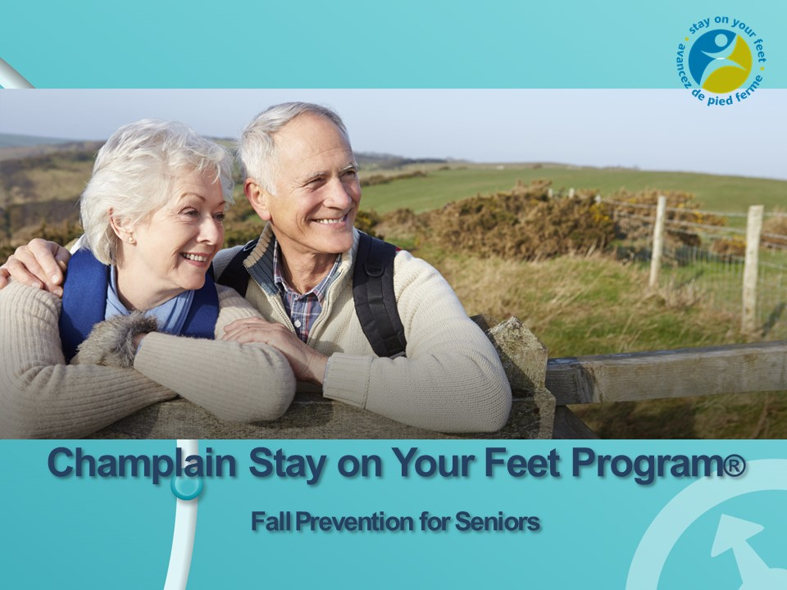
Notes:
Introduction
\Add date
Hand out list:
*Staying Independent Checklist
Med checklist (if available)
Blister pack or dosette
*Which Exercise Class is best for me: local version ( generic version on slide)
A shoe / non slip sock to demonstrate
Home safety checklist (You Can Prevent Falls)
*What to do if you Fall
*My Falls Action plan
* these are available on www.stopfalls.ca

Slide 2

Notes:
Recognize these people?
Hillary Clinton, Leonard Cohen, Madonna Helen Mirren, Kelsey Grammer, Fidel Castro,
Can you guess what they have in common?
All have had serious falls – with a variety of injuries.
A fall can have devastating consequences and can significantly affect one’s quality of life.
A fall can happen to anyone, but…..
risk increases with age
big impact on health, mobility and independence in later years
However, Falls are NOT a normal part of aging.

Slide 3
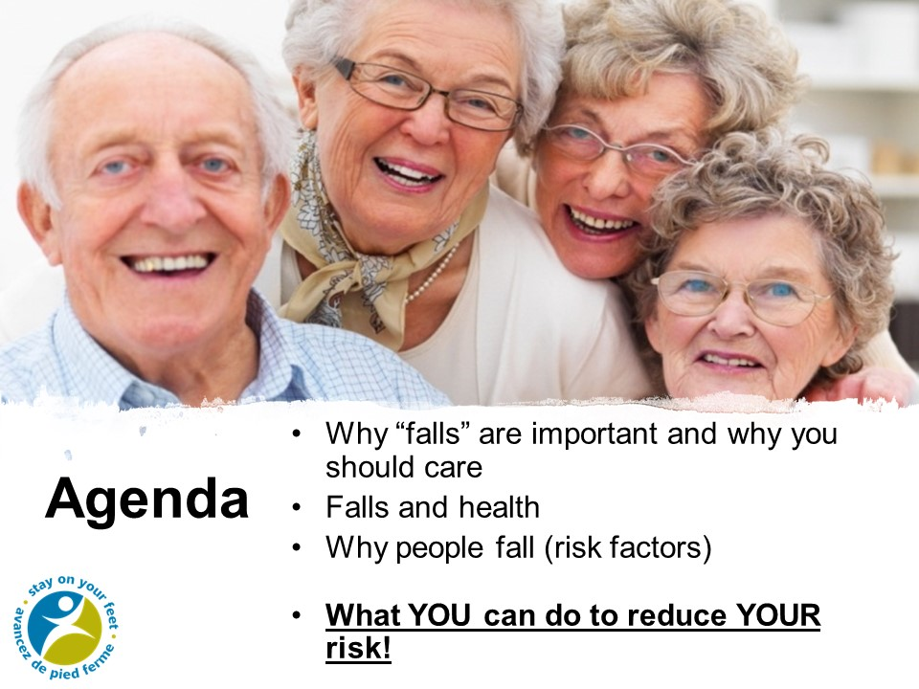

Slide 4
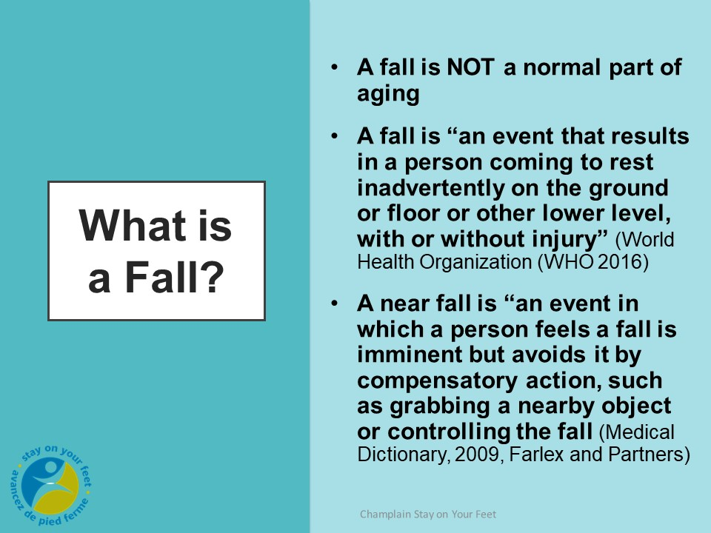
Notes:
Discuss with the audience their views on falls
Then click on the WHO definition
Talk about a near fall.. It is important to report and near fall to prevent the next fall

Slide 5

Notes:
Reponses and results of a fall over the years! More serious as you get older.

Slide 6
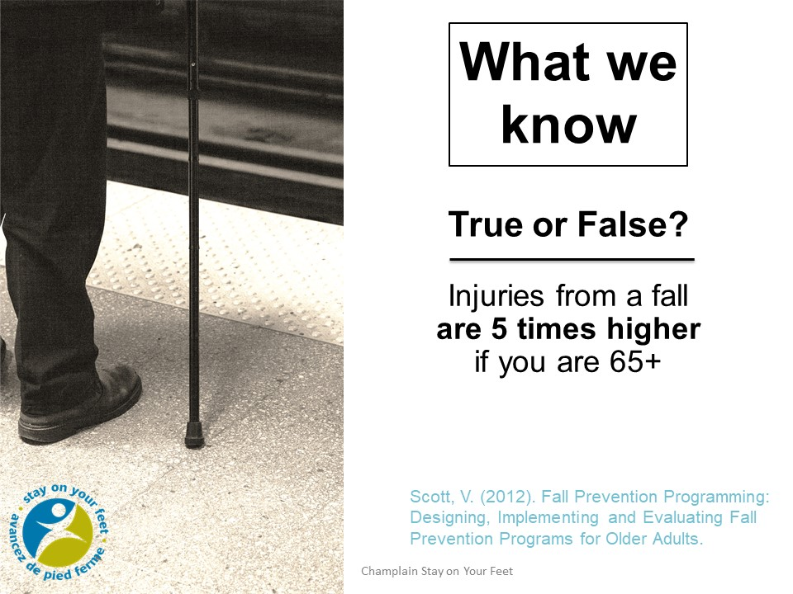
FALSE 9 times higher
Notes:
Let’s start by doing a short quiz. (read from slide, answer requires another click to appear)
Ask for a show of hands for T and F
Additional info :
Almost 50% minor injury, 5-25% have serious injury
Cause 95% of hip fractures & 20% die within a year of the fracture
The average Canadian senior has to stay in hospital 10 days longer for falls related admissions than for any other cause.

Slide 7
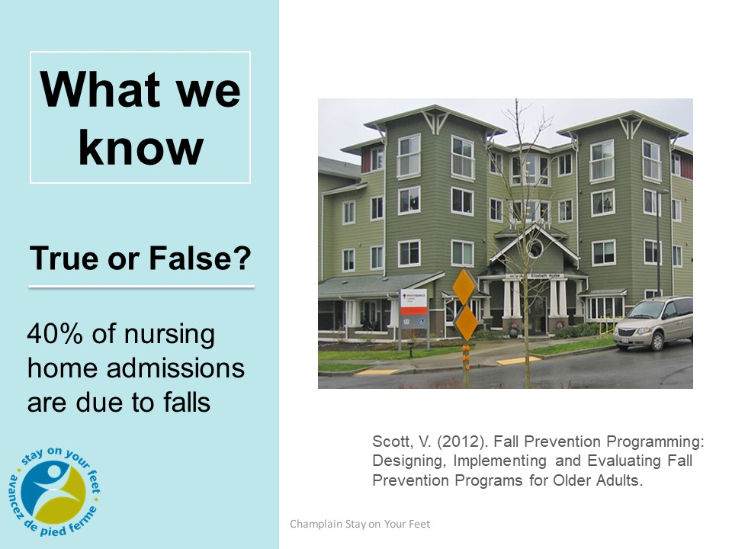
TRUE

Slide 8
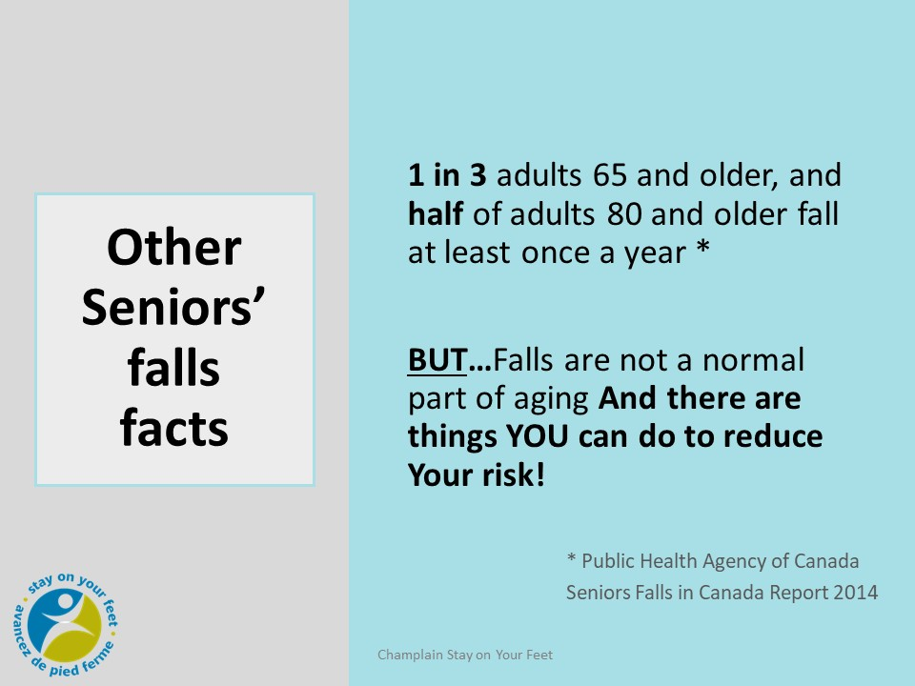
Notes:
Anyone can fall, but as we age the risk increases, and the risk of injury is much higher. About one out of three people over the age of 65 who live in the community fall at least once a year.
If you look to your right and now to your left, one of you will probably fall at least once this year.
The number of single falls per year increases to 1 out of 2 for people over the age of 80.
If you fall once, you are twice as likely to fall again.
Women are 3X more likely than men to be hospitalized for a fall-related injury.
(Contributing factors could include age-related frailty, restricted mobility, more frequent use of multiple medications, and increased incidence of osteoporosis.
Men are more likely than women to experience fatal falls. It may be that men are more physically active or more likely to engage in risky behaviors.)
Most important thing is that falls are NOT a normal part of aging.

Slide 9
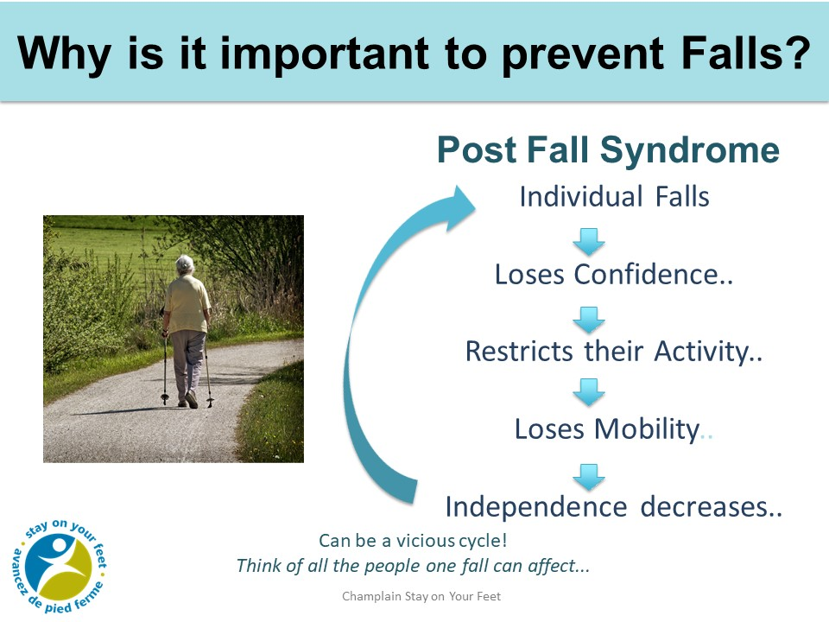
Notes:
Why do falls matter? Impact on individual’s quality of life due to injury, disability, and potential loss of independence.
Mention near falls and the need to be proactive to stay independent.
Post-Fall Syndrome:
-Stats only telling part of the story. This cycle also has an impact on the individual’s caregivers and family members if they become less independent and less mobile (time, money, effort) .
-We know from the research that most falls can be prevented.

Slide 10
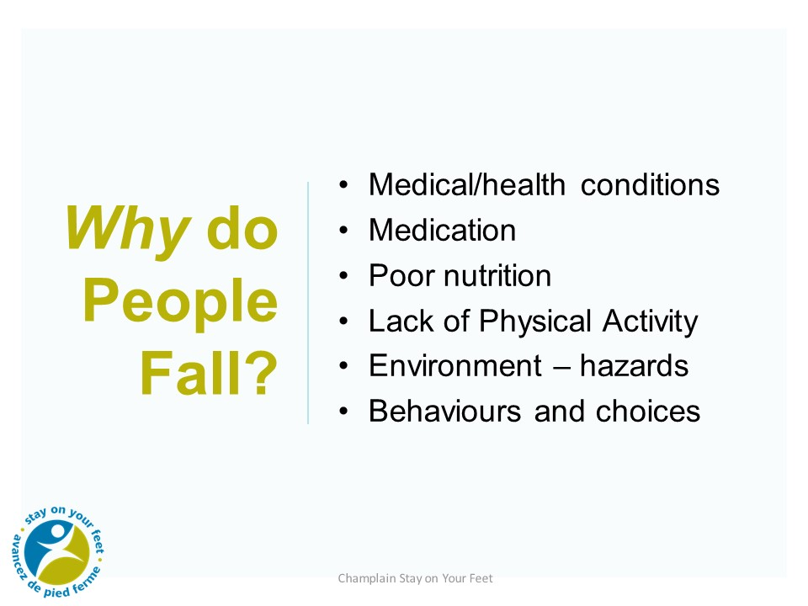
Notes:
Ask the audience: Who in the group has ever fallen please stand up!
Remain standing if you have fallen in the past year
Ask if they wish to share their stories (depends on the size of the group) and
discuss the causes of these falls
The risk factors for falls are numerous, complex and interrelated.
Emphasize that we can’t get caught up in dealing with just one risk factor, look at the big picture.
What are the risk factors for falls?
Biological / intrinsic
Social & Economical
Environmental
Behavioural
Each bullet will show with a click of the mouse
This list groups and summarizes the major reasons why people fall.
Medical/health conditions, vision, symptoms like dizziness, weakness, bowel/bladder incontinence
Medication
Poor Nutrition ) fuel and support for your body
Inactivity
home and environmental Hazards
Behaviours and choices

Slide 11
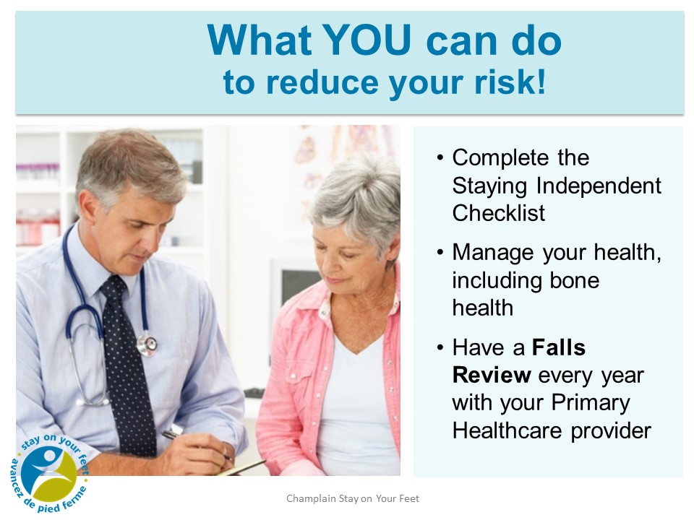
Notes:
Complete the Staying Independent Checklist
This is a checklist that YOU CAN fill out yourself, with a family member or caregiver. If you score 4 or more on this checklist you should make an appointment with your healthcare provider/ family doctor to review and find some solutions.
Regular medical exam:
Have regular medical follow-up with your healthcare provider. Discuss how often you should see them.
See them if you have symptoms and you are not sure what the issue is…..eg. dizziness, weakness. You want to detect health problems early.
Manage your health conditions according to physician recommendations– medication, diet, activity, monitoring, etc…
Report any falls or near fall to your health care provider, (and if appropriate, including staff from your retirement home). Discussing your fall can help identify why you might be falling and what can be done to help you. It’s all about prevention!
(Include any process for falls in the retirement home or facility)

Slide 12
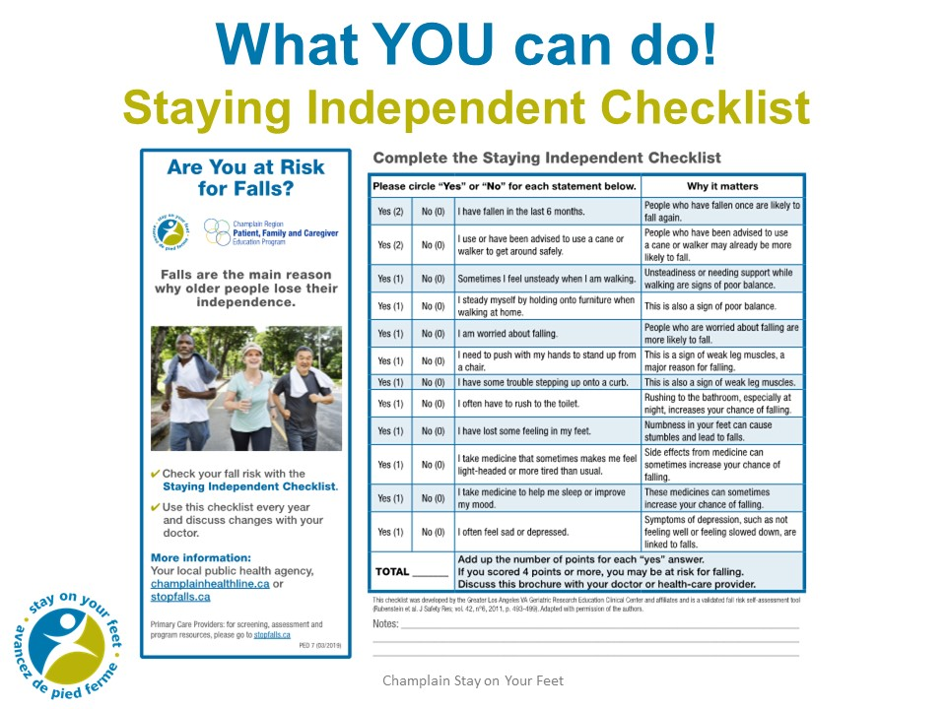

Slide 13
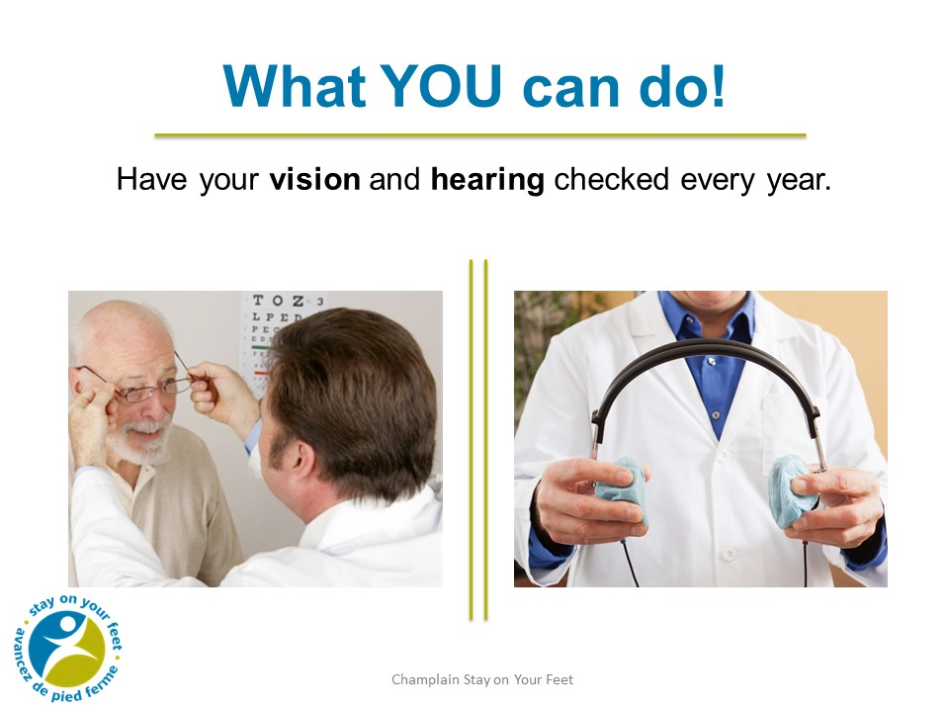
Notes:
As we age, our vision changes.
We become more sensitive to glare.
We need more light to see at night. People who are 60 need 10 times more light to see at night than teenagers.
It takes our eyes longer to adjust to sudden light changes.
It becomes harder to judge distance and depth. We need this depth perception when we are going up and down stairs and curbs.
That’s why it’s so important to have your vision checked yearly.
Who wears bifocals and multifocals? With multifocals, where the prescription changes you don’t always get clear vision. So you have to be careful when on stairs and curbs. You need to tip your head down and look out of the top to see better. Avoid wearing bifocals while walking and on the stairs.
And remember to clean your glasses frequently.
Show a night light - especially important to use if you get up during the night
Cost to run a night light 7 watts in an 8 hour night = $.10 for the 8 hours.
Hearing : It is important to have your hearing checked regularly and to wear aids to help you hear if you need them. Talk to your health provider about any changes in your hearing.
Protect your ears from loud noises. Researchers have found that people with hearing loss can be 3x more at risk of falling
This is a quote from Researchers at the Johns Hopkins School of Medicine and the National Institute of Aging . Dr Frank Lin from John Hopkins says “One reason might be that people with hearing loss have less environmental awareness. This means they don’t notice things happening near to them, such as people, pets, or other things.
Many researchers also suggest that people with hearing loss need to use more of their mental resources to hear and interpret speech and other sounds, so they have less mental energy left for other tasks such as balancing. Gait and balance are things most people take for granted, but they are actually very cognitively demanding," Dr Lin says. "If hearing loss imposes a cognitive load, there may be fewer cognitive resources to help with maintaining balance and gait."

Slide 14
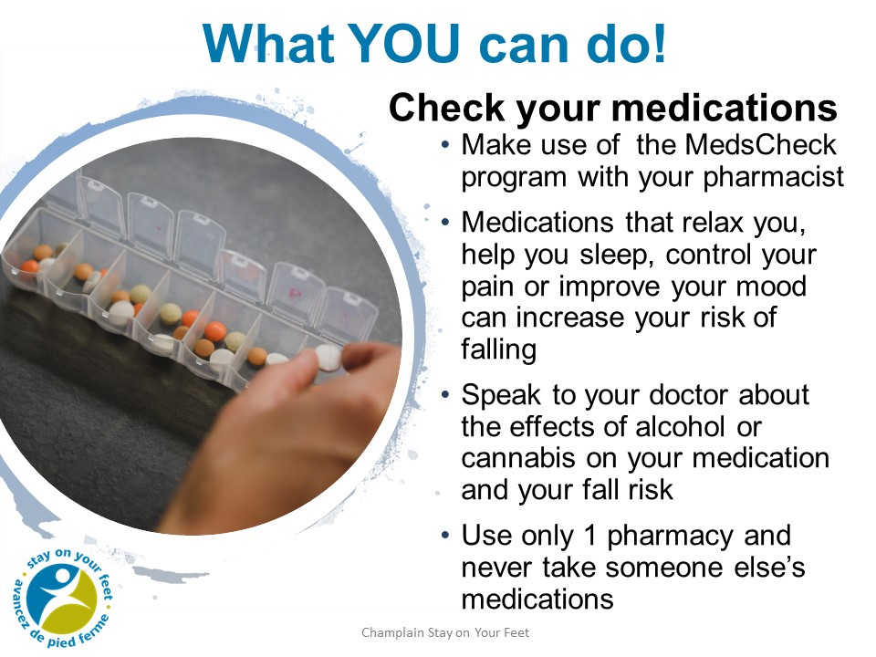
Notes:
As we age, the way some medications work and/or are handled by the body can change and increase the risk of falling. Medications that help relax you, help you sleep or improve your mood can increase your risk of falling.
The more medications you take, the greater your risk of falling.
It’s a good idea to keep a current list of medications with you and in your home. Show a sample medication booklet/list. Can also get a printout from their pharmacist.
It’s also really important to use only one pharmacy so that the pharmacist is aware of all the medications that you take. Ask the participants where they get their medications, how it’s packaged. Show blister pack and/or dosette.
You should also never take another person’s medication. Medications are prescribed specifically for that person depending on their age, symptoms, etc.
As we age, our bodies do not break down alcohol as efficiently so it is best to minimize the use of alcohol as even a small amount can increase the risk of falling. The combination of having a nightcap and a medication like a sleeping pill is particularly risky.
If you are unsure about whether it is safe to drink alcohol or take cannabis with your medication, speak to your doctor, pharmacist or nurse practitioner.

Slide 15
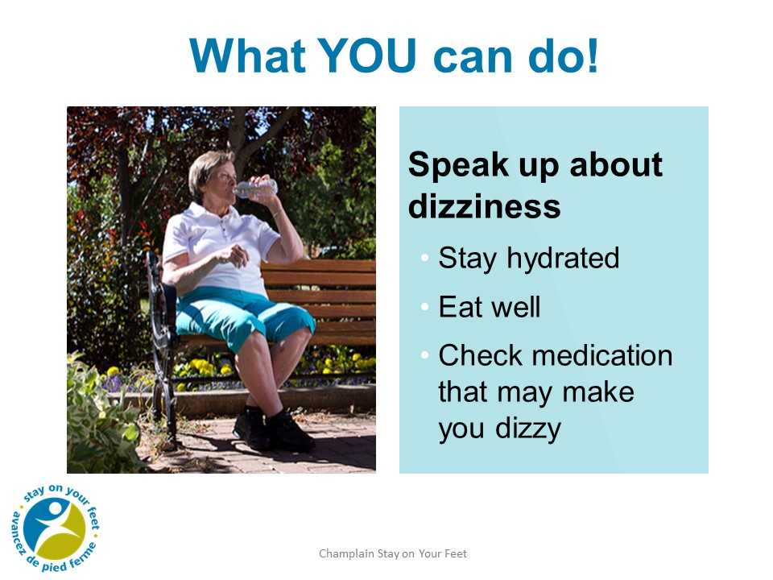
Notes:
Dehydration (when the body has lost too much fluid and electrolytes i.e. mineral compounds required by the body to regulate temperature and maintain healthy fluid balance) can also make you dizzy.
Drink 6 – 8 glasses of fluids including water each day or as directed by your healthcare provider. (Speaker may need to clarify that it’s not 6 - 8 glasses of water plus other fluids, but a total of 6 - 8 glasses of fluids).
If you have heart failure OR KIDNEY DISEASE or take water pills, talk to your healthcare provider about how much you should drink.
Medications for depression, sleep, blood pressure and other heart problems can cause drop in blood pressure. Talk to your doctor or pharmacist to be sure you are on the right dose and number of medications.
Dehydration can also be caused by medications such as diuretics or laxatives or some medical problems such as diarrhea, vomiting, heat stroke, high blood sugar, infections or excessive exercise.

Slide 16
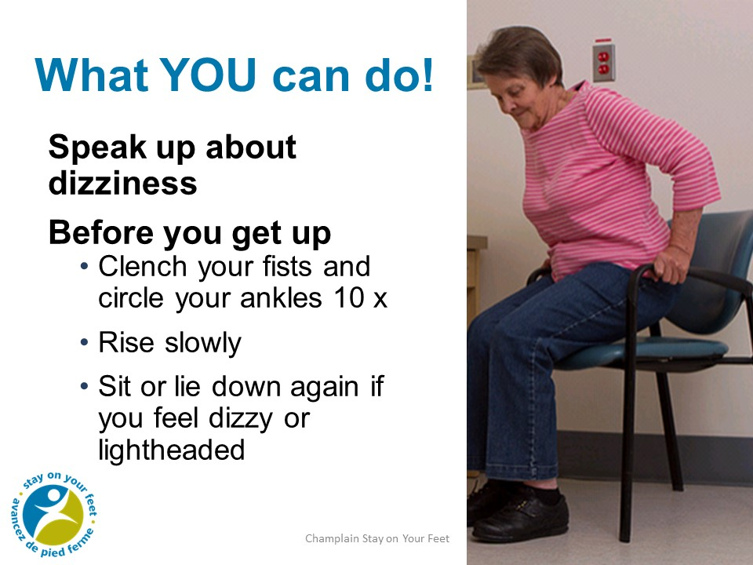
Notes:
If you do feel dizzy when you get up, or if your healthcare provider has told you that you have postural hypotension, there are some things you can do.
After lying in bed or sitting in a chair, clench your fists and circle your ankles 10 times. This helps to raise your blood pressure before you get up.
Demonstrate and encourage clients to do.

Slide 17
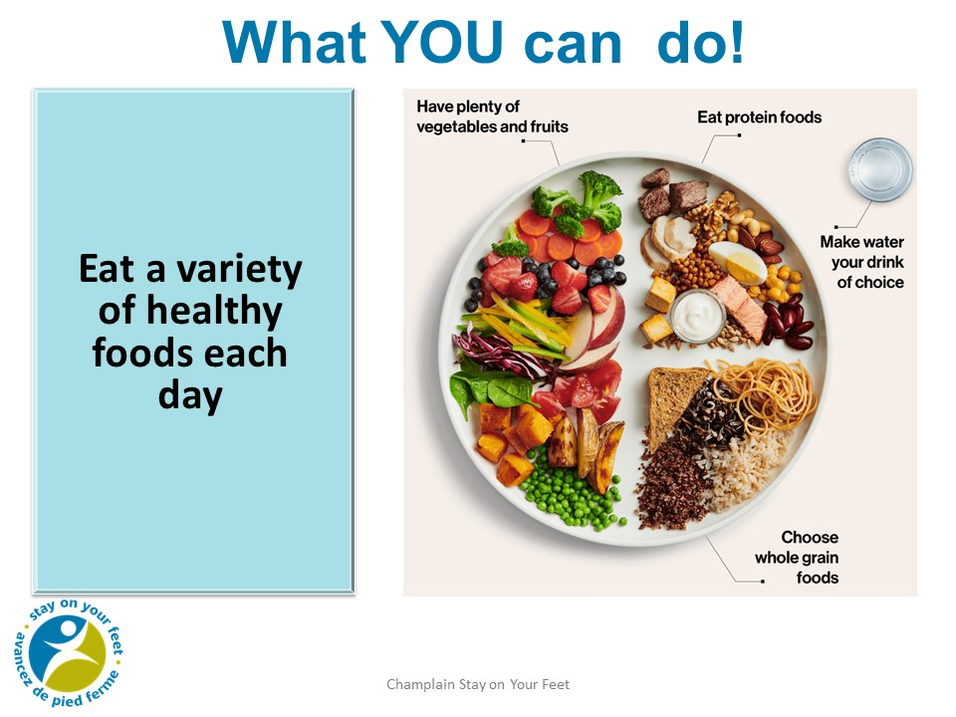
Notes:
- Eat a variety of healthy foods to make sure you get enough different nutrients.
- As you age, your body needs less food, but may need more of certain nutrients, such as vitamins or minerals. Vitamin D and Calcium are especially important because they work together to keep bones and muscles healthy. Aim for 1200 mg of Calcium
and 800 IU of Vitamin D each day if you are over 70 years of age. If you do not get enough milk products or calcium-rich foods, speak to your health care provider about taking a supplement. Everyone over the age of 50 should take a daily Vitamin D supplement of 400 IU. - Choose vegetables and fruits, whole grain foods and protein foods that you enjoy
- Frozen and canned options can be just as healthy and easier to prepare.
- If your sense of taste or smell has changed, try different spices and herbs to add more flavour, instead of salt. You can also switch up the texture and temperature of foods to make them more interesting.
- If some foods have become more difficult to eat, try choosing and preparing foods differently. For example, for a softer texture, try cooking vegetables instead of raw.
- Make eating enjoyable by eating in a pleasant environment and with other people.
- As you age, your sense of thirst may decline, but you still need to drink regularly whether you feel thirsty or not. To stay hydrated, drink water throughout the day and with each meal and snack. Satisfy your thirst with water instead of sugary drinks.
Other foods and drinks that can help keep you hydrated include: lower fat milk,
low sodium soups, vegetables and fruit, unsweetened fortified soy beverages
Retirement home note: You can ask the group if they get all their meals in the dining room. Can they think of ways to increase their calcium intake at meals? If they have a mini fridge, can they stock some cheese or yogurt for snacks?

Slide 18
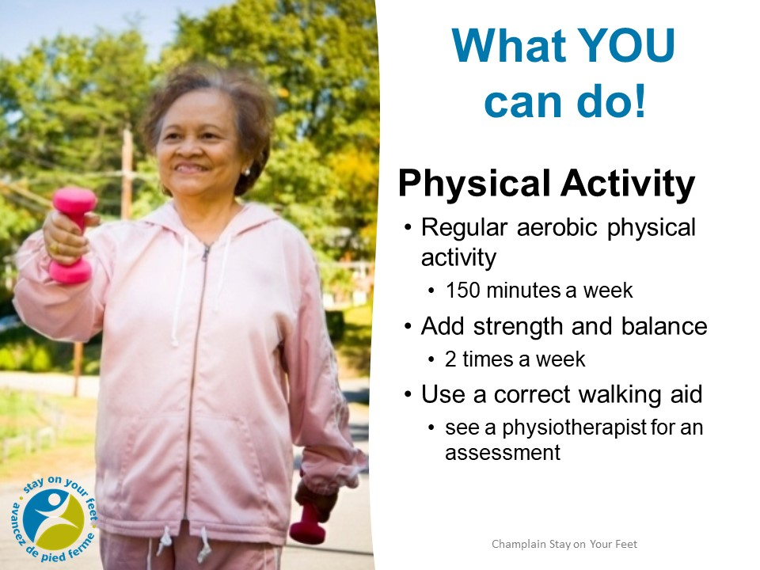
Notes:
Physical activity = Move More Sit Less
Most important thing you can do to reduce your risk of falling. Need strong muscles and bones to keep fit, strong, flexible, and stable! “If you don’t use it, you lose it.” You need to be active to continue with your daily activities and do the things you enjoy SUCH AS WALKING, SWIMMING, DANCING. It is never too late to become active and get the benefits.
150 minutes of aerobic Physical Activity per week to achieve health benefits – moderate to vigorous intensity.
should accumulate at least 150 minutes of moderate-to vigorous- intensity aerobic physical activity per week, in bouts of 10 minutes or more.
Include strength and balance activities at least twice a week, in addition to the 150 minutes.
Strength and Balance are especially important for those with poor mobility
Talk to a health care professional before beginning a new activity or exercise program to be sure it’s right for you.
If at a retirement home:
Ask group if there is exercise class in the retirement home. Ask the group “How many of you go to the exercise class.” (Depending on the residence, more active seniors may be going to programs outside of the facility.)
Take advantage of the program being offered to you….

Slide 19
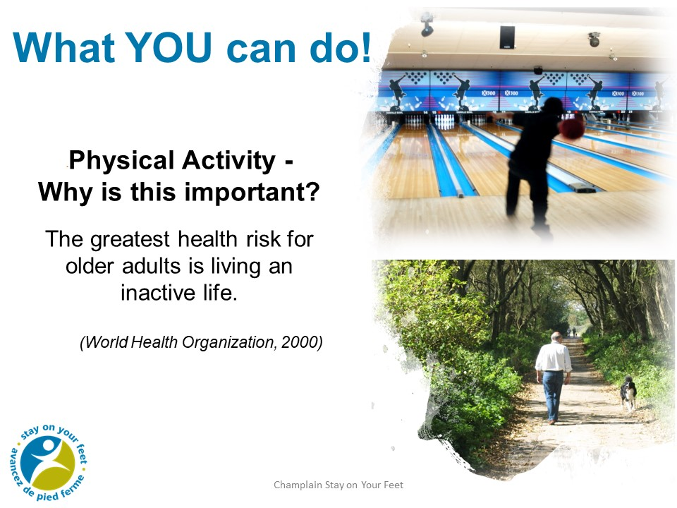
Notes:
If you don’t move it, you lose it.
What is the difference between exercise and physical activity
Physical activity: any bodily movement produced by skeletal muscles that results in energy expenditure. Walking the dog, gardening, housework, shopping (NOT ON LINE!!) dancing, playing with grandchildren
Exercise: physical activity that is planned and structured, repetitive movements such as a class or video exercise session
Activity is beneficial for many chronic conditions, such as arthritis in hips and knees, low back pain, falls prevention, heart failure, coronary artery disease, COPD lung disease, chronic fatigue, diabetes
Should be tailored to fall prevention-specific, prescriptive, progressive, challenging, with focus on strength, balance and walking
Exercise can reduce falls risk by 13-40%

Slide 20
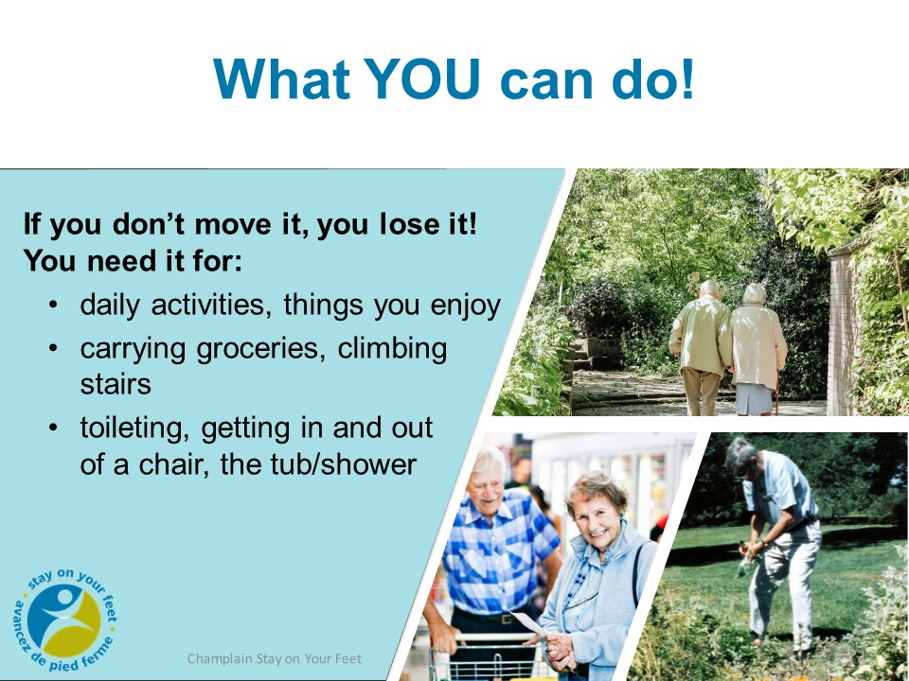
Notes:
Improving your balance improves walking on uneven ground, riding a bus
Stronger muscles helps for stairs, curbs, getting out of a chair or car
Strength and balance give you better Functional mobility for getting out of bed, getting dressed, walking, toileting, bathing, stairs, curbs, walking in the community, preparing food, reaching into the fridge.
Walking training can be included with balance training

Slide 21
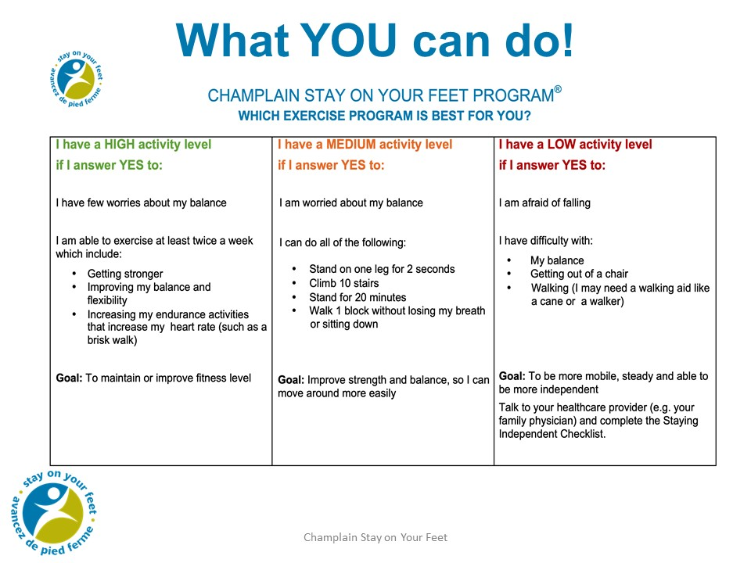

Slide 22
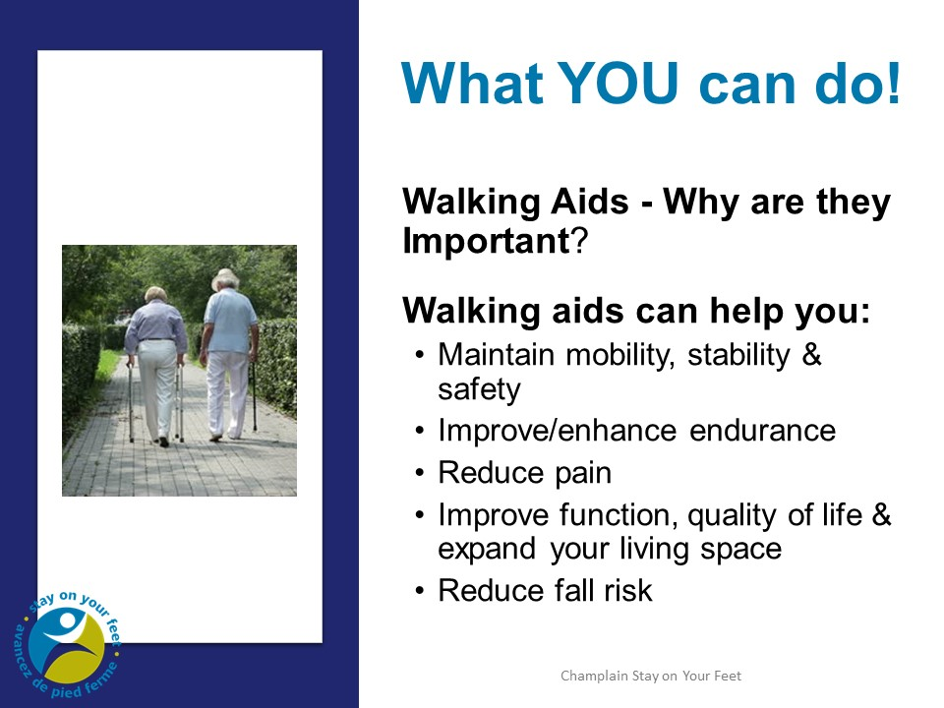
Notes:
Gait= how you walk
Gait aids: canes, walker, wheelchairs & scooters
Used for mobility & stability-cane for light stability
Safety and reduce fall risk-cane or walker
Improve/enhance endurance-usually a walker can extend endurance by reducing workload-gets people outdoors and able to go further.
Reduces pain- by taking the weight off a painful joint such as a hip or knee
Reduces a limp, makes for a smoother step pattern and that reduces the strain on other joints

Slide 23
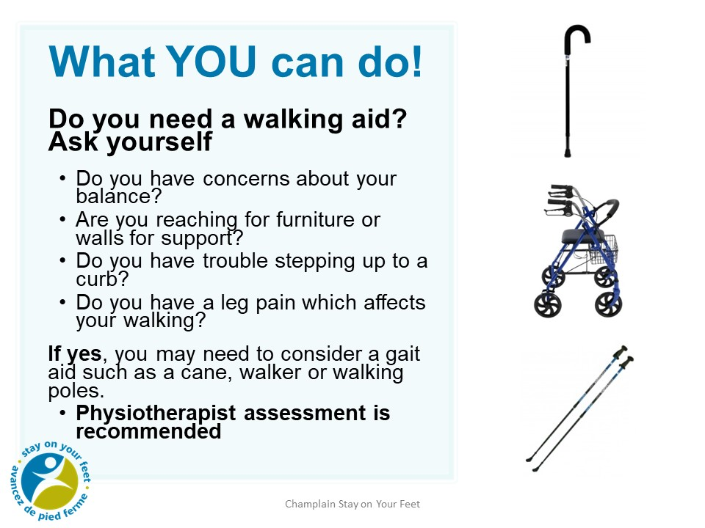
Notes:
Do you need balance support or for taking weight off a joint?
Physiotherapist assessment is recommended to make sure that you have the right aid that fits You and Your needs and to be taught how best to use it.
Mention canes with different tip shapes, sizes, ice picks
Where to get a walking aid?
Canes –available at most pharmacies
Walkers—rent/buy at medical supply stores
If you need a walker most of the time, you may qualify for provincial government funding through the Assistive Devices Program (ADP)
Nordic/walking poles-can be considered for light balance or
offloading -available at many outdoor sporting stores
Nordic poles-can be helpful for fitness, balance assist, light offloading, helpful to take a nordic walking class to learn technique

Slide 24
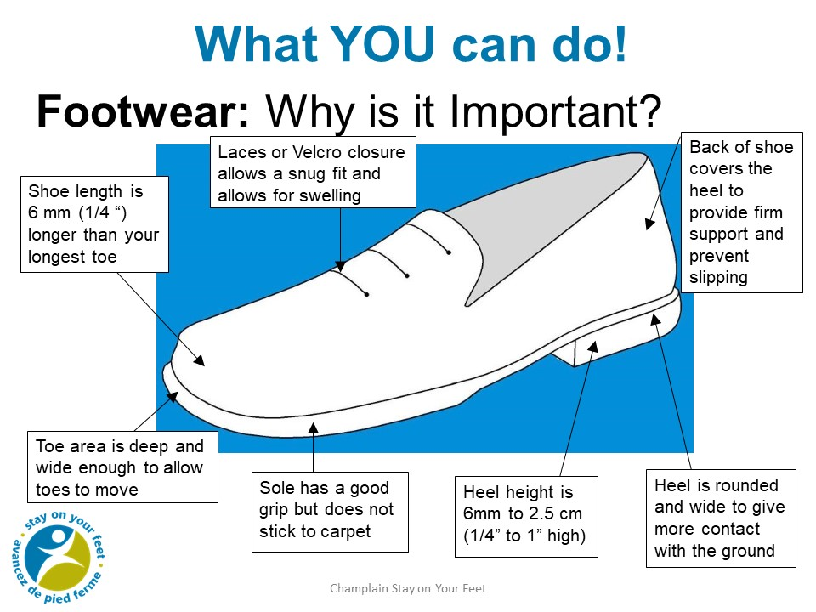
Notes:
Importance of a well fitting supportive shoe
Stability
Comfort and pain reduction
Protection-especially diabetic feet
Shock absorption and support for all lower body joints
Reduce slipping
Consider Ice picks and warm winter boots when the weather requires it.
Reduce fall risk
Review components of ideal shoe
Have seniors check own shoes or show your own. Depending on your audience, you could ask them to pair up and look at their own shoes to decide who has good shoes and ask where they were purchased., etc.
Stocking feet on certain flooring can also be hazardous.
Show:
Example of a good shoe, boot and/or slipper
Show example of non-slip socks

Slide 25
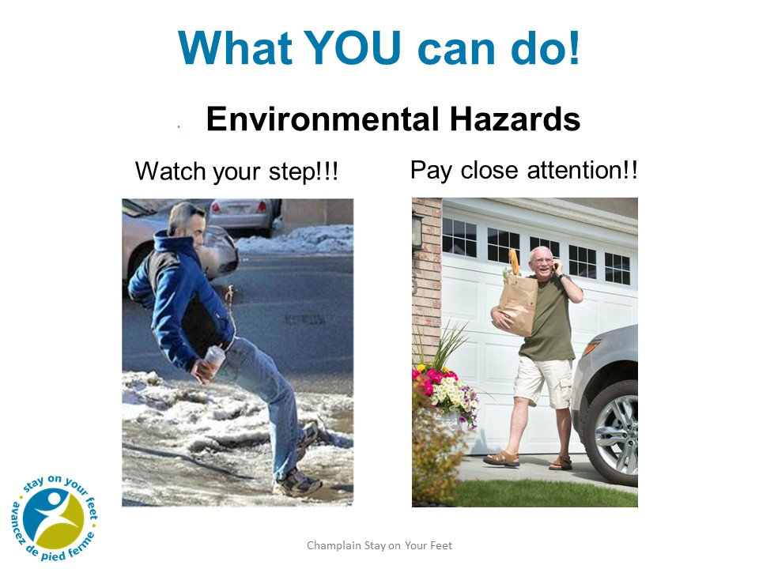
Notes:
What’s wrong with these photos? Not paying attention, multitasking
Stress importance of paying attention especially in unfamiliar settings – give examples such as stairs, uneven flooring, etc.
Winter:
When walking in winter - ice, snow and piles of snow become barriers to getting out and about.
Keep walkways clear of snow. There are snow removal programs such as ‘Snow Angels’ to help. Find out local information
Can use ice melt or sand or even kitty litter on your walks for traction. Can show bag of sand to carry with you. Usually available within communities, outside seniors’ centres, etc.
Try to avoid walking over drifts or snowbanks, go around where possible.
Show:
Cane tip
Boot with ice grippers
Bag of sand

Slide 26
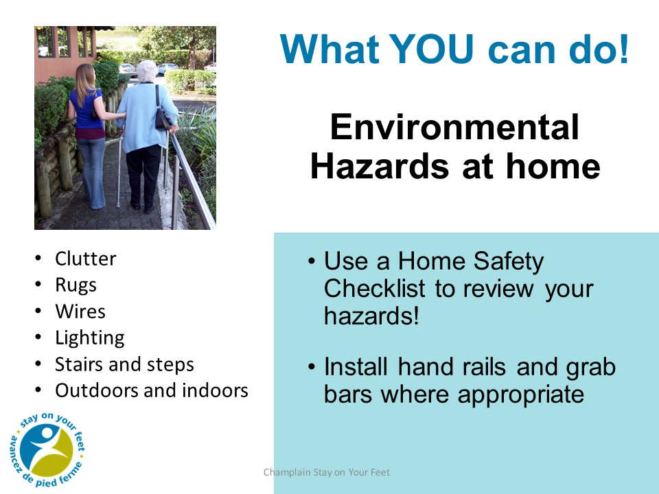
Notes:
Have Home safety checklist from Public Health to hand out such as You Can Prevent Falls

Slide 27
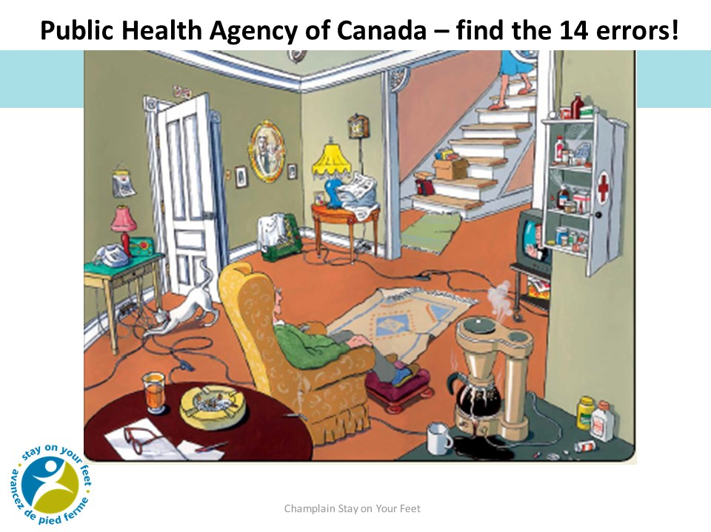
Notes:
What is wrong with this picture?
Stairs without handrail
Deactivated fire alarm
Cloth on space heater
Overloaded outlets
Loose extension cords in traffic areas
Smoking. Cigarettes left unattended
No automatic shut-off on coffee maker
Open bottles of medicine
Outdated medications in cabinet
Loose rugs
Flip-flop slippers
Clutter on staircase
Newspapers too close to lamp
No handle and no deadbolt on door
Can any one spot any more!
Unlocked and open medicine cabinet
Telephone out of reach

Slide 28
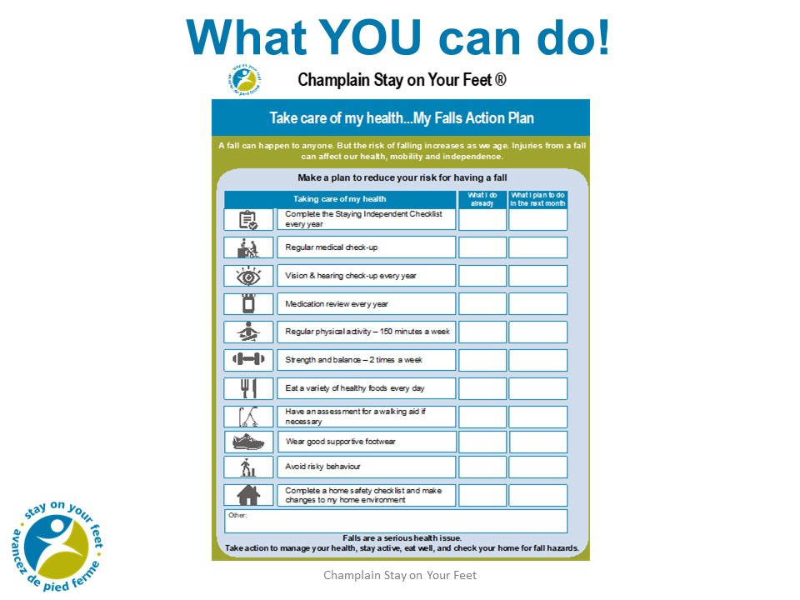
Notes:
Have handouts of this action plan available for each member of the audience
Fall Action Plan being finalised with symbols.
Use this for now!!

Slide 29
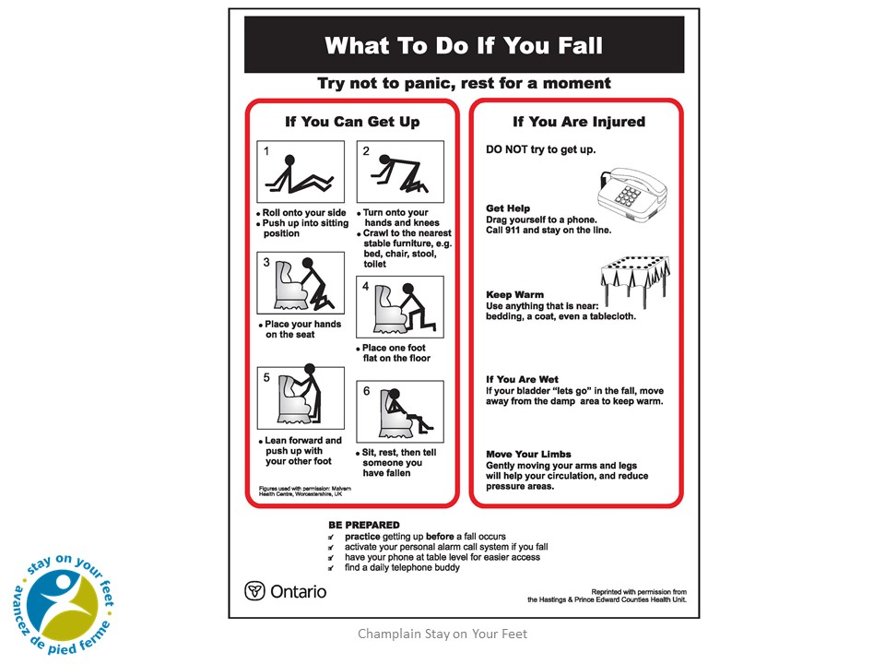
Notes:
Check with RH staff where presenting re: their procedures when someone has fallen
How To Get Up from the floor by yourself after a fall.
It’s important to know how to safely get up from the floor if you have fallen and are NOT injured.
This document was created when EMS (ambulance service) visited the same woman 11 out of 13 days because she had fallen but didn’t know how to get up. She was never transferred to hospital because she was not injured. It is important to know how to safely get up.
PLEASE NOTE: Do not lift a person after they have fallen. You may hurt yourself or hurt the person who has fallen.
Demonstrate: How to get up from the floor.
Ask: Is there someone who would like to try this?
If you are injured and cannot get up, call for help. Consider an alert system or carry a phone with you.
Show Handout: How to get up from the floor

Slide 30
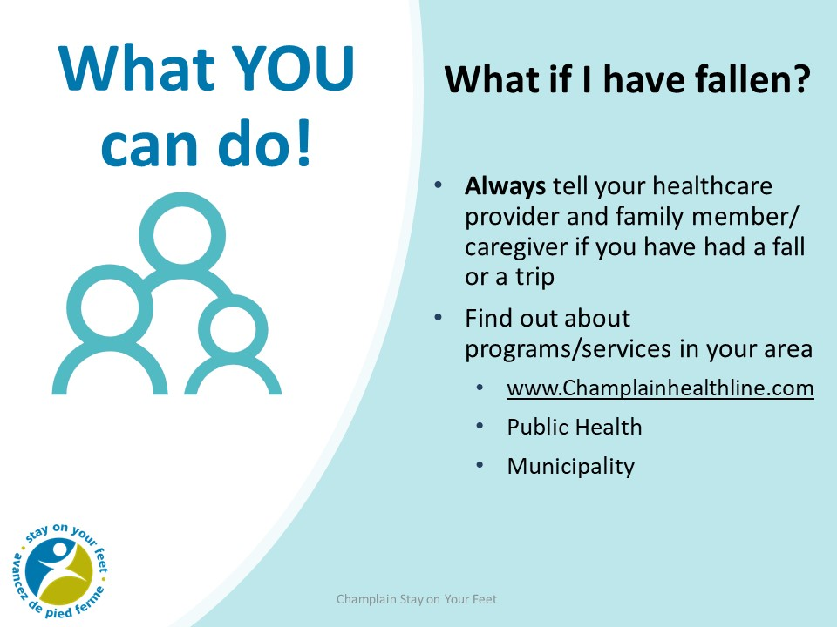
Notes:
Falls can result in serious injury. After a fall you may feel dizzy, drowsy, or have new aches and pains. See a health care provider right away!
Always tell your healthcare provider if you have had a fall.
Falls can act as a red flag. It’s important to tell a healthcare provider so you can explore the reasons why you may have fallen and to prevent if from happening again.
Ask about programs in your area Discuss activities with the group, what is available what do people enjoy doing.

Slide 31
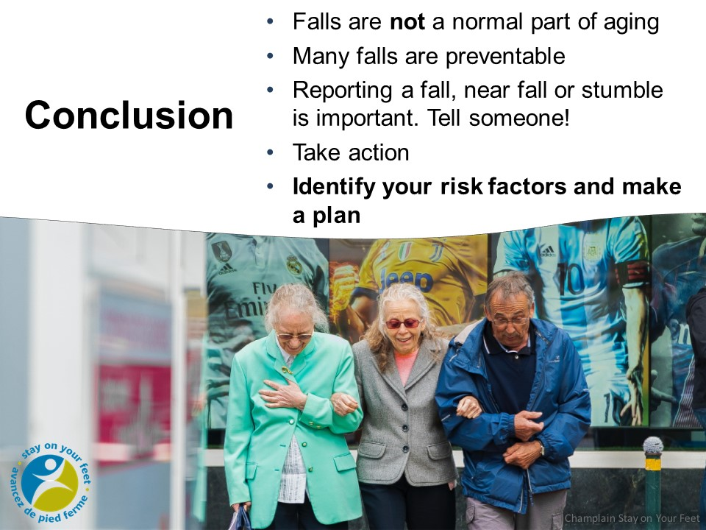
Notes:
Anyone can fall, but as we age the risk increases.
The good news is that falls are not a normal part of aging and in fact many falls are preventable.
Take action to prevent a fall before it happens. You can complete the Staying Independent Checklist to see if you are at risk of falling and how you can stay safe.
And always let your healthcare provider know if you have had a fall.
Make a Falls Action Plan so that you can continue a healthy active lifestyle

Slide 32

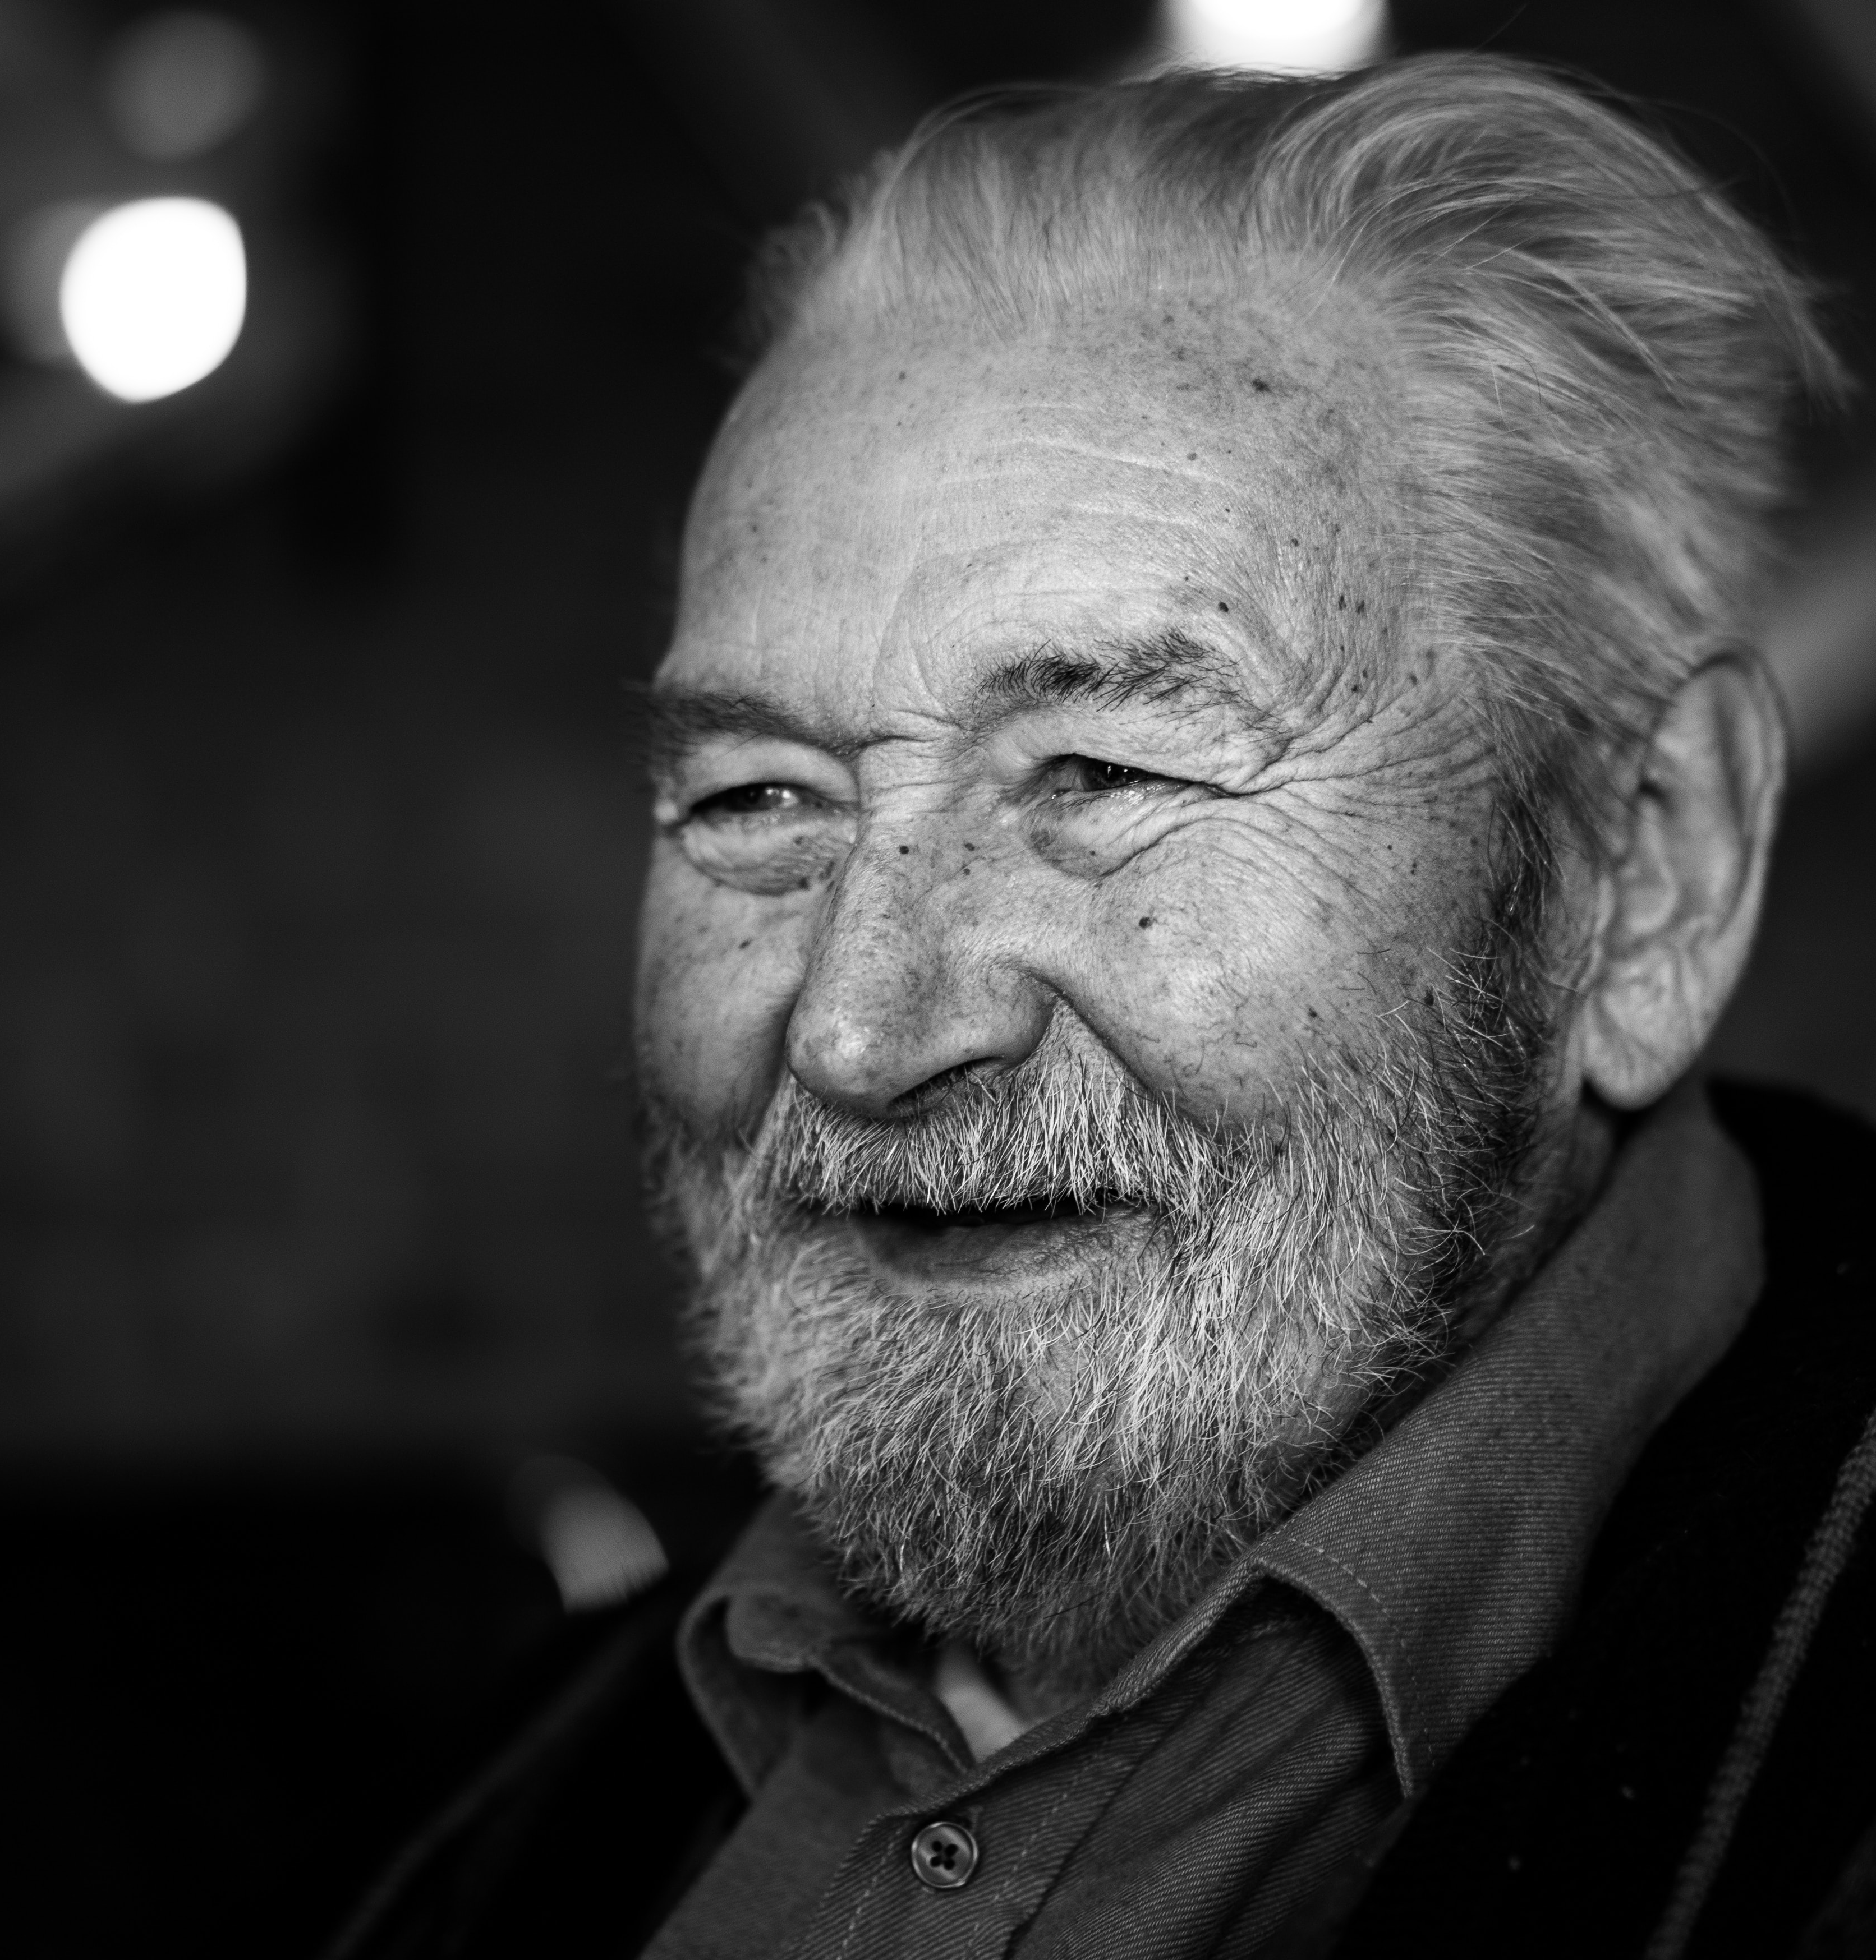

Thank You
Questions?
Your Name and contact info Here

