Slide 1

INTRODUCING
Jennifer
Koop
Jennifer is an Advanced Practice Nurse (APN) working at The Ottawa Hospital in the Division of Geriatrics, specializing in Dementia Care. She started her specialization in Geriatrics as a Geriatric Emergency Management Nurse conducting targeted geriatric assessments in the Emergency Department and connecting at risk older adults to further specialized geriatric care and services in the community. Next, she joined the In-patient Geriatric Medicine Consult Team providing recommendations for the care of admitted patients with geriatric concerns through comprehensive geriatric assessments. She completed her Master’s in Nursing with a leadership focus and special interest in delirium and patient and family education. Currently, in her role as APN she is committed to improving clinical outcomes for people living with dementia through advanced nursing practice, program development, consultation, research, education, and leadership.
ADVANCED PRACTICE NURSE
DEMENTIA CARE
THE OTTAWA HOSPITAL

Slide 2
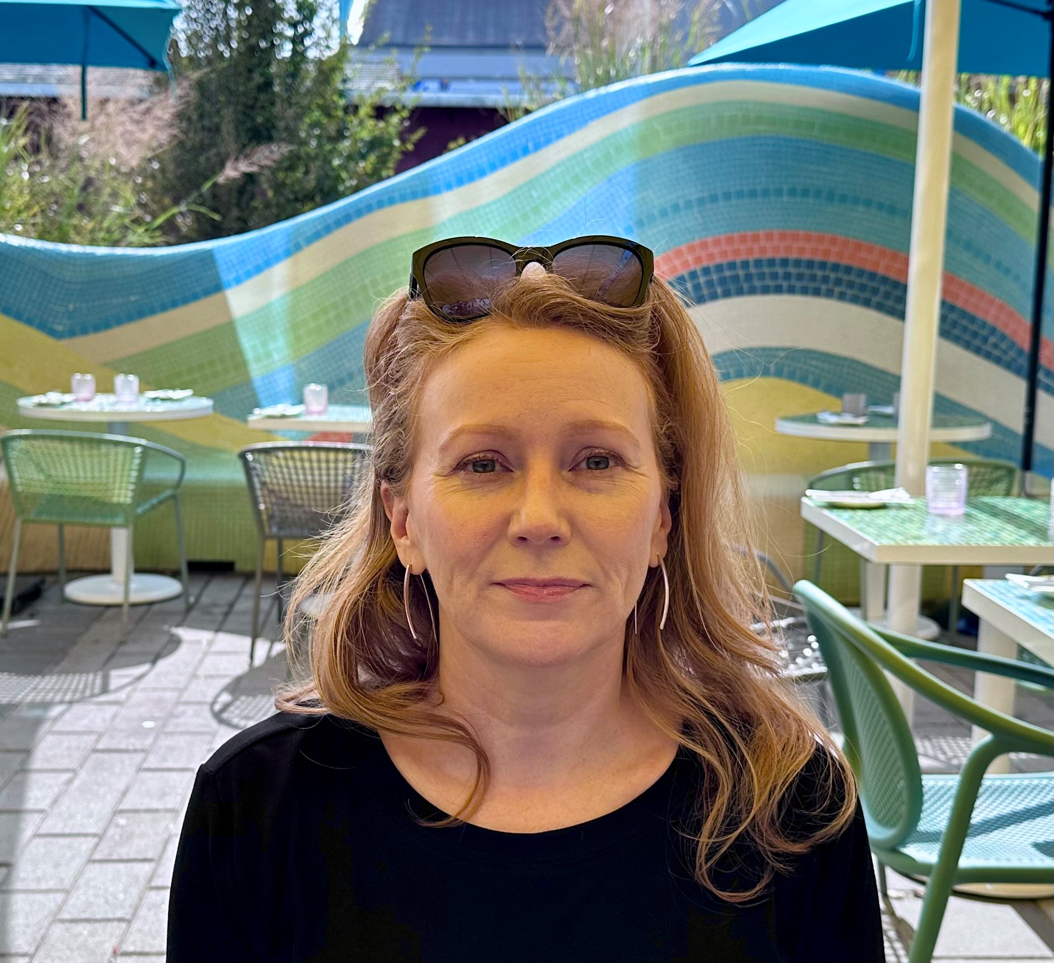
INTRODUCING
Lisa
White
Lisa White is a Registered Nurse with a Bachelor’s of Science in Nursing from Georgian College and York University’s collaborative Nursing program. She is currently a member of The Royal’s Geriatric Psychiatry Outreach and Behaviour Supports Ontario (BSO) team. Prior to this, she worked on the Geriatric Psychiatry inpatient unit at The Royal. Her initial start in Geriatric Nursing began as a Unit Nurse at The Perley and Rideau Veterans' Health Centre. Lisa’s passion for advancing care in the Geriatric population and continuing education was the inspiration for her to return to school as a mature student and enter the Nursing profession.
GERIATRIC PSYCHIATRY OUTREACH NURSE
THE ROYAL OTTAWA

Slide 3
DEMENTIA
Cognitive Impairment and BPSD: Assessment and Intervention
Jennifer Koop
Dementia Behavioural Support Team
The Ottawa Hospital
Lisa White
Geriatric Psychiatry Outreach Team
Royal Ottawa Mental Health Centre
Notes:
Jen
Welcome everyone.
Lisa and I are excited to talk to you about cognitive impairment and Behavioural and Psychological Symptoms of Dementia .
It has been a wonderful experience working together and learning from each other.
Lisa is predominantly working in outreach to LTC home setting and I have the acute care perspective. Both work on interprofessional teams supporting people living with dementia and their care partners.

Slide 4
ACKNOWLEDGMENTS
Louise , Geriatric Assessor GAOT
Lyne Marcil, Geriatric Assessor East GAOT
Dr. Andrew Wiens, Geriatric Psychiatrist
Alzheimer Society of Canada
Timah Black-Geisterfer, Royal Ottawa Mental Health Centre
P.I.E.C.E.S. 7th edition ® - 2020
RNAO
Notes:
Jen
Before beginning we would like to acknowledge a few people and groups who’s knowledge and work helped shape this presentation.

Slide 5


LEARNING OBJECTIVES
To increase knowledge about cognitive changes as they relate to normal aging, MCI and Dementia
To develop an understanding of how to assess cognitive changes in the context of normal aging vs MCI vs Dementia and to identify care strategies and interventions.
To develop an understanding of how to assess Behaviours and Psychological Symptoms of Dementia (BPSD) and of appropriate care giving strategies for persons with dementia
© Regional Geriatric Program of Eastern Ontario
Notes:
Jen

Slide 6
COGNITIVE IMPAIRMENT
Notes:
Jen (5 min mark - 15 min to go to slide #21)

Slide 7
THE 3DS: DEMENTIA, DELIRIUM AND DEPRESSION
They can occur at the same time
They share common features with overlapping symptoms
Having one of the 3 conditions can increase the risk of a person developing one of the other conditions.
A condition can be a result of another condition
Health care professionals need to be able to differentiate the 3 conditions to be able to refer to appropriate clinicians, teams or services for further assessment and diagnosis
RNAO, Jan 2017, Delirium, Dementia, and Depression in Older Adults: Assessment and Care
Notes:
Quick review – dementia is a progressive brain disorder characterized by impaired cognitive functioning that can affect learning, memory, mood, behaviour, as well as the ability to manage IADLs & ADLs
-delirium is a complex neuropsychiatric syndrome marked by an acute onset, fluctuating course, altered LOC, inattention, and disorganized thinking,
-depression is a spectrum of mood disorders characterized by a sustained disturbance in emotional, cognitive, behavioural, and/or somatic regulation that is associated with functional impairment in ADLs and often loss of capacity for pleasure and enjoyment
Can occur at same time ie. A person with dementia can experience a delirium
Can share features/symptoms ie. Hypoactive delirium presents similar to depression
Can increase risk of developing other conditions ie. Late life depression can increase risk of developing dementia
Can contribute to symptoms another condition ie. Depressive episodes can develop with dementia
Understanding, recognizing and differentiating these conditions helps you the healthcare provider to engage the appropriate clinicians for further assessment, diagnosis and treatment

Slide 8
WHAT IS COGNITION?
A function of the brain
It is our ability to interact with world around us.
It includes many important functions such as :
    Learning and memory
    Language
    Visual and spatial function
    Executive function
    Social function
Different cognitive abilities are linked to different areas of the brain.
Mac in Five – What is Dementia? Dr. Anthony J. Levinson and Dr. Richard Sztramko, 2019
http://alumni.mcmaster.ca
Notes:
Jen
Let’s start with the basics:
Cognition is a function of the brain (our central command center).
In general, it is our ability to interact with the world around us.
It includes many important functions such as:
Learning and memory: For example: our ability to remember conversations and events or learn new information or how to do new things
Language: Not just our ability to speak but also to read, write, and understand
Visual and spatial function: for example: navigating in our environment
Executive function: making decisions, problem solving and organizing our lives.
Social function: how we interact appropriately with our family, friends and colleagues.
These are just some of the many cognitive domains that are important for our day-to-day lives.

Slide 9
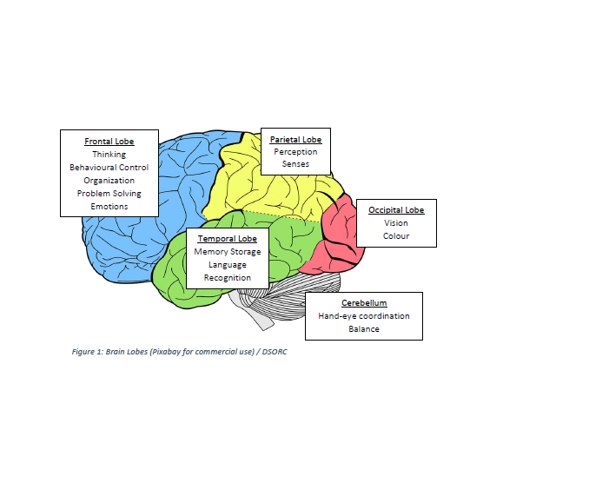
Notes:
Jen
Different cognitive abilities are linked to specific areas of the brain.
We could do a full presentation on this but I will be brief and give you a few examples:
Frontal lobe:
Planning and Organizing, Problem solving, Emotional control and social skills , Judgement: Decision making and self awareness
When there are significant changes in the frontal lobe, the person may be impulsive or disinhibited and may have difficulty with problem solving or organizing themselves.
Temporal Lobe:
Verbal Memory, Visual Memory ,New learning, STM, LTM
Someone with significant changes you might notice receptive or expressive aphasia. They might develop a neurological condition called primary progressive aphasia.
Occipital Lobe
Vision and Depth perception
Understanding of sensory information
Cerebellum
Motor control and Motor learning
Coodination, precision and accurate timing of movements
Parietal Lobe
Logical thinking
Spatial information – where things are
Sequencing– putting things in order
Recognition of the familiar

Slide 10
Cognitive changes are normal with aging.
True or False?
POLL

Slide 11
NORMAL AGE-RELATED CHANGES IN THE BRAIN
Decreased brain weight
Decreased blood flow
Decreased number and functioning of CNS neurons
Increased neurofibrillary tangles and senile plaques
Changes in neurotransmitter systems
Accumulation of free radicals
Notes:
Jen
Just like our bodies, we can expect that our brains will change with aging.
Certain parts of the brain shrink (especially those important to learning and other complex mental activities.) With normal aging, the number of nerve cells in the different parts of the brain decreases.
Blood flow decreases by 20% on average. Decreases are greater in persons with small vessel cerebrovascular disease for example those who have diabetes and HTN.
Communication between neurons can be reduced
« Also, protein plaques and, less frequently, neurofibrillary tangles occur in elderly persons without clinical evidence of dementia (In a person with AD – plaques and tangles occur in much greater numbers )» Merks
With normal aging, there are changes in neurotransmitter systems (changes in enzymes, receptors and neurotransmitters) - Merks
Inflammation, which occurs when the body responds to an injury or disease, may increase.
Free radicals which are produced normally during metabolism, accumulate with age and may have a toxic effect on certain nerve cells.
These changes can affect cognition even in healthy older adults.
…there is growing evidence that the brain remains « plastic » able to adapt to new challenges and tasks as people age.
The changes vary greatly from person to person, depending on different factors.
National Institute on Aging. May 2017. « How the Aging Brain Affects Thinking ».
Centre for Studies in Aging and Health. Dr. John Puxty. Presentation « Physiology of Aging »
Merk Manual 2018. (Internet)
Merk Manual of Geriatrics, 2000

Slide 12
COGNITIVE CHANGES RELATED TO NORMAL AGING
The changes are subtle
Can vary from person to person
Some cognitive abilities gradually decline:
      Can’t remember as much when learning new information
      Don’t process things quite as fast
      Learning more complicated tasks become more difficult
However, older adults can still:
      Learn new things
      Create new memories
      Improve vocabulary and language skills
Levinson & Sztramko
Notes:
Jen
The changes associated with normal aging are subtle.
And can vary greatly from person to person.
As we age, some of our cognitive abilities gradually decline
Can’t remember as much when learning new information
Don’t process things quite as fast
Learning more complicated tasks become more difficultbut
we can adapt and our ability to function is not impacted.
…there is growing evidence that the brain remains « plastic » able to adapt to new challenges and tasks as people age.
Research shows that older adults can still:
Learn new things
Create new memories
Improve vocabulary and language skills
National Institute on Aging, www.nia.nih.gov/health/how-aging-brain-affects-thinking

Slide 13
NORMAL AGING
  Subjective complaints, but no concerns by family
  No objective findings of memory loss
  Information is slower to be retrieved, but comes later
  Cognition does not impact on daily functioning
Notes:
Jen
With normal aging, usually the person notices changes but the changes are so subtle that those around them do not.
With cognitive screening, the person typically scores within normal ranges.
Often clients with changes related to normal aging report noticing that their thinking is a bit slower, they aren’t quite as sharp as they used to be.
It is very important to note that the slight changes in cognition do not impact on daily function.
For my clients experiencing changes related to normal aging, I do a lot of teaching around what they can do to keep their brain healthy.
I often assess client’s who are referred for cognition - sometimes it is because the client has mentioned noticing memory loss to their PCP and are worried that they are developing dementia.
With these clients I do a lot of teaching around what they can do to keep their brain healthy.

Slide 14
KEEPING THE AGING BRAIN HEALTHY
  Challenging the brain
  Being socially active
  Choosing a healthy lifestyle:
    Healthy food choices,
    Regular physical activity,
    Managing vascular risk factors – HTN, diabetes, ect
    Reducing stress
    Getting enough sleep
    Quitting or avoiding smoking
    Avoiding excessive alcohol consumption
  Protect the head (Alzheimer’s Society)
Notes:
Jen
Some risk factors cannot be controlled: genetics, age
Aging is inevitable but older adults can potentially delay effects and severity with certain activities such as:
Challenging the brain: playing games, doing puzzles, taking courses, visiting museums, enjoying hobbies, developping new interests, learning a language, musical instrument,
Being socially active: appears to have a protective effect against developping dementia; spending time with family and friends, attending events; staying active in the workforce or vollunteering
Making healthy food choices: varied diet rich in dark coloured fruits and veggies, omega 3, antioxidants
Being active; regular moderate physical activity
Managing vascular risk factors such as diabetes, hypertension, ect.
Reducing stress: practice relaxation, meditation, getting counselling, setting boundaries
Getting enough sleep: Ensuring good sleep hygiene and good quality sleep. I often assess clients who suffer from sleep apnea and chose not to wear the CPAP that was recommended. They do not seem to understand the detrimental consequences of this on their body and brain.
Quitting or avoiding smoking and excessive alcohol consumption.
Protecting the head is also very important. Having a concussion increases a person’s risk of developping dementia.
60% of the overall risk for Alzheimer’s disease came from lifestyle choices and not from genes (in a study of identical twins) – Sent Heather a note re: where/what study
People can influence how quickly brain function declines
Healthy lifestyle choices help the brain maintain connections and even build new ones

Slide 15
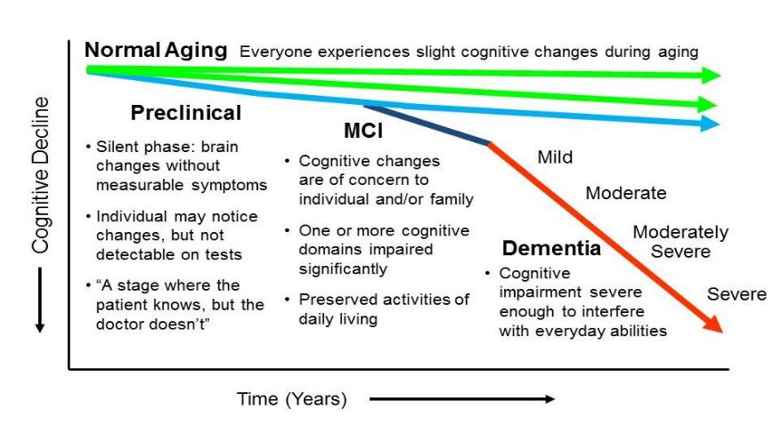
PROGRESSION FROM NORMAL AGING TO DEMENTIA
http://www.alz.uci.edu/alzheimers-disease/what-is-alzheimers/mild-cognitive-impairment/
Notes:
Jen
Everyone experiences slight cognitive changes as they aging.
As I mentioned, the changes and the rate of the changes vary from person to person.
Overall, studies estimate that 10-15% of people with MCI progress to AD each year.
Although, for yet unknown reasons, some people with MCI remain stable and a few even improve, MCI is widely viewed as a transitional state between normal aging and AD or another dementia

Slide 16
MILD COGNITIVE IMPAIRMENT (MCI)
Also known as Mild Neurocognitive Disorder (DSM-5-TR)
A clinical condition in which a person may have problems with:
  Memory (ex: Forgetting info such as appointments, conversations or recent events)
  Impaired thinking (ex: Losing train of thought, difficulty organizing or planning)
  Language difficulties (ex: Trouble finding the right word)
  Disorientation in time and space (ex: Getting lost in a familiar environment)
  Poor judgment (ex: Wearing a jacket on hot summer day)
  Impaired depth perception (ex: Confusing a dark rug for a hole)
***NO impact on function
The cognitive deficits are not due to a medical or mental health disorder (ex: depression, hypothyroidism, etc).
Notes:
Jen
Mild Cognitive Impairment – MCI is also known as Mild Neurocognitive Disorder
It’s a clinical condition where the person may have changes in one or several cognitive domains:
Memory problems: With most people with mci – memory is the domain most affected. Examples: Forgetting appointments, conversations, recent events
Impaired thinking skills: Examples: often losing train of thought, difficulty organizing or planning
Language: Example: Finding the right word
Disorientation in time and space: Example: Getting lost in a familiar environment
Poor judgment: Example: Wearing a jacket on a hot summer day
Impaired depth perception: Example: Confusing a dark rug for a hole in the ground
It is very important to note that the changes are not serious enough to affect a person’s function, ability to perform everyday activities.
The changes are not due to medical or mental health disorder for example: depression, hypothyroidism, etc.
See Alzheimer Society – MCI

Slide 17
MILD COGNITIVE IMPAIRMENT (MCI)
Conversion over to dementia – 10-15% of persons with MCI progress to dementia each year
No drugs available
Practical memory strategies can be helpful
A diagnosis can lead to acknowledgement and treatment of risk factors for dementia
Notes:
Jen
Not all persons with MCI will progress to dementia.
For unknown reasons, some people with MCI remain stable and a few even improve.
However, MCI is widely viewed as a transitional state between normal aging and AD or another dementia
Overall, studies estimate that 10-15% of people with MCI progress to dementia each year.
There are no medications available to cure MCI
Alzheimer Society
Practical memory strategies – Examples:
Electronic calendars on smart phone or computer
Paper based aids – calendars, diaries, lists, sticky notes
Voicemail to leave messages as reminders
A diagnosis of MCI can lead to acknowledgement and treatment of risk factors for dementia.
Dementia Society of Ottawa & Renfrew County
So keeping the brain healthy cannot be understated. It is extremely important at this stage.

Slide 18
RISK FACTORS FOR DEVELOPING DEMENTIA
Age
Family history
Vascular risk factors (diabetes, hypercholesterolemia, hypertension, metabolic syndrome)
Post stroke
History delirium
Onset of depression after 65
Head injury
Alcohol abuse
Low education, physical frailty, low social support, never being married
US preventive Services Task Force( 2020): cognitive impairment in Older Adults: Screening)
Notes:
Jen
Not all persons with MCI will progress to dementia.
For unknown reasons, some people with MCI remain stable and a few even improve.
However, MCI is widely viewed as a transitional state between normal aging and AD or another dementia
Overall, studies estimate that 10-15% of people with MCI progress to dementia each year.
There are no medications available to cure MCI
Alzheimer Society
Practical memory strategies – Examples:
Electronic calendars on smart phone or computer
Paper based aids – calendars, diaries, lists, sticky notes
Voicemail to leave messages as reminders
A diagnosis of MCI can lead to acknowledgement and treatment of risk factors for dementia.
Dementia Society of Ottawa & Renfrew County
So keeping the brain healthy cannot be understated. It is extremely important at this stage.
Here is a list of risk factors for developing dementia. Many of which have already been mentioned in previous slides.
Also if you remember from the beginning, Timah mentioned that with Dementia, Delirium and Depression, having one of the three can increase the risk of developing one of the others. So a person who has a delirium or who suffers from depression later in life will be at higher risk of developing dementia.

Slide 19
DEMENTIA DSM-5-TR criteria for major neurocognitive disorders
  Substantial cognitive decline from a previous level of performance in one or more cognitive domains such as memory, orientation, language, perception, performance of motor tasks and ability to plan, organize, sequence or think abstractly.
  The cognitive deficits are sufficient to interfere with one’s ability to perform normal activities (IADLs/ADLs)
  Commonly caused by changes in the brain related to toxic proteins and/or blood vessel damage in the brain
Notes:
Jen
Needs updating
The new DSM-5 was released in May 2013. Roman numeralV has been replaced with the arabic 5. Also the section on Delirium, dementia, Amnestic, and other cognitive disorders was changed for neurocognitive disorder. Term dementia was eliminated and replaced with minor and major neurocognitive disorders such as AD, vascular neuro cognitive disorder, frontotemporal neurocongitive disorder, etc.
Dementia represents disorders where there is substantial cognitive decline from a previous level of performance in one or more cognitive domains.
The cognitive deficits are sufficient to interfere with a person’s ability to perform normal day to day activities.
Commonly caused by damage to brain tissue related to toxic proteins that clump together and form plaques and tangles and /or blood vessel damage in the brain.
Abnormal proteins (like beta amyloid, Tau, synuclein) clump together and form plaques and tangles that damage brain tissue. Harvard Health Publishing. How memory and thiking ability change with age. www.health harvard.edu/mind-and-mood
Commonly caused by … « Dr. A. Levinson and Dr. R. Sztramko » Mac In Five Week 4 – alumni.mcmaster.ca -
Alzheimer’s disease : toxic protein beta amyloid
Frontotemporal dementia: toxic protein call Tau
Parkinson’s disease: low levels of neurotransmitters dopamine and acetylcholine and presences of toxic proteins called synuclein
Lewy body dementia: Lewy bodies which are abnormal protein structures made of alpha-synuclein

Slide 20
DEMENTIA IS MUCH MORE THAN MEMORY LOSS
ADLs/IADLs – Functional ability to carrying out daily activities
Behaviour, personality, mood
Cognitive Abilities - memory, orientation, language, judgement and reasoning, concentration, ability to sequence tasks, and motor planning deficits
Notes:
Jen
Dementia is much more than just changes in memory. Think ABCs
A – ADLs/IADLs – Function
B – Behaviour- personality and mood
C- Cognitive Abilities – Which include memory but also orientation, language, judgement and reasoning, concentration, ability to sequence tasks and motor planning.
The progressive degeneration of brain cells in Dementia affects not only memory but other cognitive abilities. The functional decline results from impaired thinking, ability to learn, impaired judgment and behavioural symptoms. There may be changes in personality such as emotional fluctuations, and mood swings as well as motor planning problems. It is a disease of the brain, characterized by deterioration of thinking ability and of memory, caused by the progressive degeneration of brain cells. In order to meet the criteria for a diagnosis of dementia, an individual needs to have declined cognitively compared to a year ago but also to have declined functionally due to cognitive reasons as compared to a year ago.

Slide 21
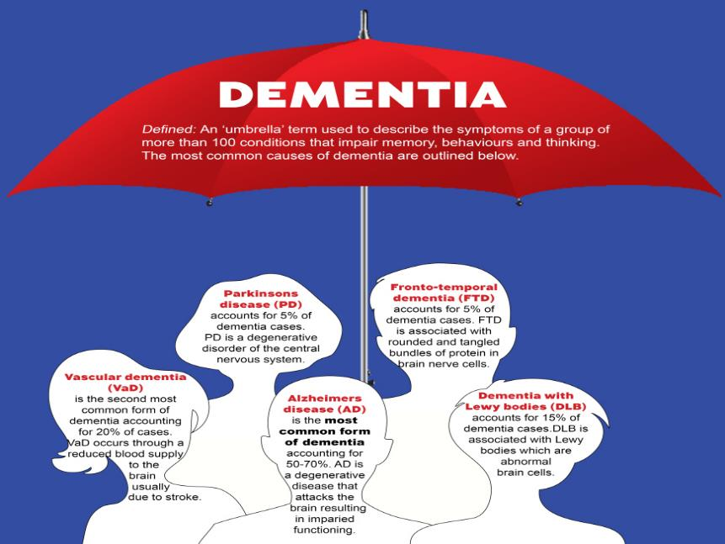
Image source: Shutterstock 2012. A Dobos
http://dementianewsforum.com
Notes:
Jen introduces Lisa (15 min mark – 25 min to slide #32)
LIsa will now walk us through some of the most common types of dementia

Slide 22
Difficulties with problem solving, reasoning and hallucination are common early features of which type of dementia:
Fronto-temporal Dementia
Alzheimer’s Dementia
Vascular Dementia
Lewy-body Dementia
POLL
Notes:
Lisa
Before we get started I'd like to start with a general knowledge question...
Answer: Lewy-body dementia

Slide 23
TYPES OF DEMENTIA
Alzheimer’s Dementia | Most common type – characterised by a progressive decline & short term memory loss.
Vascular Dementia | Microangiopathic changes leading to cell death. It is characterized by a step wise decline that is unpredictable.
Fronto-Temporal Dementia | Early onset. Short term memory may not be affected. Common deficits: disinhibition, poor judgement changes to language.
Lewy-Body Dementia | Its characterized by a triad symptoms that present in the early stages of the dementia – memory, mobility, visual hallucinations.
Parkinson’s Disease Dementia | Characterized by slowness of thought and speech combined with cognitive and emotional issues.
Notes:
Lisa
We will briefly review the most common types of dementia
Alzheimer's’ 60-70% of cases, characterized by plaques & tangles of proteins in the brain, treated with Cholinesterase inhibitors (function to decrease the breakdown of acetylcholine a chemical messenger in the brain that's important for memory and learning)
Vascular 10-20% caused by brain cell death due to insufficient oxygenation, treated with addressing vascular risks
Fronto-temporal >10% caused by shrinkage of brain tissue & death of nerve cells in frontal and/or temporal lobes
Lewy-body 5-15% caused by protein deposits (Lewy bodies) causing death/damage to nerve cells in brain
Parkinson’s existing disease process contributes to development of dementia

Slide 24
DEMENTIA – DIAGNOSIS
Only a physician can give a diagnosis of dementia.
Physician's may order tests to identify potential contributing factors, such underlying medical issues or conduct cognitive testing in addition to performing in person assessments
Notes:
Lisa
Sometimes Clients or families may ask us as care providers for a diagnosis after we perform an assessment or even to rule out a diagnosis of dementia. It is important to explain and for Clients and their families to understand that only a Physician can give a diagnosis.
Tests such as CTs, MRIs, blood labs for contributers of cognitive changes are often ordered as some treatable conditions can produce symptoms similar to dementia.
Do not read:
« Some treatable conditions can produce symptoms similar to dementia, for example, vit deficiencies, thyroid disease, sleep disorders, alcohol abuse or depression. Other possible causes of confusion include poor sight or hearing. » Alzheimer Society Canada. (Alzheimer.ca)
Physical tests: blood pressure, cholesterol levels, thyroid function, vit levels
brain imaging such as CT or MRI to see if there is evidence of recent stroke or vascular changes or other changes that could indicate show signs of NPH or

Slide 25
REVERSIBLE CAUSES OF COGNITIVE IMPAIRMENT
Delirium (Infections)
Depression
Medications (side effects, drug interactions, drug overdose)
Alcohol and other drugs
Concussions/head injury
Thyroid conditions
Metabolic disorders (dehydration, kidney failure, COPD)
Heart disease
Brain disease (ex. tumours)
Dietary, vitamin and mineral deficiencies
Environmental toxins
Notes:
Lisa
It is important to address reversible causes to help our Clients maintain their maximum cognitive functioning escpecially in the event they are facing the added challenges of a potential dementia diagnosis.

Slide 26
DEMENTIA – TREATMENT
Pharmacotherapy: Cholinesterase inhibitors & Memantine - NMDA (N-methyl-D-aspartate) receptor antagonist
Optimizing brain health
  Physical activity
  Social activity
  Mental stimulation
Non-pharmacological approaches
  Aromatherapy
  Music therapy
  Pet therapy
  Massage
Notes:
Lisa
Dementia is a progressive, terminal disease process with no current cure
Current treatments which may slow disease progression include cholinesterase inhibitors (such as donepezil or galantamine) which decrease the breakdown of acetylcholine a chemical messenger in the brain that's important for memory and learning – not noted to be effective for MCI or frontotemporal dementia
or N-methyl-D-aspartate receptor angtagonists (NMDAs) (such as memantine or ketamine) which is a glutamate receptor which with age become less functional
Some non-pharmocological therapies may be antidotically beneficial to persons with dementia but, research is often lacking.

Slide 27
Treating the Client Recognizing Rights
Client Rights
As we gain better education, access to care, increased visibility and hopefully a reduction of stigma re: dementia we can identify symptoms earlier and begin interventions sooner to more effectively address outcomes improving quality of life
In caring for our Clients we acknowledge their rights ie. Dementia Bill of rights (Bell & Troxel 2013), Canadian Charter of Rights for People with Dementia (2018)
Notes:
LISA
Bell & Toxel
To be informed of one’s diagnosis
To have appropriate, ongoing medical care
To be productive in work and play for as long as possible
To be treated like an adult, not like a child
To have expressed feelings taken seriously
To be free from psychotropic medications, if possible
To live in a safe, structured, and predictable environment
To enjoy meaningful activities that fill each day
To be outdoors on a regular basis
To have physical contact, including hugging, caressing, and hand-holding
To be with individuals who know one’s life story, including cultural and religious traditions
To be cared for by individuals who are well
Canadian Charter of Rights:
To be free from discrimination of any kind. To beneft from all of Canada’s civic and legal rights. To participate in developing and implementing policies that affect my life. To access support so that I can live as independently as possible and be as engaged as possible in my community. This helps me: • Meet my physical, cognitive, social, and spiritual needs, • Get involved in community and civic opportunities, and • Access opportunities for lifelong learning. 5 6 7 To get the information and support I need to participate as fully as possible in decisions that affect me, including care decisions from the point of diagnosis to palliative and end-of-life care. To expect that professionals involved in my care are: • Trained in both dementia and human rights. • Held accountable for protecting my human rights including my right to get the support and information I need to make decisions that are right for me. • Treating me with respect and dignity. • Offering me equal access to appropriate treatment options as I develop health conditions other than my dementia. To access effective complaint and appeal procedures when my rights are not protected or respected

Slide 28
DEMENTIA – TREATMENT
Treating the Client & their Caregivers
  Has the diagnosis has been clearly established and conveyed?
  Do they accept/understand diagnosis?
  Do they truly accept BPSD as involuntary?
  What is their level of knowledge about the disease?
  Do they have realistic strategies and skills for dealing with BPSD?
  Do they know how to access and utilize professionals appropriately?
  What are their beliefs regarding accepting help?
  What is their level of emotional resilience or vulnerability?
  What is the history of their relationship – love vs duty vs resignation?
  Do they perceive they have adequate social support?
  Do they accurately appraise their own physical condition?
    Dr. Joel Sadavoy and Dr. Virginia Wesson Reitman Centre Mount Sinai Hospital
Notes:
Lisa
We cannot overstate the importance of working with our Clients and their primary caregivers. Care givers are instrumental in supporting the person as the disease progresses.
It’s important to make sure that they understand the diagnosis and what to expect as the disease progresses and that they know where to find support.
Most clients prefer to stay at home as long as possible – supporing their caregiver is key to acheiving this.

Slide 29
UNDETECTED DEMENTIA
Health care professionals commonly miss the diagnosis of cognitive impairment or dementia; the prevalence of missed diagnosis ranges from 25% to 90%.
Primary Care Physicians may not recognize cognitive impairment until the moderate to severe stage.
        Tsoi, K.Chan, J.et al., 2015
Notes:
Lisa

Slide 30
BARRIERS TO RECOGNIZING/ASSESSING
COGNITIVE IMPAIRMENT
Lack of time
Lack of ability to screen for dementia
Lack of knowledge about dementia
Lack of symptom recognition
Belief that early detection increases patient and caregiver distress
Other possible barriers:
Not your role
Not sure what to do with information gathered or who to go to?
Misconceptions
Notes:
Lisa
To be fair there may be several barriers to recognizing or assessing cognitive impairment:
Lack of time: PCP have limited time alotted per visit. An older adult may have a long list of chronic issues and may be presenting with a new acute health problem.
Lack of ability to screen for dementia
Lack of knowledge about dementia – PCPs dealing many age groups.
Lack of symptom recognition – family or caregiver may be covering for the client. Or there may be red flags but the client may deny changes or provide plausible answers and present very well
Belief that early detection increases patient and cg distress
For other health care professionals:
Not your role
Not sure what to do with the information gathered or who to go to
Misconceptions: He’s 82 what do you expect? She’s pretty good at 80. The family or cg are in denial about the changes
I’m just getting older
Ex: Friend in ED - She’s coming from a LTC – Of course she’s confused. This is just worsening of dementia.
« The importance of early diagnosis » Alzheimer Society of Canada, 2013.

Slide 31
BENEFITS OF ASSESSMENT AND TREATMENT
Social
Right/Need to know
Social/financial planning
Client and caregiver education and support
Safety: med compliance, driving, cooking, etc
Advance directives planning
Medical
For those with Mild Cognitive Impairment (MCI), identify people at risk for developing dementia
Option of participating in clinical trials
Reversible cause/component
Risk factor treatment
Treatment of other diseases
Anti-dementia treatment
Compliance strategies
Crisis avoidance
Notes:
Lisa
Hand over to Jen

Slide 32
ASSESSMENT
Notes:
Lisa hands over to Jen (time 25 min mark – 45 min to slide #50)

Slide 33
ASSESSING COGNITIVE IMPAIRMENT
What are the changes?:
  ADLs & IADLs – Functional changes
  Behavioural changes
  Cognitive changes – 8As, executive function & judgment
Onset: abrupt, recent, gradual, longstanding ***If acute change – need to rule
out delirium
Progression: Gradual, Step-wise, Fluctuating
Cognitive screening
Medical history, risk factors, mental health
Notes:
Jen
Are there changes? What is new and different?

Slide 34
ADLS & IADLS: FUNCTIONAL CHANGES
Instrumental activities of daily living (IADLs)
Telephone use
Meal planning and preparation
Shopping
Laundry
Home maintenance
Financial Management
Transportation
Medication management
Notes:
Jen
Things we do to manage our homes.
Skills that are learned by young adulthood.
We want to ask what is new and different and try to pick up clues as to why there is a change. For example the person is having difficulty with meal planning and preparation – It might be related to many factors such cognitive impairment, lack of motivation, pain, mobility, decreased stamina.

Slide 35
ADLS & IADLS: FUNCTIONAL CHANGES
Activities of Daily Living (ADLs)
Grooming
Bathing
Dressing
Toileting
Eating
Notes:
Jen
Things we do to take care of ourselves.
Tasks that young children learn.

Slide 36
BEHAVIOURAL CHANGES
Apathy
Anxiety
Depression
Frustration
Agitation
Aggression
Temper outburst (shout, threaten)
Disinhibition
Hallucinations
Delusions
Impulsivity
Food cravings for sweets
Notes:
– in what ways can you support them, give examples
OR pick 3:
Disinhibition may be expressed by a person who demonstrates inappropriate social or sexual behaviors ie. spitting on the table during a meal or attempts to touch individuals they have just met in an intimate way
Hallucinations may be auditory, visual, olfactory, tactile, gustatory for example a person describes seeing kittens under their bed when there are no animals around
Delusions may include a fixed belief in something untrue despite evidence to contrary for example a person believes they must pick up their children at the school bus stop despite their children being grown adults

Slide 37
A person avoiding a dark mat on the floor is a sign of altered perception.
True or False?
POLL
Notes:
Answer: True

Slide 38
COGNITIVE CHANGES
8As plus executive function and judgment
Amnesia - Forgetfulness affecting day to day function - events, instructions, recent conversations
Aphasia - Language - partial or total loss of the ability to communicate verbally or using written words
Agnosia - Difficulty identifying objects/recognizing people despite intact sensory function
Apraxia - Difficulty doing a motor task (i.e. dressing) despite intact motor/sensory function
Apathy - Apathy of dementia vs. apathy of depression
Attention Deficit – Difficulty sustaining or shifting attention
Altered Perception – misinterpretation in visual data
Anosognosia - Lack of insight/knowledge of disease
AND EXECUTIVE DYSFUNCTION & JUDGEMENT Trouble with SOAPS – Strategizing, Organizing, Arranging, Planning, Sequencing Judgement
Notes:
Amnesia – consistent routines, calendars
Aphasia – physical gestures, visual cues
Agnosia – demonstrating items' use with gestures
Apraxia – set up and cue one step at a time
Apathy – initiate, guide and engage
Attention deficit – reduce distractions, simplify options
Altered perception – ensure use of sensory aids ie. Glasses, hearing aids, etc.
Anosognosia – use of knowledge of personal history, requests for their assistance
Executive dysfunction – assisting with personal schedules
Judgement – providing reduced risk options
And now I will pass it along to Jen

Slide 39
ASSESSING COGNITIVE IMPAIRMENT
Onset: abrupt, recent, gradual, longstanding ***If acute change – need to rule out delirium
Progression: Gradual, Step-wise, Fluctuating
Notes:
Jen
Are there changes? Most (80%) of our older adults do not have cognitive impairment
When assessing new changes – those with early changes in cognition and those with changes and already have a diagnosis

Slide 40
PAPER AND PENCIL TESTS
Help form an impression
Need to look beyond a test score
Notes:
Jen
I have seen clients who have been given a diagnosis of dementia because of a low score of a cog screen.

Slide 41
FACTORS THAT CAN INFLUENCE SCORES
Education
Mood – anxiety, irritability, perceived consequences
Language – best to assess client in their first language
Physical disabilities – poor vision and hearing even with aids, arthritis, paralysis of limbs, tremors, etc.
Pain
Family interference
N.B. All of these should be clearly documented
Notes:
Jen
Importance of documentation and factors that you feel could influence the score
Family interference
Molloy (1999)
These are also things that need to be considered when developing interventions.

Slide 42
COGNITIVE SCREENING TOOLS
Mini-Cog (3 item recall & Clock Drawing Test)
Animal naming (animals named in 1minute)
MMSE (Mini-Mental State Examination or Folstein)
MoCA (Montreal Cognitive Assessment)
Trails A & B
RUDAS (Rowland Universal Dementia Assessment Scale)
CAM (Confusion Assessment Method)
N.B. There are many others.
Some are more appropriate depending on the setting and
situation
Notes:
Jen
Different organizations will determine what tools are most appropriate for their setting.

Slide 43
MONTREAL COGNITIVE ASSESSMENT (MoCA)
Designed as a rapid screening instrument for mild cognitive dysfunction
Time to administer the MoCA is approximately 10 minutes
Assesses different cognitive domains: attention and concentration, executive functions, memory, language, visuospatial/executive skills, conceptual thinking, calculations, and orientation.
Notes:
Jen
Importance of documentation and factors that you feel could influence the score
Family interference
Molloy (1999)
These are also things that need to be considered when developing interventions.

Slide 44
MONTREAL COGNITIVE ASSESSMENT (MoCA)
MCI = MOCA <26
Using a cut-off score <26 provides sensitivity of 90%, and
specificity of 87% to distinguish MCI from normal – 13%
mislabelled as impaired (false-positive)
MoCA tested on people with high premorbid education – tendency to have
false positive when client’s education is low
Much better discrimination between
  Normal vs. MCI and Dementia
  ≥ 26 < 26 < 26
  (usually 18-25) (usually <18 and function affected)
Notes:
Jen

Slide 45
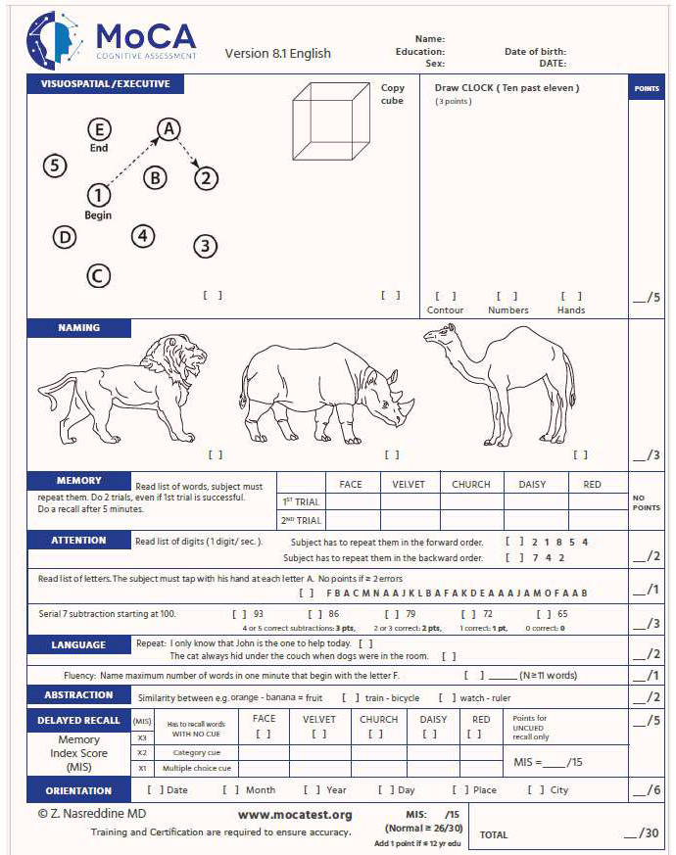
Notes:
Jen

Slide 46
TRIAL MAKING A & B
These two-timed tests examine visuospatial, executive function, attention and speed of mental processing.
Sample Trails A should be completed before the full Trails A test; sample Trails B should be completed before the full Trails B test
Complete Trails A first, then Trails B - not just Trails B
Notes:
Jen
Mostly used to assess for driving – part of fitness to drive
Trails B is task switching look at completion time and number of errors

Slide 47
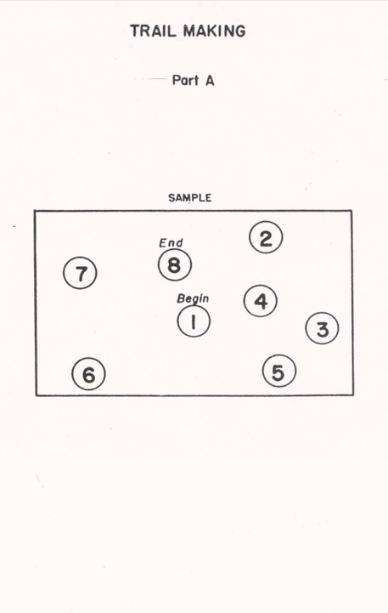
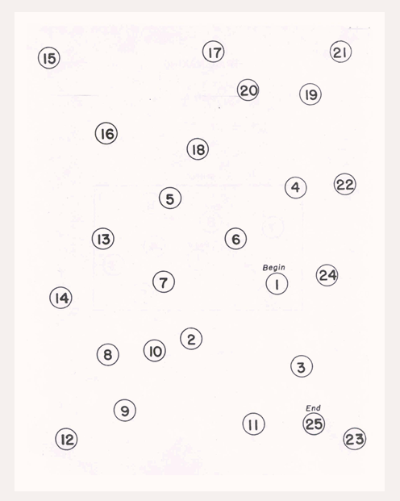
Notes:
Jen
numbers only

Slide 48
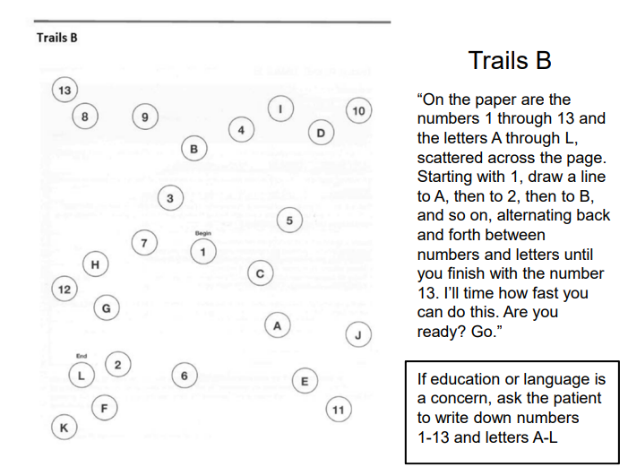
Notes:
Jen
Ascending order alternating between numbers and letters

Slide 49
MEDICAL HISTORY
Identify medical conditions that increase risk of developing dementia and reversible causes of cognitive impairment.
Identify medications or recent changes to medication that might contribute to cognitive impairment.
Notes:
Jen
You want to go over medical history to
Id medical conditions that increase the risk of developing dementia
Id conditions that when treated, can improve cognition
Id medications or recent changes to medication that might contribute to cognitive impairment
Vascular risk factors.
Uncontrolled medical conditions for example CHF, very low blood pressure
Some medications can contribute to cognitive changes – Anticholinergic activity.

Slide 50
INTERVENTIONS
Notes:
Jen (45 min mark – 75 min at the end)

Slide 51
COGNITIVE IMPAIRMENT - INTERVENTIONS
Assess (ABCs – reported by client and collateral and observed, Onset and Progression, Cognitive screening, Medical history, Risk factors)
Refer to appropriate clinicians, teams for further assessment of cognition and medical conditions potentially impacting on cognition depending on your setting for example:
In the community:
      PCP
      GAOT
      Geriatric Day Hospital
      Bruyere Memory Program
      Champlain Primary Care Memory Clinics
      ED
Notes:
Jen
ADLs/IADLs, Behaviour, Cognitive abilities (slide 21)
Because you are working with older adults, you are likely to have clients that are showing signs of cognitive impairment.
It may not be your role to fully assess or develop interventions, but you should know who you can refer to.
In the community…

Slide 52
COGNITIVE IMPAIRMENT - INTERVENTIONS
    In Acute care:
      Treating physician
      Geriatric consult team
      Behaviour management team
      Occupational therapist
      In Long term care:
        Treating physician
        Geriatric Psychiatry Outreach Team
Notes:
Jen
In Acute care…
(LTC...the treating physician may also include NPs, collaborative programs with acute care hospitals. The Geriatric Psychiatry outreach team may also include the Behavioral Support Champions and other LTCH disciplines/programs/committees)

Slide 53
DEMENTIA - INTERVENTIONS
Support services in the community:
  LHIN H&CC
  Community & private support services
  Primary Care Outreach
Safety concerns (driving, medication management, wandering, falls, etc) :
  PCP/ doctor involved
  Family
  Medic Alert – Safely Home Program
  Personal Emergency Alarm System
  GPS systems
  Medication dispensing systems
Notes:
Jen
Persons with dementia have difficulty with function and may need help with IADLs/ADLs:
Foot care
Meals on Wheels
Help with bathing
Housecleaning
When safety becomes an issue, it is important to address this with the client, CGs and PCPs. There are several things that can be put in place to minimize risk.

Slide 54
DEMENTIA - INTERVENTIONS
In-home safety evaluation:
  LHIN H&CC OT
  Private OT
Management of BPSD:
  Geriatric Psychiatry
Client/family education
  Dementia Society/ Alzheimer Society
Notes:
Jen

Slide 55
DEMENTIA - INTERVENTIONS
Respite:
  LHIN H&CC (Home, Short stay, Adult Day Program)
  Retirement home
  Community resource centres
  Private support services
Notes:
Jen

Slide 56
DEMENTIA - INTERVENTIONS
Community exercise program or social activities:
  Dementia Society
  Social clubs/Community Resource Centres
  Adult Day Programs
If the person needs long term care:
  LHIN H&CC
Notes:
Jen

Slide 57
BEHAVIOURAL AND PSYCHOLOGICAL
SYMPTOMS OF DEMENTIA
(BPSD)
Notes:
Lisa
BPSD are non-cognitive symptoms of dementia such as changes to behaviour and mood that frequently occur in all dementias
https://ccsmh.ca/wp-content/uploads/2024/03/V4-CCSMH-BPSD-Clinical-Guidelines_Final-for-webinar.pdf

Slide 58
BPSD: RESPONSIVE BEHAVIOURS
Term now replacing “challenging or aggressive behaviours”
Most behaviours are in response to an unmet need or trigger
Notes:
Lisa - consider mention of GPA training

Slide 59
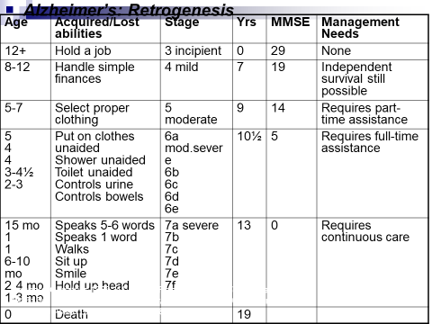
Notes:
Lisa
Retrogenesis theory refers to “the process by which degenerative mechanisms in dementia reverse those of normal human development”

Slide 60
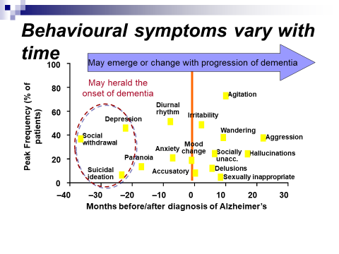
PROGESSION OF BEHAVIOURS
Notes:
Lisa

Slide 61
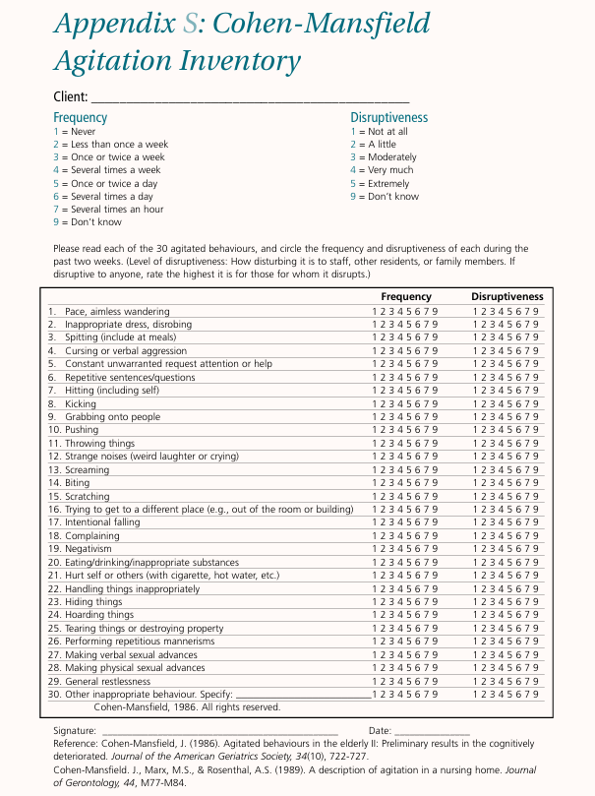
Cohen-Manfield
Agitation Inventory
(CMAI)
Notes:
Lisa
The Cohen-Mansfield Agitation Inventory (CMAI; Cohen-Mansfield, 1986) is a 29-item questionnaire designed to measure the types and frequencies of agitated behaviors exhibited by elderly nursing home residents.

Slide 62
ENHANCING & TRANSLATING KNOWLEDGE
Behavioral Supports Ontario (BSO)
P.I.E.C.E.S. Canada
Regional Geriatric Program of Eastern Ontario (RGPEO)
The Dementia Society of Ottawa and Renfrew County
Alzheimer Society of Ontario
brainXchange
Pharmacological Interventions

Slide 63
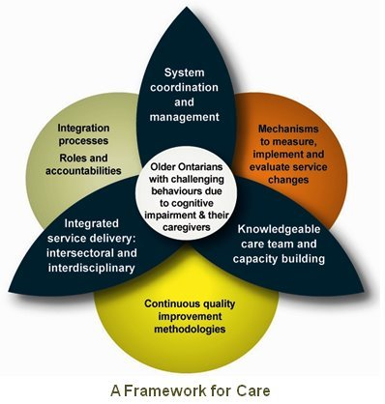
Behavioral Supports Ontario (BSO)
BSO is an initiative to enhance the behavioural support system of care for older adults and their care partners across Ontario who have complex behavioural health need(s): https://www.behaviouralsupportsontario.ca/
The Behavioural Supports Ontario (BSO) Framework is modeled under three provincial pillars:
Pillar 1: System Coordination and Management
Pillar 2: Integrated Service Delivery - Intersectoral and Interdisciplinary
Pillar 3: Knowledgeable Care Team and Capacity Building
Notes:
Lisa to add notes on BSO program

Slide 64
Behavioral Supports Ontario (BSO)
BSO operates under the following seven value-based principles:
1) Behaviour is communication
2) Respect
3) Diversity
4) Collaborative Care
5) Safety
6) System Coordination & Integration
7) Accountability & Sustainability

Slide 65

Behavioral Supports Ontario (BSO)
Shifting focus: a guide to understanding dementia behaviour is available in a short booklet or full guide which can be downloaded and printed at home.
https://brainxchange.ca/Public/Files/Caregiving/Shifting_Focus_Guide_-full_version.aspx

Slide 66
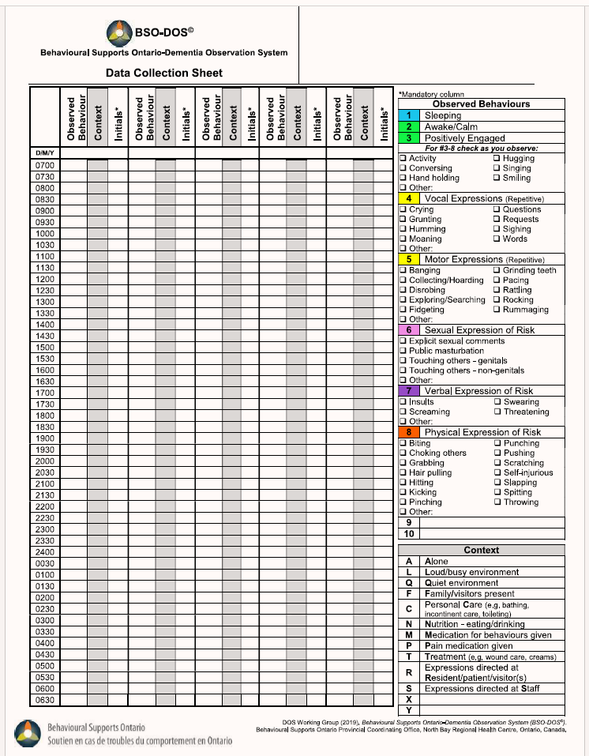
DEMENTIA OBSERVATION SYSTEM
Notes:
Lisa
The BSO-DOS© is an observational tool that helps to identify patterns of behaviour for care planning purposes

Slide 67
P.I.E.C.E.S.
“P.I.E.C.E.S.™ is a holistic, person and care partner-directed model which enhances capacity at the individual, TEAM, organization and system levels to support the care of the older individual living with complex chronic disease, including neurocognitive disorders and/or other mental health needs, and associated behavioural changes.”
All that PIECES encompasses is informed by 4 Foundational Principles - Validating, Shared Solution Finding, Acting Together and Enhancing and Translating Knowledge. https://pieceslearning.com/
Notes:
Lisa

Slide 68
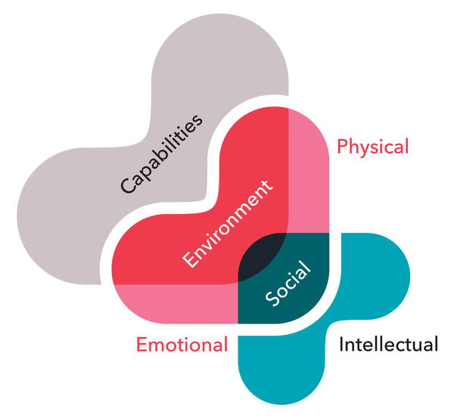
FINDING A SHARED SOLUTION &
ACTING TOGETHER!
“The model provides a shared understanding of the often multiple underlying causes of behavioural expression and associated risks, recognizing areas of need, building on the person’s remaining strengths, and considering the person’s:
Physical
Intellectual
Emotional
Capabilities
Environment
Social
https://pieceslearning.com/
Notes:
Lisa
Physical-Delirium, drugs, disease, discomfort, disability; Optimize physical health - polypharmacy, pain control.
Intellectual-Which of the 8 A’s are at work here?; Compensate for cognitive losses – understand the meaning behind behaviours.
Emotional-Consider the person’s emotional health. Is there a depression or psychosis?; Treat depression, psychosis & agitation.
Capabilities-Which skills are retained? Assess for excess disability; Maximise strengths & compensate for losses.
Environmental-A supportive environment is essential for reducing frustration or fear.; Decrease noise, enhance lighting (day/ night), maintain routines, provide familiar objects.
Social-What is this person’s life story? Who is in their social network? What is their cultural heritage?; Knowing what is familiar and comforting can help staff to reassure and distract when a person is anxious or unsettled.

Slide 69
ASSESSMENT AND INTERVENTION PLANNING
The 3 Questions Template
1. What has changed?
What are the RISKS (roaming, imminent physical harm, suicide ideation, kinship, and self-neglect) and possible causes (PIECES)?
3. What is the action?
Notes:
Lisa
Change: Is the problem/behaviour new?
If the problem/behaviour already existed, is it worse or different in some way?
When did the change emerge?
If the behaviour is longstanding and unchanged, what else could have changed – change of caregivers etc.?
2. Evaluating RISKS helps you determine the urgency of A situation so you can plan care strategies that keep the person and others safe.
*frailty (delirium), falls, fire,
Firearms
**safe driving and substance abuse

Slide 70
Regional Geriatric Program of Eastern Ontario (RGPEO)
RGPEO is a coordinated network that includes a broad range of specialized geriatric services, from hospital to home
Aims to be a leader in the provision of:
  Comprehensive, interdisciplinary geriatric assessment and treatment services in partnership with older adults, their families and the community;
  Education in geriatrics/gerontology to practitioners, students and community members;
  Research into appropriate treatment and service delivery to older adults; evaluation, advocacy and planning in the development of community services which promote older adult health.
Goals: Clinical care, Reseach, Education, Advocacy
Notes:
Lisa
Services for 65 or older
May include:
-inpatient (may be transferred to an in-patient Geriatric Medicine Unit for assessment and treatment. To be transferred to the unit from an in-patient unit the patient is seen in consultation by one of the Geriatric Nurse Specialists and/or Geriatric Physicians. )
-outpatient, community services (referred by their physician or family. Typically, patients are seen in their own home) by a Geri outreach Assessor and referral to Geri day hospital

Slide 71

The Dementia Society of Ottawa and Renfrew County
Goal to provide compassionate support, tailored coaching and practical education for everyone impacted by dementia while building a dementia inclusive community.
https://dementiahelp.ca/

Slide 72

Alzheimer Society of Ontario (ASO)
Founded in 1983, the Alzheimer Society of Ontario (ASO) is the province's leading care and research charity committed to helping people with Alzheimer's disease and other dementias.

Slide 73

brainXchange
Approach: Knowledge transfer and exchange is about accessing existing knowledge (from research, practice and lived experience) and bringing it together so that it can be built upon to create new understanding and ways of doing things. It’s about using knowledge in ways that it can be put into practice to make positive change.
https://brainxchange.ca/

Slide 74
WHEN TO CONSIDER PHARMACOLOGIC TREATMENT OF BPSD
Behavior is dangerous, distressing, disturbing, damaging to social relationships and persistent
AND
Has not responded to comprehensive non-pharmacologic treatment plan. Including removal of possibly offending drugs
OR
Requires emergency treatment to allow proper investigation of underlying problems
Notes:
Lisa

Slide 75
BEHAVIOURS AMENABLE TO PHARMACOTHERAPY
Anxiety: restlessness, hand-wringing, pressured pacing, fidgeting, psychomotor agitation
Sadness: crying, anorexia, terminal insomnia, nihilism, guilt
Withdrawn: apathy, quiet negativity, anorexia, sullenness, uncooperative
Markedly bizarre or regressed behaviour from previous standards
Over-elation
Overly boisterous: verbal hostility, aggressiveness, argumentativeness
Delusions: ideas of reference, paranoia, persecuted, sensory
Hallucinations
Notes:
Lisa

Slide 76
BEHAVIOURS UNLIKELY TO
RESPOND TO MEDICATIONS
Purposeless and repetitive behaviour: motor and verbal
Resistance to care
Sexually inappropriate behaviour
Inappropriate dressing/undressing
Wandering
Exit-seeking
Inappropriate urination/defecation
Repetitive activities (perseveration) or vocalization
Hiding/collecting
Eating inedible items
Pushing wheelchair bound co-residents
Notes:
Lisa

Slide 77
“Medication GUIDELINES”
Document informed consent
  Risk/benefits
  Consequences of not treating
Start low, go slow, and monitor side effects
  ↑sedation
  ↓BP
  gait disturbance
Regularly reassess need for continued use and carefully document
Notes:
Lisa

Slide 78
MULTIDISCIPLINARY SUPPORTS
Occupational Therapists
Physiotherapists
Dieticians
Recreational Therapists
Psychogeriatric Outreach Nurses
Behavioral Supports Ontario Champions
Psychiatrists
Family Physicians
Behavioral Therapists
Spiritual Supports
Notes:
Lisa

Slide 79

DEMENTIA – PEARLS OF WISDOM
Dementia is not:
Normal aging
MCI
Delirium
Depression
Remember your ABCs
Don’t be fooled by a score
Notes:
Jen

Slide 80
DEMENTIA – PEARLS OF WISDOM
Enter into the person’s reality and validate their emotional response.
Where possible accomodate behaviours rather than attempting to extiguish them.
Get to know the person behind the dementia. This will enable caregivers to design interventions specific to that person’s needs.
A consistent approach and schedule is key to accessing procedural memory.
Provide opportunities for the person with dementia to succeed at a task.
Notes:
Jen
Person’s with dementia tend to relate more on a emotional level than they do cognitively.
Behaviours will change over the course of dementia. Trying to reduce behaviours related to dementia can sometimes be harmful. For example wandering poses a risk but when accommodated promotes and maintains physical functioning and may improve sleep. The question should be: “Is there an unmet need?”; “How can we help this person to wander safely?
Understanding who the person was will help caregivers understand which distractions will work when the need to redirect is appropriate. For example: repetitive tasks, wood working, doll therapy, music therapy.
A consistent schedule and approach is like sign posts for persons who are lost and having difficulty knowing what will happen next and what is expected of them.
Establishing rapport and obtaining cooperation is easiest when the person feels a sense of accomplishment. Interactions between people who share mutual respect.

Slide 81
QUESTIONS?
THANK YOU!
Notes:
Jen

Slide 82
lmacdonald@qch.on.ca
https://www.qch.on.ca/
lisa.white@theroyal.ca
https://www.theroyal.ca/
© Regional Geriatric Program of Eastern Ontario
Notes:
Jen
update

Slide 83
RESOURCES
RNAO, Delirium, Dementia, and Depression in Older Adults: Assessment and Care, July 2016
The Merck Manual of Geriatrics, Third Edition, 2000, Chapter 42, pgs 380- 383.
Alzheimer Society of Ottawa (http://alzheimer-ottawa-rc.org)
Alzheimer Society Canada (https://alzheimer.ca)
P.I.E.C.E.S. 7th edition ® - Sept 2020; Hamilton, P., LeClair, J.K., Collins, J., Sturdy-Smith, C., O'Connell, M. (2020). PIECES Resource Guide; Guiding Collaborative Engagement, Shared Assessment and Supportive Care (7th Edition), Canada
Canadian Study of Health and Aging © 2002, www.csha.ca
Mac in Five, Dr. Anthony J. Levinson and Dr. Richard Sztramko, 2019.
http://ww.apa.org/reseach/action/memory-changes.aspxhttp://alumni.mcmaster.ca
National Institute on Aging, www.nia.nih.gov/health/how-aging-brain-affects-thinking
http://www.alz.uci.edu/alzheimers-disease/what-is-alzheimers/mild-cognitive-impairment/
American Psychiatric Association, Mild Neurocognitive Disorder, © 2013 American Psychiatric Association
http://dementianewsforum.com
Tsoi KK et al. Cognitive Tests to Detect Dementia: A Systematic Review and Meta-Analysis. JAMA Internal medicine. 175(9): 1450-1458. 2015
Health Canada: Division of Aging and Senior Derived from Statistics Canada figures
Nasreddine ZS MoCA Montreal Cognitive Assessment. www.mocatest.org
Virginia Bell and David Troxel called “A Dignified Life: The Best Friend’s Approach to Alzheimer’s Care; A Guide for Family Caregivers.”
CANADIAN CHARTER OF RIGHTS FOR PEOPLE WITH DEMENTIA, https://alzheimer.ca/sites/default/files/documents/Canadian-Charter-of-Rights-for-People-with-Dementia_Alzheimer-Society-Canada.pdf
Regional Geriatric Program of Eastern Ontario https://www.rgpeo.com/
The Dementia Society of Ottawa and Renfrew County, https://dementiahelp.ca/
BrainXchange https://brainxchange.ca/
Notes:
Read 1st case study

