Slide 1
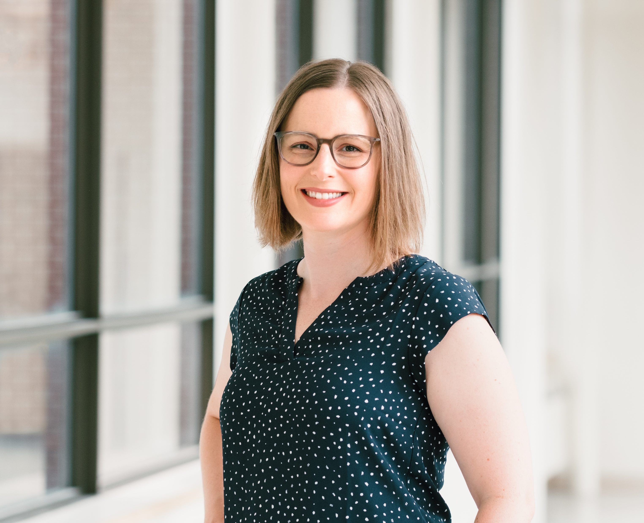
INTRODUCING
Courteney
Munch
Courteney Munch graduated from the University of Ottawa in 2009 with a Bachelor of Science in Nursing, completed her Advanced Studies in Critical Care Nursing Certificate in 2017, and completed her Master of Science in Nursing in 2023. Courteney has worked at The Ottawa Hospital since 2007 in various roles including as a Registered Nurse in Medical Oncology, Intensive Care and Post-Anesthesia Care, as the Nurse Educator in Peri-anesthesia and Intensive Care, a Corporate Nurse Educator within Nursing Professional Practice, and as a Nurse Specialist with the Geriatric Medicine Consult Team (GMCT).
Currently, as the Advanced Practice Nurse for the Geriatric Emergency Management (GEM) team and the Geriatric Medicine Consult Team (GMCT) of the Ottawa Hospital, Courteney shares her knowledge and expertise in the assessment and management of frail older adults across the spectrum of care, leads the GEM and GMCT team members, and supports the Geriatric Medicine team to continue to lead and advocate for exemplary care for older adults.
ADVANCED PRACTICE NURSE
REGIONAL GERIATRIC PROGRAM
OF EASTERN ONTARIO

Slide 2
Introduction to Frailty
Courteney Munch, APN Geriatrics TOH

Slide 3

HEALTHY AGING
Developing and maintaining the functional ability that enables well-being in older age.
Functional ability is:
  - the internal abilities of an individual
  - the environment in which he or she lives
  the interactions among them
Actions to improve healthy ageing (multiple levels, multiple sectors, multiple disciplines):
    to prevent disease
    promote health
    maintain intrinsic capacity and
    enable functional ability
https://www.who.int/publications/m/item/decade-of-healthy-ageing-plan-of-action
Notes:
Healthy ageing can be a reality for all. This will require a shift in focus from considering healthy ageing as the absence of disease to fostering the functional ability that enables older people to be and to do what they value. Actions to improve healthy ageing will be needed at multiple levels and in multiple sectors to prevent disease, promote health, maintain intrinsic capacity and enable functional ability.
Healthy Ageing is developing and maintaining the functional ability that enables well-being in older age. Functional ability is determined by the intrinsic capacity of an individual (i.e. the combination of all the individual’s physical and mental capacities), the environment in which he or she lives (understood in the broadest sense and including physical, social and policy environments) and the interactions among them.
Actions to improve healthy ageing will be needed at multiple levels and in multiple sectors to prevent disease, promote health, maintain intrinsic capacity and enable functional ability.
We can’t do this alone- we are trying to all work together and an interprofessional lens allows us to do just that.
We are all a piece of the puzzle.

Slide 4
HEALTHY AGING
Attitudes and Assumptions: change how we think, feel and act towards age and ageing. Examples:
  - ill health is inevitable
  - intervention is ineffective
  - improved outcomes are not valuable
Ensure that communities foster the abilities of older people
Deliver person-centred integrated care and primary health services responsive to older people
https://www.who.int/publications/m/item/decade-of-healthy-ageing-plan-of-action

Slide 5
HEALTHY AGING PROGRAMS
HEALTHY AGING
GOALS
Primary Prevention
Secondary Prevention
Tertiary Prevention
Prevent disease or disability
Lessen health risks by screening early
Treat or remediate those with diagnosed health conditions
Enhance or maintain wellness
Maintain, improve and/or avoid
Prevent, delay and/or improve progression
https://www.who.int/publications/m/item/decade-of-healthy-ageing-plan-of-action

Slide 6

AGING AT HOME
Most older adults want to remain at home even if their health changes. (Canadian Mortgage and Housing Corporation, 2008).
  Home is where the majority of older adults want to be discharged to following hospitalization. (Popejoy, 2011).
https://www.who.int/publications/m/item/decade-of-healthy-ageing-plan-of-action
Notes:
I am setting the context to support remaining at home….
There are newer stats but due to COVID, they are likely a bit skewed (to the higher end).
Since 2008, the stats have consistently shown that 80-90% of people want to age at home.

Slide 7
THE CLINICAL CONTEXT
Six Dimensions:
Social
Built & Natural Environment
Time & Space
Economic
Socioeconomic & Health
Psychological & Psychosocial
WHAT WE KNOW
Living in their homes
90% still live in their homes
Reported functional limitations
57% of 85+
12% of 65-74
Receiving home care
30% of 75+
50% of 85+ (home care or support from caregivers)
Residential mobility
70% not moved in past five years
Decreases with age
85% less likely to move than 65
FACTORS INFLUENCING THE HOME DECISION
Roy et al., 2018
Notes:
Working in geriatrics, we tend to have a skewed sense of what aging is.
This is less about the numbers---more about what the opposite number means…
These numbers show us what is possible.

Slide 8
SELF-REPORTED
BARRIERS TO AGE IN PLACE
Home Mobility
and Safety
Personal Health
Access to
Community
Services
Home Improvement
and Maintenance
General Home
Safety
Bathroom Safety
Brim, Fromhold, Blaney, 2021
Notes:
•Here is another study that shows self-reported barriers to aging in place.
•PT is a big part of solving these barriers.
•
•Home mobility and safety
•Physical environment – trip hazards, stair safety, lighting, decluttering, front door accessibility and bathroom mobility
•Personal health
•Functional mobility/balance, hearing changes, activity tolerance, bowel and bladder concerns, cognitive changes, access to food and nutrition, counseling and mental health needs, hydration, sleep, vision
•Access to community services
•Exercise programs, day programs, PT, grocery delivery, transportation and medication delivery
•Home improvement and maintenance
•Renovations, repairs, cosmetic and structural damage
•General Home Safety
•Electrical, smoke alarms, carbon monoxide, kitchen safety,
•Bathroom safety
•Safety devices
Again, how can we be part of the solution?
Home mobility and safety
Physical environment – trip hazards, stair safety, lighting, decluttering, front door accessibility and bathroom mobility
Personal health
Functional mobility/balance, hearing changes, activity tolerance, bowel and bladder concerns, cognitive changes, access to food and nutrition, counseling and mental health needs, hydration, sleep, vision
Access to community services
Exercise programs, day programs, PT, grocery delivery, transportation and medication delivery
Home improvement and maintenance
Renovations, repairs, cosmetic and structural damage
General Home Safety
Electircal, smoke alarms, carbon monoxice, kitchen safety,
Bathroom safety
Safety devices

Slide 9
AGING AT HOME - SERVICES
OPTIMIZING HEALTH
SPECIALIZED
GERIATRIC SERVICES
GERIATRIC
MEDICINE
GERIATRIC
PSYCHIATRY
FOR PROFIT
SUPPORT & HEALTH SERVICES
NOT FOR PROFIT
FREE
Notes:
There are 2 groups of services responsible for keeping an older adult at home.
1- optimizing health (SGS)- I will be speaking to this more in detail in a moment
2- support and health services (want to support older adult where they are, don’t always consider reversibility)
Both of these services refer back to one another

Slide 10
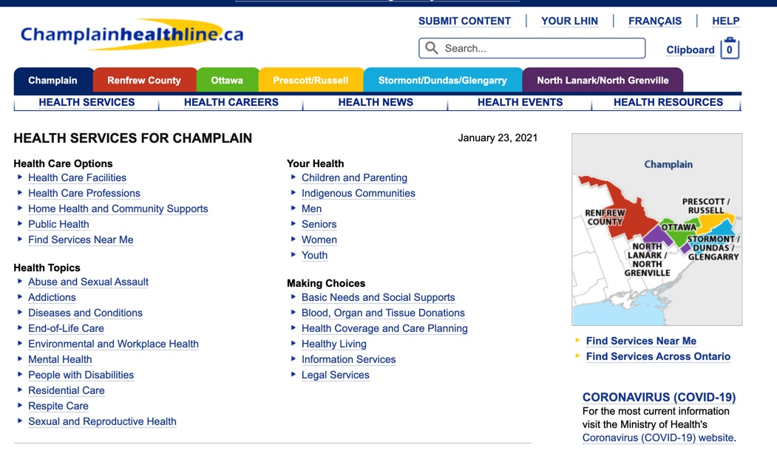
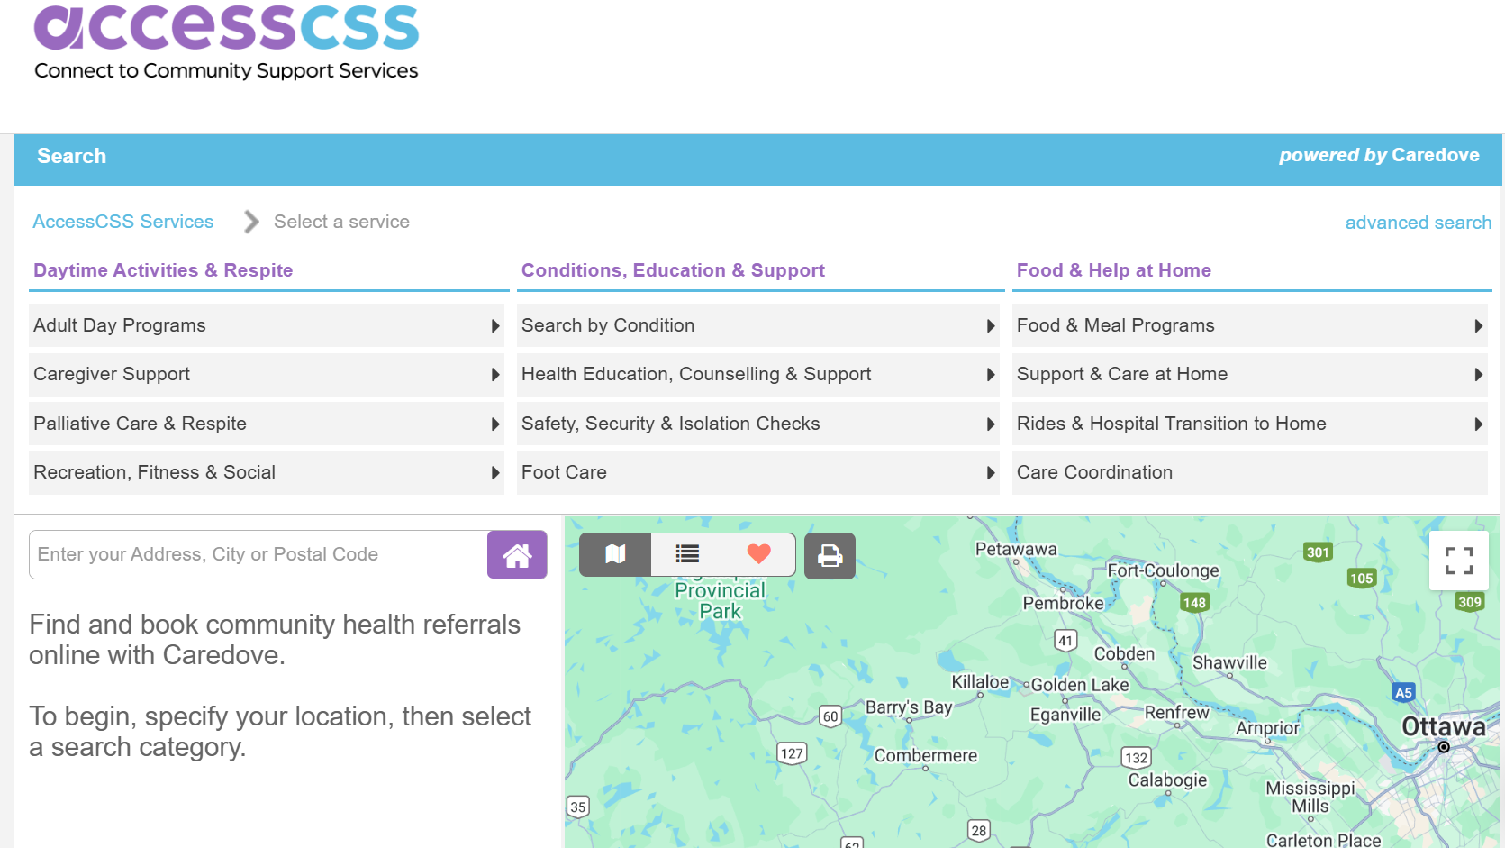
SERVICES AND RESOURCES
www.champlainhealthline.ca; https://www.caredove.com/accesscss

Slide 11
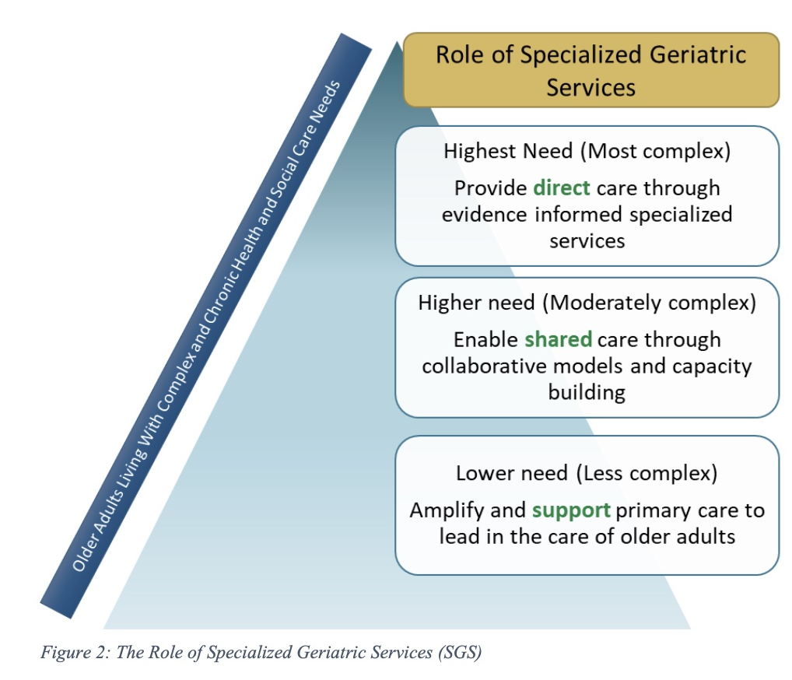
SPECIALIZED GERIATRIC SERVCES

Slide 12
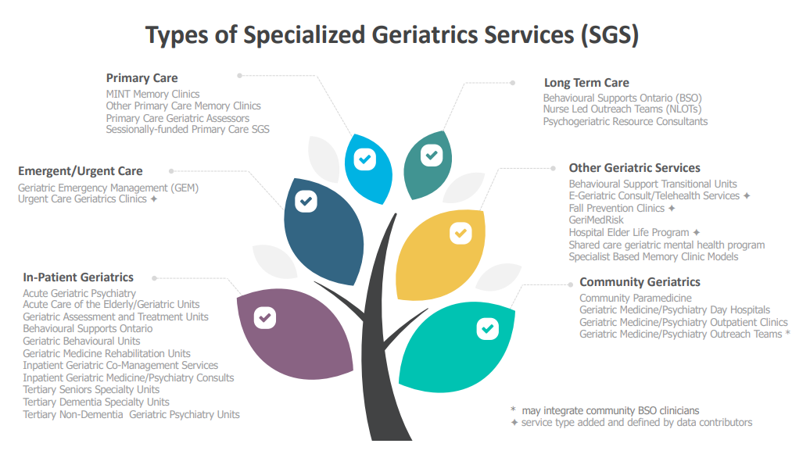
SPECIALIZED GERIATRIC SERVCES
(Kay, Corsi & Morrison, 2021)

Slide 13
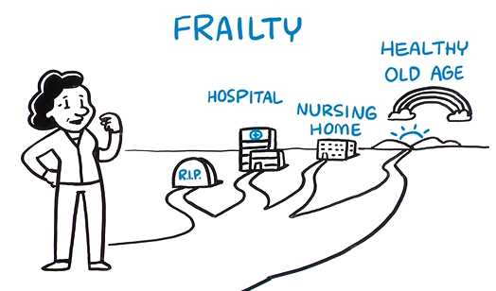
WHAT IS FRAILTY?
Frailty: Every Step you Take Matters
Archibald, Mandy; retrieved from: https://www.youtube.com/watch?v=41cMkvsaOOM&t=22s
Notes:
Variety of definitions
Challenge to define and diagnose
Systematic review highlighted 15 different components
Multiple causes in frailty- physical is only one of them
Where we do get some alignment is that there is some type of vulnerability based on physical, emotional and social factors, there is a general lack of strength, the fail individual may be at more vulnerable to disease and/or diability, may experience a decline in health more quickly and may have more difficulty with recovery

Slide 14
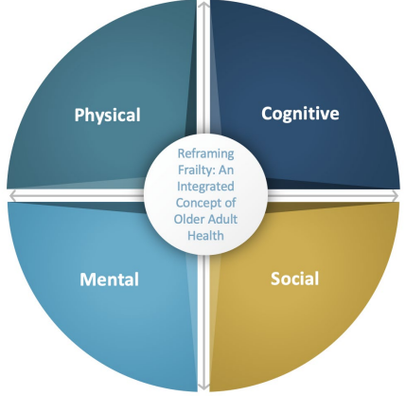
WHAT IS FRAILTY?
Common descriptions:
Vulnerability to physical, emotional and social factors
General lack of strength
More vulnerable to disease and/or disability
⬇ health more quickly / ⬆ difficulty with recovery
Holistic Approach to Frailty for Ontario Health Teams - Provincial Geriatrics Leadership Ontario (rgps.on.ca)
Notes:
Variety of definitions
Challenge to define and diagnose
Systematic review highlighted 15 different components
Multiple causes in frailty- physical is only one of them
Where we do get some alignment is that there is some type of vulnerability based on physical, emotional and social factors, there is a general lack of strength, the fail individual may be at more vulnerable to disease and/or diability, may experience a decline in health more quickly and may have more difficulty with recovery

Slide 15
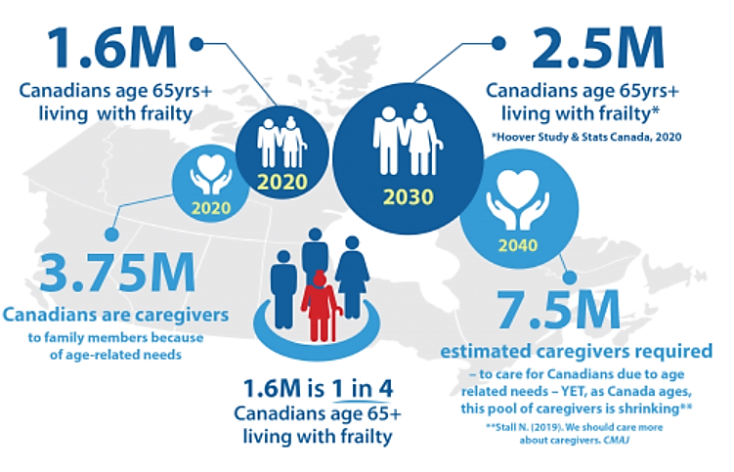
WHAT ARE THE NUMBERS?
Infographic from: https://www.cfn-nce.ca/frailty-matters/
Notes:
By 2030 Projected increase of 56%

Slide 16
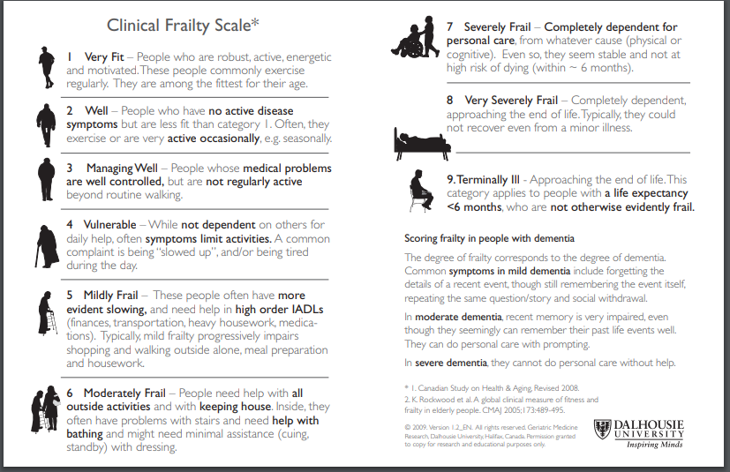
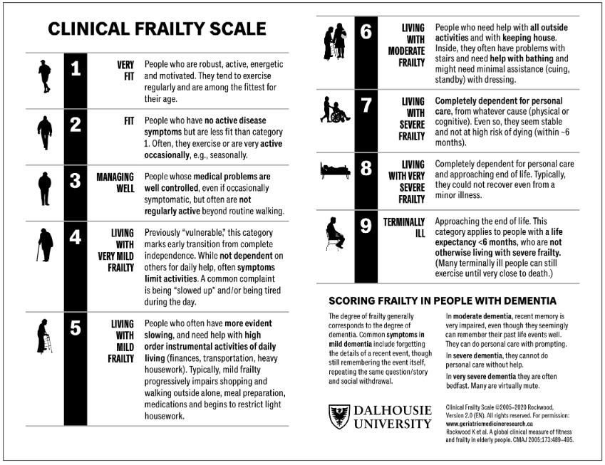
Rockwood et al. 2005-2020
help with ADLS & IADLS
IDENTIFY
difficulty with activities
help with IADLS
Notes:
The CFS focuses on a few items that can be readily observed without special training. The key point is to find out about the person’s baseline health state. This is especially needed in clinical settings where changes in how healthy someone appears can change quickly. For example, when older people are ill enough to come to the Emergency Department, even people who have been fit can appear frail. The baseline health state is what the person was like before they were ill (i.e. two weeks ago). It is hard for someone to get better than they were two weeks before they became ill. Understanding their baseline is essential in planning for their care. If the person themself cannot tell you about their health over the past two weeks, you must speak with someone who can. The more information you have about someone, the better you are able to score them on the scale. That is why it requires talking to someone who knows what the person is usually like. Scoring the CFS requires you to incorporate this information, with what you observe, and with what you know from experience in dealing with older adults. The CFS requires judgment; it’s not a questionnaire in which you write down whatever the patient tells you. If it is not clear to you, ask a colleague whose judgment you trust. The CFS is introduced by saying something like: “I’d like to know about how you are [your dad is] doing overall.” We then ask about four features: how the person moved, functioned, thought and felt about their health over the last two weeks. We can ask about which medications the person uses; experienced clinicians can quickly assay which illnesses are likely present from what medications are being prescribed and/or used. We also ask about how active an individual is. This allows the first thre
Within each level, individuals will vary. About 80% or more of people will fit the description offered for a given level. If they fit two categories equally well, it is best to score the scale at the higher or more dependent level.e levels to be identified.
it’s about the baseline
Is an objective clinical assessment tool – frailty must be sensed, described and measured – not guessed
Note that the CFS is not designed for people whose disabilities reflect single-system problems (e.g. spinal cord injury) or developmental delay, not a gradual accumulation of health deficits with age.

Slide 17
Q&A
Which level on the clinical frailty scale are the clients/patients that you work with?
Put your answers in the chat.

Slide 18
WHY IDENTIFY FRAILTY?
Prevent adverse outcomes
Understand restorative potential
Determine causality
Inform goals of care
NOT to be used to allocate services
Notes:
The CFS focuses on a few items that can be readily observed without special training. The key point is to find out about the person’s baseline health state. This is especially needed in clinical settings where changes in how healthy someone appears can change quickly. For example, when older people are ill enough to come to the Emergency Department, even people who have been fit can appear frail. The baseline health state is what the person was like before they were ill (i.e. two weeks ago). It is hard for someone to get better than they were two weeks before they became ill. Understanding their baseline is essential in planning for their care. If the person themself cannot tell you about their health over the past two weeks, you must speak with someone who can. The more information you have about someone, the better you are able to score them on the scale. That is why it requires talking to someone who knows what the person is usually like. Scoring the CFS requires you to incorporate this information, with what you observe, and with what you know from experience in dealing with older adults. The CFS requires judgment; it’s not a questionnaire in which you write down whatever the patient tells you. If it is not clear to you, ask a colleague whose judgment you trust. The CFS is introduced by saying something like: “I’d like to know about how you are [your dad is] doing overall.” We then ask about four features: how the person moved, functioned, thought and felt about their health over the last two weeks. We can ask about which medications the person uses; experienced clinicians can quickly assay which illnesses are likely present from what medications are being prescribed and/or used. We also ask about how active an individual is. This allows the first thre
Within each level, individuals will vary. About 80% or more of people will fit the description offered for a given level. If they fit two categories equally well, it is best to score the scale at the higher or more dependent level.e levels to be identified.
it’s about the baseline
Is an objective clinical assessment tool – frailty must be sensed, described and measured – not guessed
Note that the CFS is not designed for people whose disabilities reflect single-system problems (e.g. spinal cord injury) or developmental delay, not a gradual accumulation of health deficits with age.

Slide 19
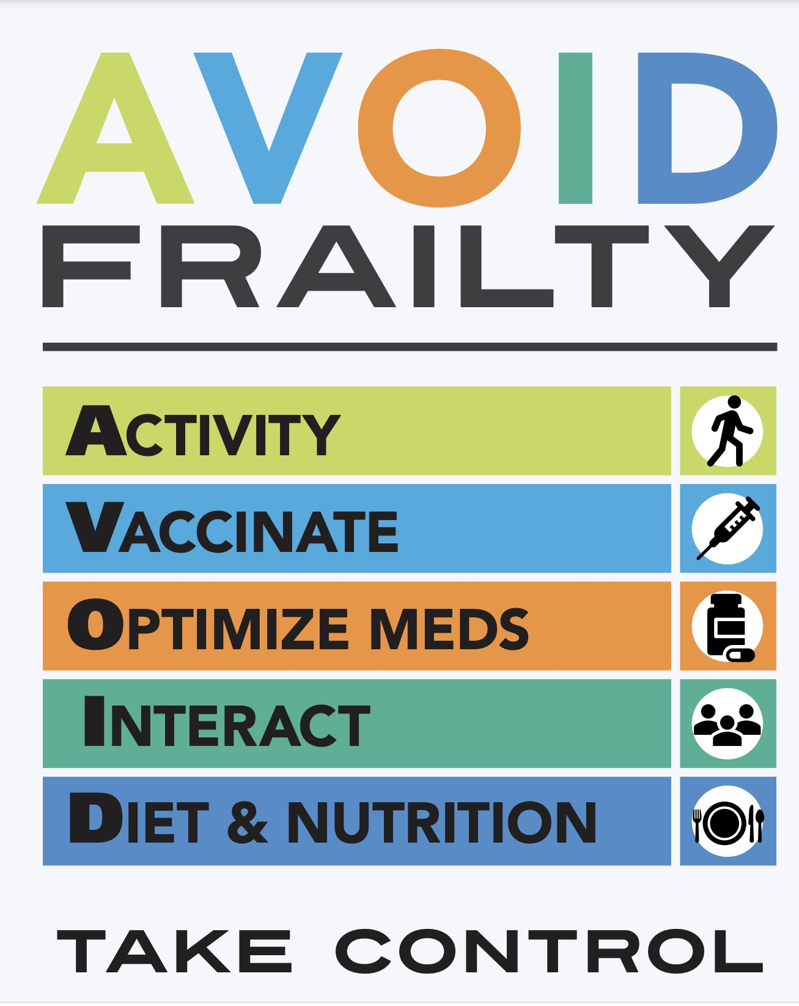

BEST PRACTICE
GUIDELINES
Notes:
These are the drivers of the main causes of frailty.
Main of them fall well-within the scope of practice. PT can play an important role in preventing frailty.
PTs are well-suited to make a big difference and help with healthy aging.
If at the very least, you address---AVOID---you will be touching on most causes of frailty.

Slide 20
BEST PRACTICE GUIDELINES
(McMaster Health Forum, 2016)
PREVENT
FRAILTY
“Use PT and OT to improve strength and function to support older adults to live at home.”
Interventions that encouraged physical activity have positive results.
Decreased rates of hospitalizations and fewer falls.
MANAGE
BURDEN
Make care more integrated and person-centered.
Use team-based models.
Encourage patient decision making.
SUPPORT
CAREGIVER
Address economic security.
Engage caregivers in decision making.
Provide education and support.
Notes:
More best practice guidelines---that show that PT/OT are identified as important roles in prevention of frailty
Manage burden- team-based models…what does that look like in the community? Where services are more fragmented.
Back to our previous discussion about knowing when to pass the baton and to whom?

Slide 21


BEST PRACTICE GUIDELINES
(BGS, 2024)
Older adults should be assessed for the presence of frailty during all encounters with health care.
Many older people with frailty in crisis will manage better in the home environment with appropriate support systems.
Look for a cause if older people with frailty shows a decline in function.
Refer to geriatric medicine and/or geriatric psychiatry.
Recommend or compete a comprehensive geriatric assessment (CGA)
ALL ENCOUNTERS
HOME
ROOT CAUSES
SPECIALIZED GERIATRIC SERVICES
Notes:
More guidelines- from Britain. These were highlighted in the article that was sent to accompany this presentation.
Root causes: that’s why we spoke earlier about the 4 main kinds of causes (physical, mental, cognitive and social)

Slide 22
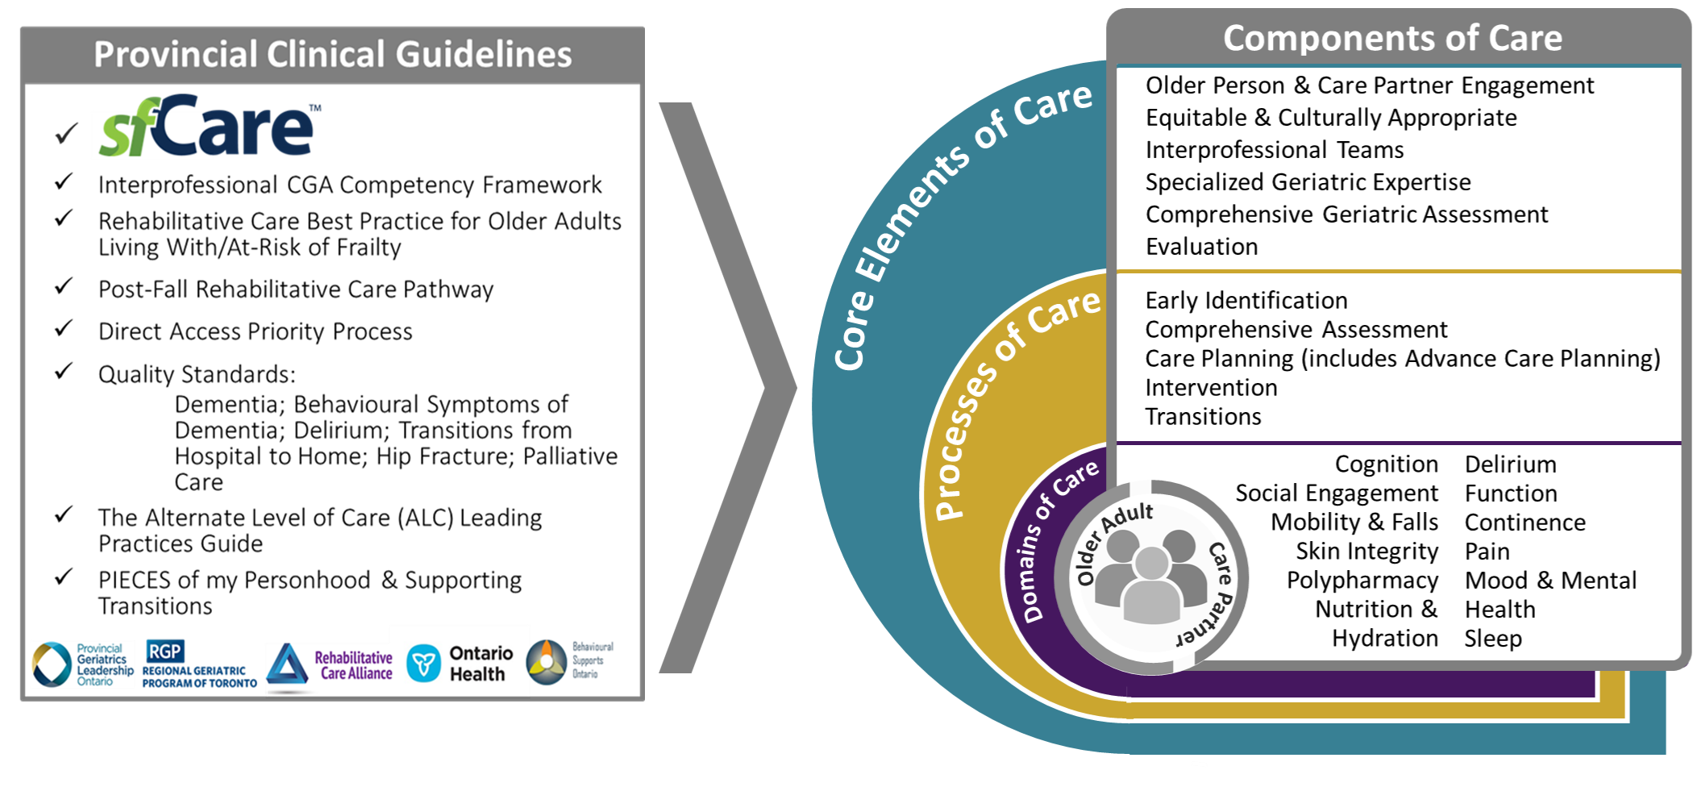

BEST PRACTICE GUIDELINES
Dana Corsi | March 12, 2025
Notes:
population is older adults with complexity/frailty and there is a defined approach to care for that population...

Slide 23
COMPREHENSIVE GERIATRIC ASSESSMENT (CGA)
Holistic approach to a client’s health and functional status (Rosen & Reuben, 2011)
Screening
Screen those at risk
Identify concerns
Assessment
Multi-disciplinary assessment
Diagnostic investigations
Intervention
Goal-based treatment
Follow-up
Recommendations, Monitoring
Re-assessment
System navigation

Slide 24
CGA DOMAINS
Medical
Medical history
Medications
Sleep
Pain
Nutrition
Continence
Social Support
Support
Financial Resources
Safety
Driving
Abuse
Injury
Malnutrition
Medication Mismanagement
Wandering
Functional Status
(ADLS/IADLS/Mobility)
Cognition
Falls
Mental Health
Physical
Environment
Physical Assessment
Vitals – OH
Musculoskeletal
Domains of a Comprehensive Geriatric Assessment (CGA) Kay et al., 2017

Slide 25
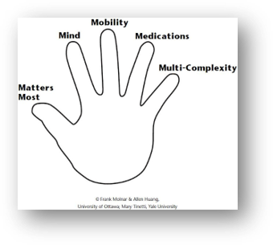
GERIATRIC 5Ms
Mind | Mentation, Dementia, Delirium, Depression
Mobility | Impaired gait and balance Fall injury prevention
Medications | Polypharmacy De-prescribing Optimal prescribing Adverse medication effects and burden
Multi-Complexity | Multi-morbidity Complex bio-psycho-social situations
Matters Most | Each individual’s own meaningful health outcome, goals and care preferences
Tinetti, Huang & Molnar, 2017

Slide 26
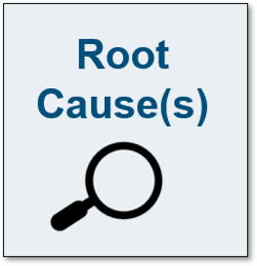
CGA: THE METHOD
Geriatric Concerns:
Falls
Incontinence
Decline in Function
Confusion
Comprehensive Geriatric Assessment
Medical – Physical - Cognitive - Mental - Social - Environmental
Non-Reversible
Reversible
Education Treatment
Adaptation Rehabilitation
Support Service
Notes:
Improves diagnostic accuracy
Optimizes care plans
Improves patient outcomes
Increased function, independence, quality of life
Decreased mortality
Decreased falls
Increased chance of remaining at home
Improves system outcomes
Prevention of avoidable ED use, hospitalization, ALC, premature institutionalization
Improved clinical efficiencies in acute care
Enabler of care coordination

Slide 27


CGA: THE APPROACH
Baseline
Uncovering the why
Weighing the facts
Impact on function

Slide 28
UNCOVERING THE WHY
What is(are) the problem(s)?
Ex. Falls, decline in function, confusion, etc.
Who has the problem?
Client, family, health practitioner, geriatric assessor
Is this New and Different?
Onset – When did this start?
Progression - What is the trajectory?
Ex. Improving, declining, stable
What is the cause of the problem?
Medical, Physical, Cognitive, Mental
What needs to be done about it?
Diagnose/Optimize/Treat/Support

Slide 29
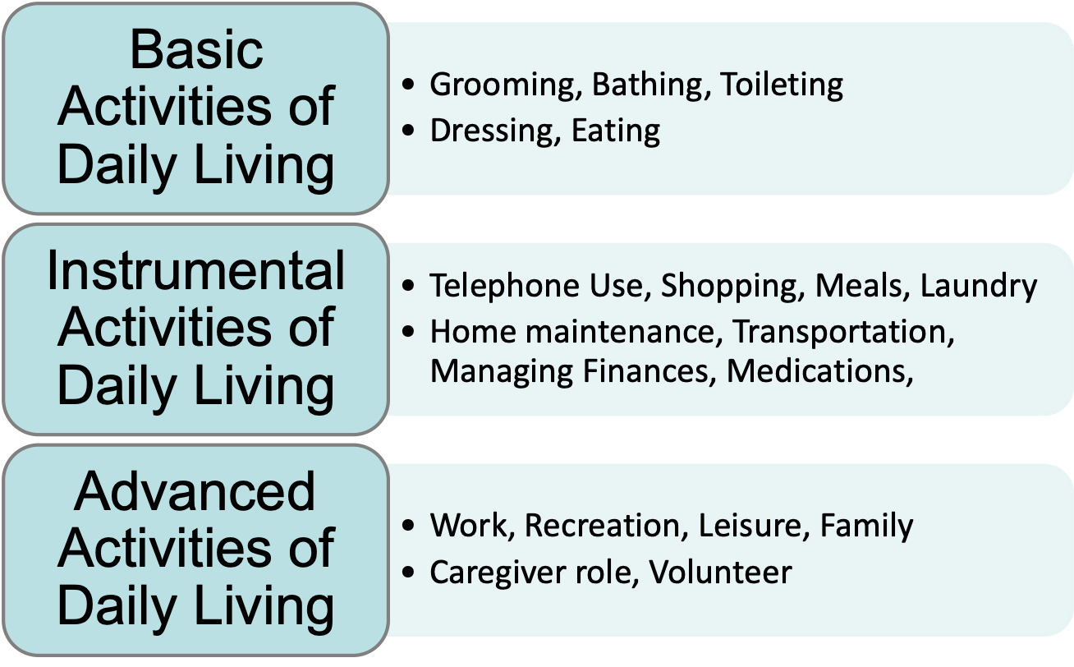
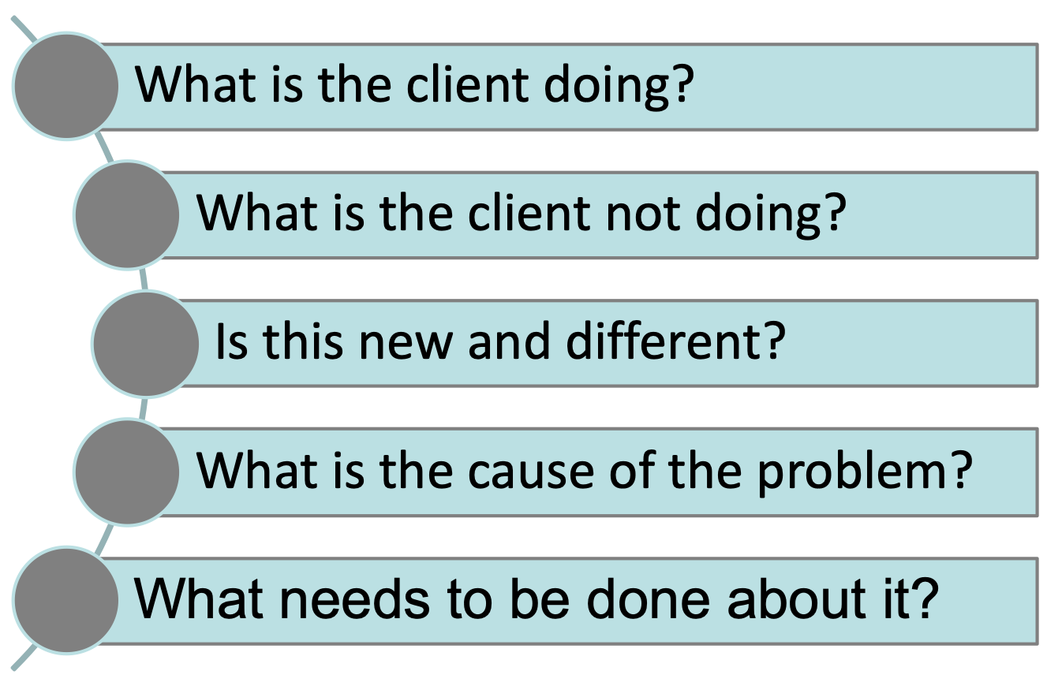
IMPACT ON FUNCTION
1
2
3
4
5

Slide 30
WEIGHING THE FACTS
Subjective self-report
By client
Subjective collateral
By family
By other health practitioners
Objective
Standardized testing
Observations
Home environment
Integration
Gathering data comprehensively
Impact on function and safety

Slide 31


CGA CLINICAL SCENARIO
Assessment of Home Environment:
    Overgrown tree branches and bushes by front door
    Screen door propped open with glass shards
    Lives alone in a dirty, neglected, cluttered multi-level home
      Carpets soiled, stacks of papers, egg cartons,
      Cracks in walls, cobwebs, musty smell
    Little food in fridge
84 –year-old
PCP referred
Increasing concerns re: balance
Baseline Function
Notes:
Primary Care Physician submitted a referral for an 84-year-old due to increasing concerns regarding balance.
Assessment of Home Environment:
Overgrown tree branches and bushes by front door
Screen door propped open with glass shards
Lives alone in a dirty, neglected, cluttered multi-level home
Carpets soiled, stacks of papers, egg cartons,
Cracks in walls, cobwebs, musty smell
Little food in fridge

Slide 32

ARE YOU CONCERNED?
Baseline Function

Slide 33
ASSESSMENT
Falls
None reported in last year
Mobility
Walked unsupported with a wide based gait
Balance
Functional static and dynamic balance
Swam 3 x weekly
Lifted weights 3x weekly
Function
Cognition
  Independent in ADLS and IADLS
  26/30 on the MoCA (3/5 recall, 0/1 word fluency, 4/5 visuospatial)
  24/30 on MoCA in 2008 – suspected depression
  Positive family history of memory loss
Collateral
  CEO multi-national company
  Home environment x 30 years
IS THIS NEW AND DIFFERENT?
Notes:
Mobility- “that’s surprising”, would never have guessed that
MoCA: no real pattern.
If something organic, we would have suspected decline
Positive family history- maybe there is something going on
CEO multi-national company- maybe we would have expected 30/30 MoCA
At the end of the day, this is a good example of someone making lifestyle choices

Slide 34
SPECIALIZED GERIATRIC SERVICES
Benefits for the client:
OPTIMIZING HEALTH AND FUNCTION
Multidisciplinary assessment and treatment
OPTIMIZING HEALTH
Supporting aging in place
OPTIMIZING SUPPORT
System navigation
Providing diagnoses
Optimizing reversibility
Ensuring the right program at the right time for the right reasons,
Avoiding duplication
Baseline Function
Notes:
Optimizing health and function
Accessing multidisciplinary assessment and treatment
Providing diagnoses
Optimizing reversibility
Optimizing Safety
To support their goal of aging in place
Optimizing Support
System navigation within Specialized Geriatric Services and Community Support Services
Ensuring the right program at the right time for the right reasons, avoiding duplication

Slide 35
CGA: ALONG THE CONTINUUM OF CARE
SPECIALIZED GERIATRIC SERVICES
Home
Geriatric Assessment Outreach Teams
Community
Geriatrician Clinics
Geriatric Day Hospitals
Emergency Department
Geriatric Emergency Management Programs (GEM)
Hospital
Geriatric Consultations
Inpt Geriatric Assessment Units
Inpt Geriatric Rehabilitation Program
Baseline Function

Slide 36
SPECIALIZED GERIATRIC SERVICES – Ottawa
How to refer to the community services?
Geriatric
Medicine
Central Intake for Specialized Geriatric Services
613-761-4145
Specialized Geriatric Services
Geriatric
Psychiatry
Geriatric Psychiatry - Central Intake
613-562-9777
Baseline Function

Slide 37
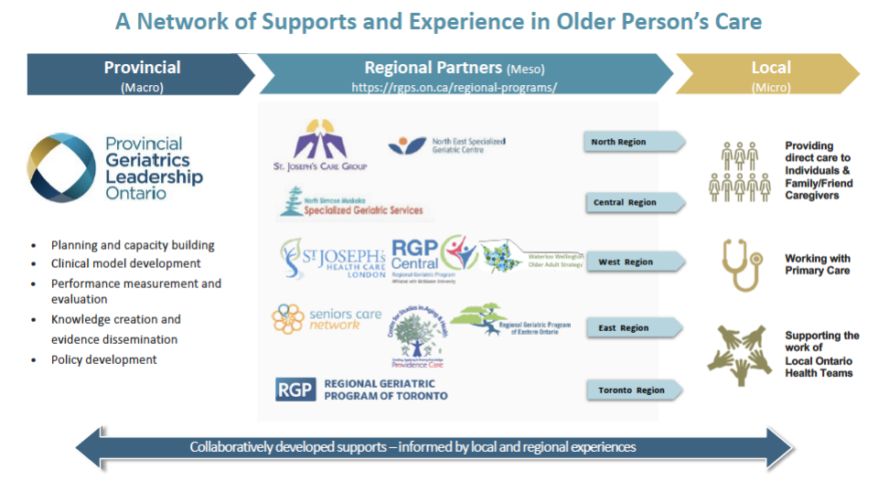
GERIATRICS LEADERSHIP ONTARIO
Baseline Function
(Kay, Corsi & Morrison, 2021)
Notes:
The Ministry of Health acknowledged the importance of providing interprofessional care to frail older adults by organizing specialized geriatric services within Regional Geriatric Programs.
Ensuring that care is providing in a wholisitc way with regards to assessment and treatment.
But also reinforcing the importance of supporting a collaborative approach to care

Slide 38
SPECIALIZED GERIATRIC SERVICES – Champlain LHIN
In-Home Geriatric Assessment:
  GAOT: City of Ottawa
  HCC: Geriatric Assessors: Eastern Counties &
  Renfrew County
Geriatric Assessment In the ED: GEM
  The Ottawa Hospital (General & Civic Campus)
  Hôpital Montfort
  Queensway-Carleton Hospital
  Pembroke General Hospital
  Renfrew Victoria Hospital
  Arnprior and District Memorial Hospital
  Cornwall Community Hospital
  Hawkesbury General Hospital
Geriatrician Clinics:
  Winchester Hospital
  Cornwall Hospital
  Renfrew Hospital
  Arnprior Hospital
  Pembroke Hospital
  Hawkesbury Hospital
  Hôpital Montfort
Baseline Function

Slide 39
SPECIALIZED GERIATRIC SERVICES – Champlain LHIN
Geriatric Mental Health:
  Geriatric Psychiatry Community Services of Ottawa – Bruyere
    Consultation/in-home case management
  Geriatric Psychiatry: Royal Ottawa Mental Health Centre
    Consultations/Ambulatory Clinic/Day Hospital/LTC
  Renfrew County Mental Health (Renfrew, Pembroke, Arnprior)
  Lanark County Mental health (Almonte, Carleton Place, Perth)
  Cornwall Community Hospital Psychogeriatric Services (Winchester, Cornwall, Alexandria)
  Brockville Mental Health (Kemptville, Prescott, Brockville)
Memory Clinics:
  Bruyere Memory Program
  Primary Care Collaborative Memory Clinics

Slide 40
SPECIALIZED GERIATRIC SERVICES – Champlain LHIN
Geriatric Day Hospitals:
  Geriatric Medicine Clinics – Civic Campus, The Ottawa Hospital
  Geriatric Day Hospital - Bruyere Continuing Care
  Geriatric Day Hospital – Queensway-Carleton Hospital
  Geriatric Day Hospital – Cornwall Community Hospital
  Almonte General Day Hospital
  Renfrew County/Pembroke Mobile Geriatric Day Hospital

Slide 41
cmunch@toh.ca
rgpeo.com

Slide 42
RESOURCES
Marsh, P., & Kelly, L. (2018). Dignity of risk in the community: a review of and reflections on the literature. Health, Risk & Society, 20(5-6), 297-311.
McDermott, S. (2010). Professional judgments of risk and capacity in situations of self-neglect among older people. Ageing & Society, 30, 1055-1072.
Ottawa Public Health (2010). The burden of injury in Ottawa, 2010. Ottawa: Ottawa Public Health.
Oxford Dictionary retrieved from https://en.oxforddictionaries.com/definition/risk on October 12th, 2016
Popejoy, L. L. (2011). Complexity of family caregiving and discharge planning. J Fam Nurs, 17(1), 61- 81. doi:10.1177/1074840710394855
Purdy, G. (2010). ISO 31000:2009 Setting a new standard for risk management. Risk Analysis, 30(6), 881-892. Doi:10.1111/j.1539-6924.2010.01442.x
Resnick, B. (2014). Resilience in Older Adults. Topics in Geriatric Rehabilitation, 30(3),155-163.
Skeleton, F., Kunik, M., Regev, T. & Naik, A. (2010). Determining if an older adult can make and execute decisions to life safely at home: A capacity assessment and intervention model. Archives of Gerontology and Geriatrics, 50, 300-305.
Titterton, M. (2005). Risk and risk taking in health and social welfare. London: Jessica Kingsley Publishers.
United Kingdom Department of Health. (2007). Independence, choice and risk: a guide to best practice in supported decision making. van Loon, J. (2002). Risk and technological culture: Towards a sociology of virulence. Oxon: Routledge.
Yardley, L. ,Donovan-Hall, M., Francis, K., and Todd, C. (2006). Older people’s views of advice about falls prevention: a qualitative study. Health Education Research, 21(4), 508-517.

Slide 43
RESOURCES
McMaster Health Forum. (2016). Evidence brief: Strengthening care for frail older adults in Canada. Obtained from: https://www.mcmasterforum.org/find-evidence/products/project/strengthening-care-for-frail-older-adults-in-canada
Muscedere, J.; Barrie, C.; Chan, K.; Cooper, B.; Critchley, K.; Kim, P.; Lorbergs, A.; Mackenzie, I.; Martineau, C.; Noseworthy, T.; O’Neil, M.; Resin, J.; Sinha, S.; Williams, R. Frailty and Aging: How the Danish Experience Might Inform Canada. Healthcare quarterly (Toronto, Ont.) 2019, 22 (1), 14–21. https://doi.org/10.12927/hcq.2019.25841.
National Health Serivce (NHS), 2018. Frailty: A framework of care capabilities. NHS England and Skills for Health.
Popejoy, L. L. (2011). Complexity of family caregiving and discharge planning. J Fam Nurs, 17(1), 61-81. doi:10.1177/1074840710394855
Regional Geriatric Programs of Ontario: https://www.rgps.on.ca/
Rosen, S.L., & Reuben, D.B. (2011). Geriatric assessment tools. Mount Sinai Journal of Medicine, 78, 489-497.
Rockwood, K., Song, X., MacKnight, C., Bergman, H., Hogan, D.B., McDowell, I., & Mitnitski, A. (2005). A global clinical measure of fitness and frailty in elderly people. Canadian Medical Journal, 173(5)
Roy, N., Dubé, R., Després, C., Freitas, A., & Légaré, F. (2018). Choosing between staying at home or moving: A systematic review of factors influencing housing decisions among frail older adults. PloS One, 13(1), e0189266–e0189266. https://doi.org/10.1371/journal.pone.0189266
Tinetti, M., Huang, A., & Molnar, F. (2017). The geriatrics 5M’s: A new way of communicating what we do. Journal of the American Geriatrics Society, 65(9), 2115.

Slide 44
HEALTHY AGING
Actions to improve healthy ageing
  - multiple levels, multiple sectors, multiple disciplines
    to prevent disease
    promote health
    maintain intrinsic capacity and
    enable functional ability
https://www.who.int/publications/m/item/decade-of-healthy-ageing-plan-of-action
Notes:
Actions to improve healthy ageing will be needed at multiple levels and in multiple sectors to prevent disease, promote health, maintain intrinsic capacity and enable functional ability.
We can’t do this alone- we are trying to all work together and an interprofessional lens allows us to do just that.
We are all a piece of the puzzle.

Slide 45
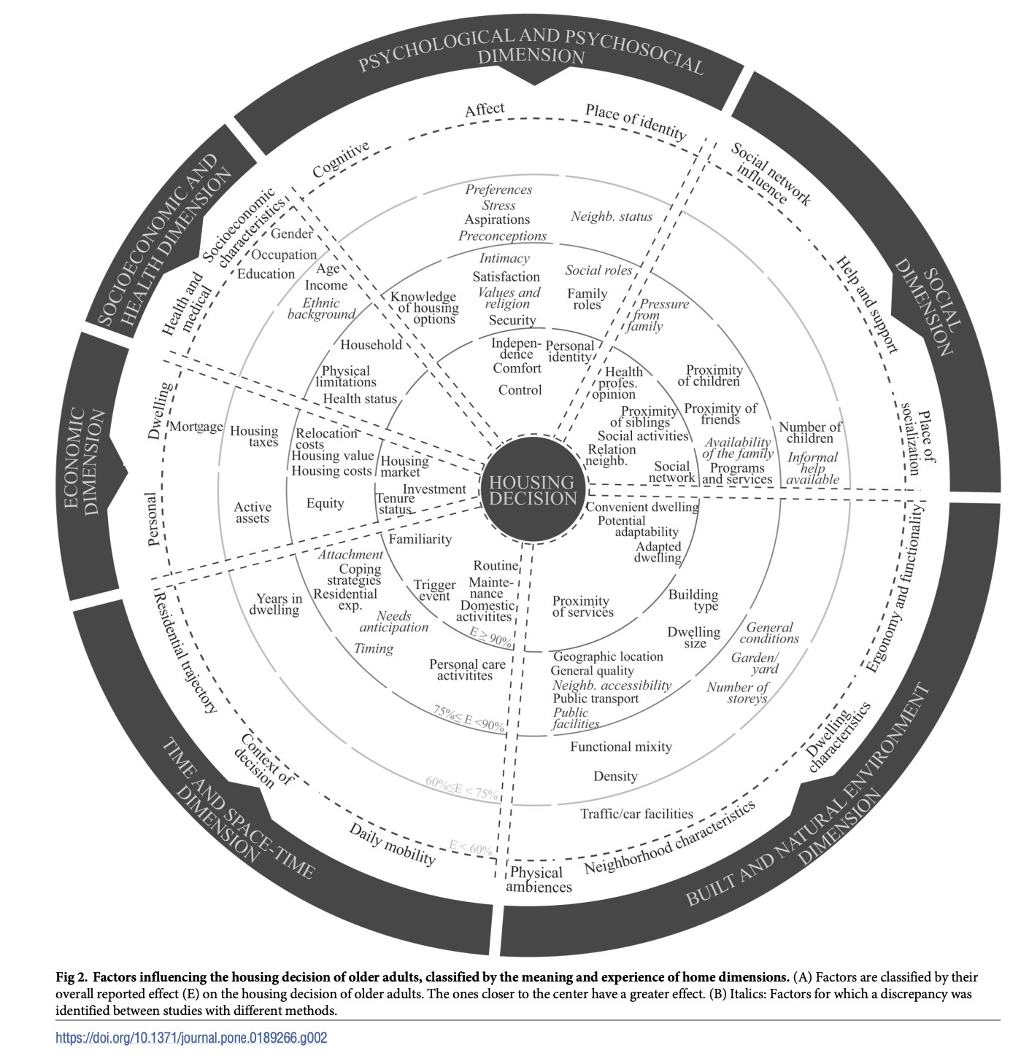
FACTORS INFLUENCING THE HOME DECISION
Six Dimensions
Social
Built & Natural Environment
Time & Space
Economic
Socioeconomic & Health
Psychological & Psychosocial
Roy et al., 2018
Notes:
These are the factors that influence that home decision. There are 88 factors divided into 6 dimentions.
At the end of the day, when we are asked by colleagues to weigh in on “can a patient be discharged home safely?”---there are really only 2 of these that we can comment on.
The home decision is complex!
Combine with prev slide?

Slide 46
INTERPROFESSIONAL CARE
The importance of all disciplines in preventing, delaying, improving frailty
  Quality of life, remaining at home, function, ⬇injury
Co-existing and intersecting journey of
  Frailty
  Cognitive decline
  Mobility changes
  Sensory impairments
How can you inform each other – whether as an individual or as a team? During assessments, treatments. What are you seeing?
Notes:
Sum up this very quick overview on frailty about the importance of interprofessional care in the management of frailty,
Whether you already work as a multidisciplinary team or whether you work as an individual
There is the need to collaborate not only across disciplines but also across programs and services
The main takeaway from this talk is
How can we all collaborate better? To prevent, delay and improve frailty because when we can we can
Improve quality of life
Increase the length of time older adults can remain at home
Improve function
Decrease injury and harm

Slide 47
INTERPROFESSIONAL CARE
  “I find that the biggest benefit is the constant learning from each other. Being an interprofessional team allows you to share your expertise and broaden your knowledge of health and wellness.”
  “I like working on interdisciplinary teams because each team member wears their own “hat” and brings a different lens to the situation, really helps with my learning and developing my clinical reasoning.”
Notes:
Not only does interprofessional care improve outcomes for clients and patients but it improves outcomes for clinicians
- As these clinicians indicated….it broadens our knowledge and develops and enhances our clinical reasoning

Slide 48


COMMON MISPERCPTIONS…
“What do you expect, my mom is 82…”

Slide 49
COMMON MISPERCPTIONS …
  Have we given up on our older adult clients/patients?
  Is there always something that can be recommended
    Optimizing health
    Optimizing the client’s environments
    Optimizing support
OR
Notes:
I have compiled three common perspectives that we hear when working with frail older adults.
I invite you to consider these perspectives and consider rather than these perspectives being dismissive – are they instead opportunities to improve the client’s situation
We often hear health care professionals describe the client’s family as ‘dysfunctional’ – are they dysfunctional or are they a family that is functioning in the only way they know how?
With the stress and the strain

Slide 50
COMMON MISPERCPTIONS…
“This client’s family is dysfunctional”

Slide 51
COMMON MISPERCPTIONS…
  Is it really that a family functions in the only way they know how?
  Who is the client?
    often interventions need to be aimed at not only the individual, their spouse and sometimes the family members
OR

Slide 52
COMMON MISPERCPTIONS …
“This client was
non-compliant with the recommendations…”

Slide 53
COMMON MISPERCEPTIONS…
OR
  Did the clinician not prescribe, recommend, or suggest a meaningful/relevant/realistic option
    Know what is important for your clients
    Think shared decision making model
    Know behaviour change models
    Learn motivational interviewing techniques

Slide 54

COMMON MISPERCEPTIONS …
Behaviour Change Theory – i.e. COM-B
Ie. Adaptive Aids
Capacity
Opportunity
Behaviour
Motivation
Knowledge
&
Skill

Slide 55
WHY INVEST IN THE COMMUNITY​
Denmark Model of Care
  Similar amount of spending on health care
  Slightly higher % of 65+
  Greater emphasis on community upstream solutions
    Flipped dollars from beds to care in the community
    Five years reduced hospital LOS by 22%
    No new number of LTC beds in 30 years
    3.4 % of people in LTC vs 7% in Canada
Muscedere et al., 2019

Slide 56
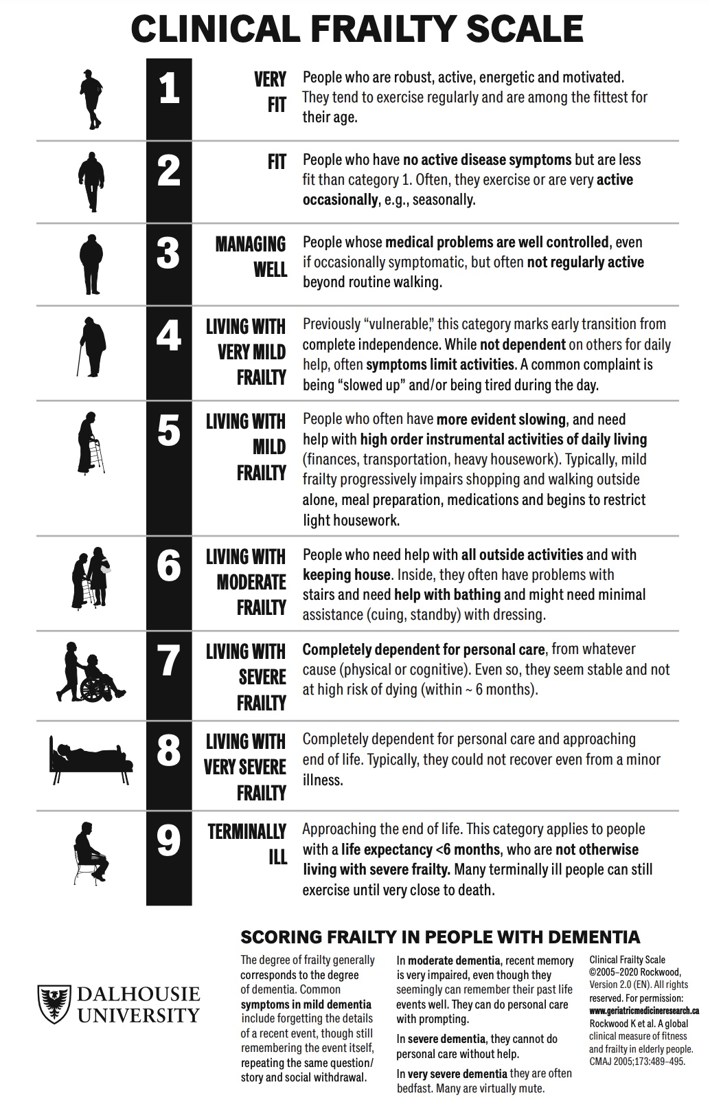
Rockwood et al. 2005
IDENTIFY
difficulty with activities
help with IADLS
help with ADLS & IADLS
Notes:
The CFS focuses on a few items that can be readily observed without special training. The key point is to find out about the person’s baseline health state. This is especially needed in clinical settings where changes in how healthy someone appears can change quickly. For example, when older people are ill enough to come to the Emergency Department, even people who have been fit can appear frail. The baseline health state is what the person was like before they were ill (i.e. two weeks ago). It is hard for someone to get better than they were two weeks before they became ill. Understanding their baseline is essential in planning for their care. If the person themself cannot tell you about their health over the past two weeks, you must speak with someone who can. The more information you have about someone, the better you are able to score them on the scale. That is why it requires talking to someone who knows what the person is usually like. Scoring the CFS requires you to incorporate this information, with what you observe, and with what you know from experience in dealing with older adults. The CFS requires judgment; it’s not a questionnaire in which you write down whatever the patient tells you. If it is not clear to you, ask a colleague whose judgment you trust. The CFS is introduced by saying something like: “I’d like to know about how you are [your dad is] doing overall.” We then ask about four features: how the person moved, functioned, thought and felt about their health over the last two weeks. We can ask about which medications the person uses; experienced clinicians can quickly assay which illnesses are likely present from what medications are being prescribed and/or used. We also ask about how active an individual is. This allows the first thre
Within each level, individuals will vary. About 80% or more of people will fit the description offered for a given level. If they fit two categories equally well, it is best to score the scale at the higher or more dependent level.e levels to be identified.
it’s about the baseline
Is an objective clinical assessment tool – frailty must be sensed, described and measured – not guessed
Note that the CFS is not designed for people whose disabilities reflect single-system problems (e.g. spinal cord injury) or developmental delay, not a gradual accumulation of health deficits with age.

Slide 57
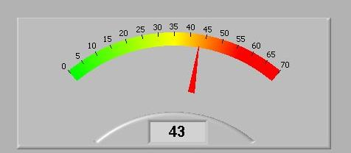
INTERVENE
difficulty with activities
help with IADLS
This Photo by Unknown Author is licensed under CC BY-SA
help with ADLS & IADLS
Quality of life

Slide 58
CGA: THE GOLD STANDARD OF CARE
Improves diagnostic accuracy
Optimizes care plans
Improves patient outcomes
Improves system outcomes
www.rgps.on.ca
Notes:
Improves diagnostic accuracy
Optimizes care plans
Improves patient outcomes
Increased function, independence, quality of life
Decreased mortality
Decreased falls
Increased chance of remaining at home
Improves system outcomes
Prevention of avoidable ED use, hospitalization, ALC, premature institutionalization
Improved clinical efficiencies in acute care
Enabler of care coordination

