Slide 1

INTRODUCING
Ioanna
Genovezos
Ioanna has worked at The Ottawa Hospital since 1999, primarily in the Emergency Department. Ioanna spent 12 years a nurse educator providing education and support to TOH nurses within the Emergency, Internal Medicine and Geriatrics.
Currently, as the program manager for the RGPEO, Ioanna leads and supports the Geriatric Assessment Outreach Team and Central Intake for Specialized Geriatric Services (Geriatric Medicine). Ioanna also supports many geriatric initiatives and advocates for improved assessment and management of older adults in the community. Her primary interest is in disseminating geriatric knowledge and developing new standards to enhance geriatric care.
PROGRAM MANAGER
REGIONAL GERIATRIC PROGRAM
OF EASTERN ONTARIO

Slide 2

DELIRIUM​
Prevent-Assess-Manage​
Ioanna Genovezos ​
Program Manager ​
Regional Geriatric Program of Eastern Ontario
​

Slide 3
ACKNOWLEDGEMENT
This presentation has been adapted from the October 2018 Delirium: Prevent-Assess-Manage from Laura Wilding used for the RGPEO Geriatric Education Series (N.D. origin version)
© 2024 Regional Geriatric Program of Eastern Ontario

Slide 4

LEARNING OBJECTIVES
Define delirium & understand relevance to care​
Discuss prevention strategies​
Provide an overview of delirium assessment ​
History​
Confusion Assessment Method (CAM)​
Review approach to management​
Discuss resources

Slide 5

DELIRIUM
Definition:
  A disturbance of consciousness with inattention that develops over a short time & fluctuates
Photo by Jon Tyson on Unsplash​

Slide 6

DELIRIUM
What is Delirium?
A sudden change in the way a person thinks or acts.​
An acute confusional state​
It’s an emergent medical condition.
  Photo by Jeremy Thomas on Unsplash​

Slide 7
FIVE KEY COMPONENTS
Disturbance in attention​
Change in cognition​
Acute onset & fluctuating course​
Not caused by a pre-existing established or evolving neurocognitive disorder​
Caused by direct physiological consequence of a general medical condition, an intoxicating substance, medication use or multiple etiologies
The Diagnostic and Statistical Manual of Mental Disorders, Fifth Edition (DSM-5), 2013 ​

Slide 8
MAY ALSO INCLUDE
Behavioural symptoms​
Agitation – aggressive or non-aggressive​
Depression or euphoria​
Sensitivity to light & sound​
Sleep/wake disturbances​
Functional symptoms​
Incontinence​
Falls
Autonomic Symptoms​
​Hypertension​
Tachycardia

Slide 9
TYPES OF DELIRIUM
Hyperactive​
Hypoactive​
Mixed
© Regional Geriatric Program of Eastern Ontario

Slide 10
PATHOPHYSIOLOGY
Mechanism poorly understood​
Signs & symptoms are manifestations of neuronal dysfunction in cortex & reticular activating system​
Possible contributors:​
  Neurotransmitter dysfunction​
  Physiologic response to the inflammatory or stress reaction​
  Abnormal signal conduction

Slide 11
DELIRIUM LITERATURE
Inouye, S., et al.(1990). Clarifying confusion: The Confusion Assessment Method, a new method for detecting Delirium.
Annals of Medicine, 32, 257 - 263.
    Common​
    Under recognized​
    Poor outcomes

Slide 12
SILENT
A number of health conditions—including neurocognitive, mood, anxiety, and psychotic disorders—may mimic delirium and cause it to be overlooked or misdiagnosed.
Distinguishing between these disorders can be especially difficult when people do not have family or caregivers available to provide knowledge of the person’s baseline mental status and when the changes occurred.
Delirium can be easily overlooked in people living with dementia because some of the symptoms overlap, and many people have both conditions (22% to 89% of people in the community and hospital have both).
    Rates of delirium
    hospital 29-64%
    ICU 19-82%
    Post op 11-51%
    Palliative 42-88%
    LTC and Post acute 20-22%
    ED 8-17%
    Community 1-2%

Slide 13

IMPACT
An episode of delirium is often associated with decreased functional independence and cognitive decline (i.e., worsening of pre-existing cognitive impairment or dementia and increased risk of new-onset dementia).
Prolonged delirium, in which the symptoms persist at or beyond discharge from hospital, may occur in 29% to 55% of patients.
As many as 30% have persistent symptoms 6 months after discharge from hospital

Slide 14

WHY IS IT IMPORTANT TO RECOGNIZE DELIRIUM?
Delirium can result in:​
Morbidity & mortality​
Length of stay​
Caregiver burden​
Rates of admission to LTC
Delirium is a predictor of:​
Cognitive decline​
Functional decline
Photo by Ludde Lorentz on Unsplash​

Slide 15

WHY IS IT IMPORTANT TO RECOGNIZE DELIRIUM?
TOP REASONS FOUND IN RESEARCH:
Lack of knowledge
Lack of continuous review (professional development)
Communiation (Between HCP)
Confounders (baseline dementia, fluctuation, visual impairment, association of symptoms to other conditions)
Interdisciplinary working (who is MRP to assess and DX)
Organizational constrains (HHR, guidelines, environ fx.)
Systematic Review in 2007-2023
(Bianci et al.)

Slide 16
DELIRIUM VS. DEMENTIA
​ | DELIRIUM​ | DEMENTIA​
ONSET​ | Abrupt confusional state that is different than their baseline; acute, potentially reversible​ | Gradual progressive decline over time; chronic, irreversible​
AWARENESS​ | Reduced awareness of their environment​ | Clear​
ALERTNESS​ | Fluctuates; can be hypervigilant or lethargic​ | Generally, normal​.
ATTENTION​ | Impaired; unfocussed​ | Generally normal, may progress over time​
ORIENTATION​ | May fluctuate but can be ​ “A & O x 3”​ | Decreases over time​
DELUSIONS HALLUCINATIONS​ | New onset of delusions or hallucinations common​ | Generally, with late-stage disease

Slide 17
RISK FACTORS
Patient Factors
Age
Sensory Impairment
Poor premorbid status/ multiple co-morbidities
Hx cognitive concerns: HI, dementia, depression, substance abuse
Previous delirium
Hospital Factors
Metabolic/electrolyte imbalances; dehydration​
Surgery​
Infection​
Pain​
Immobilization (bedrest, restraints)​
Treatment (NPO, catheters, new meds) ​
Unfamiliar environment

Slide 18
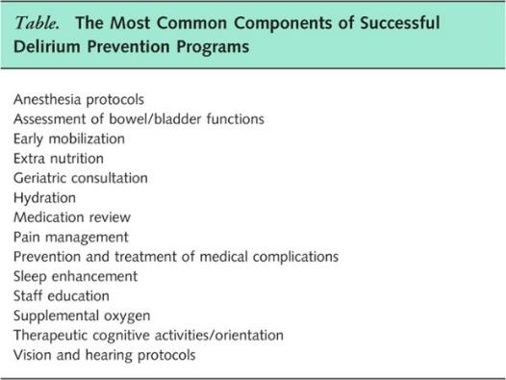

DELIRIUM PREVENTION
Image by Pete Linforth from Pixabay​
Reston, J., & Schoelles, K., 2013 ​
© Regional Geriatric Program of Eastern Ontario

Slide 19

DELIRIUM ASSESSMENT
Follow your institutional policy and procedure recommendations​. At TOH, patients are assessed ​
On admission ​
After an abrupt change in cognition
Key components​
What is the patient’s baseline status?​
Assess for risk factors:​
Patient factors​
Hospital related factors​
Collateral source for information​
Validated clinical assessment tool
Photo by Ryoji Iwata on Unsplash​
© Regional Geriatric Program of Eastern Ontario

Slide 20
TOOLS
4AT
  Short Simple <2min, always gives you a score
    Alertness
    AMT4: Abbreviated Mental Test - 4.
    Attention: Months of the Year Backwards
    Acute change or fluctuating course
R.A.D.A.R. A rapid detection tool for signs of delirium
    Was client sleepy? Did the patient have difficulty in following your instructions? 3. Movements of the patient were they in slow motion?
3D-CAM
    Takes 3 minutes
    Adds scoring for objective and clinical impressions
bCAM

Slide 21
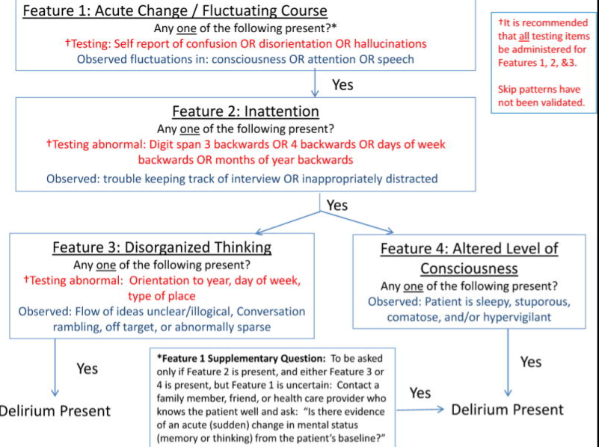
© 2024 Regional Geriatric Program of Eastern Ontario

Slide 22
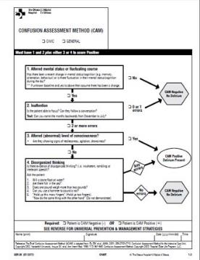
IDENTIFYING DELIRIUM: THE CONFUSION ASSESSMENT METHOD
​ 1​ | Acute onset of a change in normal mental status or fluctuating course​
and​
2​ | Inattention​
and either​
3​ | Disorganized thinking​
or​
4​ | Altered Level of​ Consciousness​
© Regional Geriatric Program of Eastern Ontario

Slide 23

MY PATIENT IS DELIRIOUS,
SO NOW WHAT?
Notify the attending physician and the interdisciplinary team of CAM positive results. In community, make an appointment with GP as soon as possible*​
Support the investigation of the root cause of the delirium.​
Document. Document. Document​
Monitor and reassess patient and response to interventions at least every shift and prn.​
Support the patient and family.​
Image by Gerd Altmann from Pixabay ​
© Regional Geriatric Program of Eastern Ontario

Slide 24

INVESTIGATING THE ROOT CAUSE
Anyone who presents with a change from their baseline cognition requires a full medical evaluation:
Physical exam​
Full v/s​
Medication review​
Bloodwork ​
Urine R&M, C&S​
ECG​
CXR​
CT head​
Also consider:​
O2 sat; ABG​
Blood culture​
Drug levels​
ETOH
Photo by Saffu on Unsplash​
© Regional Geriatric Program of Eastern Ontario

Slide 25
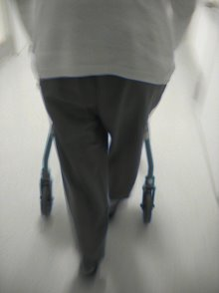
DELIRIUM MANAGEMENT
Environment​
Nutrition & Fluids​
Mobilization​
Toileting​
Pain​
Medication Review​
Sleep​
Behaviour management
Image by Gerd Altmann from Pixabay ​
© Regional Geriatric Program of Eastern Ontario

Slide 26

BEHAVIOUR MANAGEMENT
All behaviour has meaning​
What are the contributing factors/triggers?​
All patients require non-pharmacological strategies​
May consider pharmacological strategies​
Tailor to individual needs​
Involve the family
Image by Gerd Altmann from Pixabay ​
© Regional Geriatric Program of Eastern Ontario

Slide 27

BEHAVIOUR MANAGEMENT
Non-pharmacological Strategies:​
Use positive non-verbal body posture​
Approach from front​
Speak in a calm, soft reassuring voice​
Speak slowly and clearly; ​
use simple sentences​
Assess for patterns and triggers​
Explain before doing & allow time for ​
the person to respond​
Use reassurance, relaxation, diversion ​
& distraction techniques​
Don’t reason, don’t argue​
​
Image by Gerd Altmann from Pixabay ​
© Regional Geriatric Program of Eastern Ontario

Slide 28


GENTLE PERSUASIVE APPROACHES (GPA)
An interdisciplinary program to teach health care providers a person-centered, compassionate approach to assessment and response to behaviours associated with dementia ​
Interactive, practical, skills-based​
GPA training is available monthly at TOH through NPPD Education days
Photo by Cristian Newman on Unsplash​
© Regional Geriatric Program of Eastern Ontario

Slide 29
CARE PLAN
Care Plan:​
Nutrition & Fluids​ | Offer 60ml of water or beverage of choice at every interaction​ Ask family to bring in familiar foods​
Mobilization​ | Bed in lowest setting ​ Up for meals, walk to BR​ Get family to bring in proper footwear​
Toileting​ | Remove indwelling urinary catheter​ Regular toileting regime​ Initiate bowel routine​
Medications​ | Add acetaminophen QID and order regular schedule of analgesic​ Meds: decrease metoprolol, add bowel protocol​
Behaviour Management​ | Approach in a calm manner; explain what you would like to do; assessfor triggers​ Hearing aids in place, clean glasses on​ Reassure: “You’re in the hospital and you are safe”​ Orientation: Frequent gentle reorientation to place, date, time, staff​ Distract: Tell me about your garden?​
Engage the family/caregiver​ | Sit at bedside​ Pictures of his garden​
© Regional Geriatric Program of Eastern Ontario

Slide 30

PHARMACOLOGICAL INTERVENTION
Goals:​
To reverse behavioural symptoms​
Stop potentially dangerous behaviour​
Calm the patient to sufficiently evaluate ​& treat​
Consider:​
Type and degree of behaviour​
Aggressive versus non-aggressive ​agitation​
Atypical versus traditional antipsychotics​
Always start low & go slow….
Image by Free-Photos from Pixabay ​
© Regional Geriatric Program of Eastern Ontario

Slide 31
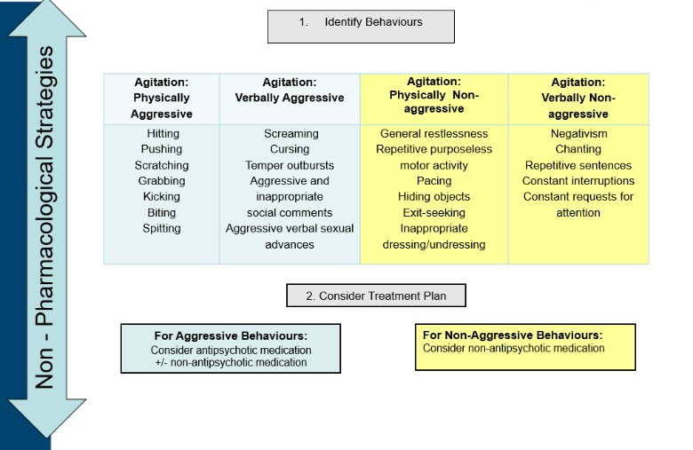
© Regional Geriatric Program of Eastern Ontario

Slide 32
MEDICATIONS TO CONSIDER
Atypical Antipsychotics:​
Respiridone 0.25 – 1 mg PO Q2-4h/prn Max 2 mg​
Olanzepine 2.5 - 5 mg PO Q2-4h/prn Max 10 mg​
Quetiapine 12.5 – 25mg PO q2-4/prn Max 75 mg BID​
Effects: sedating, calming agitation and aggression + reduce psychotic syndromes (hallucinations, paranoia, etc.)​ Risks: ▼cognitive function, ▲fall risk, ▲risk stroke/death, EPS​
Trazodone (SSRI) 12.5mg – 25mg PO Q2-4h/prn-Max 50 – 100mg​ | Good for mild agitation, mild anxiety, GPA resistant​
Loxapine (typical apx) 6.25 mg IM Q2-4h/prn​ Max 2 doses (preferred over Haldol)​ | Not for long term use​
© Regional Geriatric Program of Eastern Ontario

Slide 33

DOCUMENTATION
Document changes in mental status using the CAM & the progress notes​
“CAM positive” “acute confusion” “delirium”​
Describe the behaviour you see ​
Chart interventions​
Document patient and family education​
Document re-assessment of delirium and patient’s response to interventions​
Communicate to the team​
Note triggers
Image by Free-Photos from Pixabay ​
© Regional Geriatric Program of Eastern Ontario

Slide 34
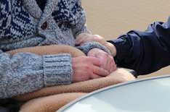
SUPPORTING THE PATIENT AND FAMILY
Delirium can result in significant distress for patient & their family​
Engage the caregiver in the patient’s care:​
  Provide information about the person​
  Bring in familiar items from home​
  Stay with patient – reorient & reassure​
  Assist with meals & ambulation​
  Engage patient in activities
Educate​
Reassure​
Resources
Image by Gundula Vogel from Pixabay ​
© Regional Geriatric Program of Eastern Ontario

Slide 35

DISCHARGE?
Cause?​
Adequate supervision​
Assess for home safety​
  Driving, smoking, cooking ​on the stove​
  Managing medications​
  Behaviour​
Consider:​
  Geriatrics, SW, LHIN Home & Community Care​
  Other community supports​
Education: patient & family​
Appropriate follow-up: GP, SGS​
​
Image by Gerd Altmann from Pixabay ​
© Regional Geriatric Program of Eastern Ontario

Slide 36

DASH PROGRAM
The Delirium Aware Safer Healthcare (DASH) campaign is a multi-year quality improvement campaign that will build towards reducing hospital-acquired delirium across Ontario.
© Regional Geriatric Program of Eastern Ontario

Slide 37
New Resource: Health Quality Ontario
NEW RESOURCE: HEALTH QUALITY ONTARIO
Quality Standards for Delirium Care for Adults
Identification of Risk Factors for Delirium
Interventions to Prevent Delirium
Early Screening for Delirium
Education for People with Delirium and Caregivers
Management of Delirium
Antipsychotic Medication
Transitions in Care
© Regional Geriatric Program of Eastern Ontario

Slide 38
QUESTIONS?
THANK YOU!

Slide 39

igenovezos@toh.ca
rgpeo.com
(613) 798 - 5555 ext. 16464

Slide 40
RESOURCES
Bianchi, L. A., Harris, R., & Fitzpatrick, J. M. (2024). Barriers to healthcare professionals recognizing and managing delirium in older adults during a hospital stay: A mixed-methods systematic review. Journal of Advanced Nursing, 80, 2672–2689. https://doi.org/10.1111/jan.16018
Delirium, Dementia, and Depression in Older Adults: Assessment and Care, Second Edition https://rnao.ca/bpg/guidelines/assessment-and-care-older-adults-delirium-dementia-and-depression ​
Emergency Department Delirium http://eddelirium.org/​
Geriatric Medicine Research Unit, Dalhousie University. Training video: delirium in an older adult https://www.youtube.com/watch?v=lJH1AoVuVS0 ​
Health Quality Ontario. Quality Standards: Delirium: Care for Adults. : https://hqontario.ca/evidence-to-improve-care/quality-standards/view-all-quality-standards/delirium?utm_source=hootsuite
OTN Hub: Delirium Learn how to identify, manage, and prevent delirium in the elderly Dr. Camilla Wong http://geriatrics.otn.ca/#tab1​
www.thisisnotmymom.ca ​
Rabheru, K. (2019). Management of agitation in an acute care hospital setting: description of a practical clinical approach employed at the ottawa hospital. Canadian Geriatrics Society, vol9 (2).
© Regional Geriatric Program of Eastern Ontario

