Slide 1

Joanna
Letemplier
Joanna is a Registered Nurse with a Bachelor’s in science of nursing from the University of Ottawa and Algonquin College collaborative program. She currently works as the Centralized Intake Coordinator with Geriatric Psychiatry Community Services of Ottawa (GPCSO). She previously worked in a variety of settings including geriatric rehabilitation in complex continuing care, long-term care, as well as community assisted living services for high-risk seniors. She is also Gerontological Nurse Certified.
INTAKE COORDINATOR
GPCSO

Slide 2
Depression
Joanna Letemplier

Slide 3
Acknowledgement
Presentation by Shauna Thaler Adeland. M.S.W., RSW
Psychogeriatric Resource Consultant
Geriatric Psychiatry Community Services of Ottawa
Presentation revised by Joanna Letemplier, RN

Slide 4
Identify, Assess, Intervene and Apply
  Review red flags and screening tools
  Explore treatment options
  And Hopefully; de-mystify mental health and increase confidence in starting conversations about mental health with older adults.
Notes:
There’s a lot of information to cover in this topic, but today our main objective is to give you tools and resources to identify, assess and intervene and, most importantly, apply this knowledge to fit your practice setting. Hopefully as well we will be able to de-mystify mental health and help you start conversations about mental health with older adults.
This is a population that, for the most part, have challenges in discussing their mood and there’s certainly a lot of stigma felt around mental health. So, being able to identify red flags and help facilitate conversation is important.

Slide 5

AGENDA
Myths of depression and seniors
Review risk factors, screening and assessment of depression
Analysis and interpretation
Care planning and intervention
How can I help? Review of resources
Notes:
Point 2 – Review risk factors, screening and assessment of depression:
Not in detail, but we will review and perhaps you might recognize one you already use in your practice or might be appropriate to start using.
Point 3 - Analysis and interpretation:
So then taking that information from the red flags you noticed or perhaps a screening tool you used and be able to have a clearer picture of what’s next in terms of care planning and intervention.

Slide 6
WHAT IS MENTAL HEALTH AND HOW DOES IT DIFFER FROM MENTAL ILLNESS?
Notes:
It’s important to be able to differentiate between mental health and mental illness. Especially following the Pandemic, we’ve witnessed many people struggling with their mental health, but this doesn’t necessarily mean they meet the criteria for a mental illness.

Slide 7
MENTAL HEALTH VS MENTAL ILLNESS
Mental Health is being able to manage life in ways that help us cope with stress and reach our goals. It’s a sense of emotional and social well-being.
Mental Illness refers to a
wide range of disorders
that affect our mood,
thinking, and behavior,
such as depression or
anxiety.
Notes:
This doesn't mean that we don’t have bad days or periods of low mood, it means that we are able to cope with these periods of time in healthy ways and move forward.
Mental illness is when you can’t function. You might see changes in thinking and behavior that might be noticeable to close friends and family and these changes in mood and behavior might start to fit more clearly into diagnostic criteria such as in the Diagnostic and statistical manual.

Slide 8



MYTH OR FACT?
Mental illness will never affect me
Myth!
POLL
All of us will be affected by mental illnesses.
1 in 5 Canadians will experience a mental illness at some point in their life.
You may not experience a mental illness yourself, but it’s very likely that a family member or friend will experience challenges.
Notes:
I would like to hear your thoughts, please write in the chat if you think the following statement is myth or fact.
This belief might not be so widely held these days especially with what we lived and witnessed throughout the pandemic, but there is still stigma around mental health and reaching out for support.

Slide 9
MYTH OR FACT?
Depression is a normal part of aging
Myth!
POLL
Depression is not a normal part of aging
Risk of depression increases with number of changes in roles and social network
Risk of depression increases with isolation/loneliness
Good outcomes with treatment in older adults
Notes:
Age is not a factor but rather depression can be due to a combination of factors such as brain chemistry and situational circumstances. Also, differentiating grief from depression can be tricky as well and we will talk about differentiating the two later in the presentation.
Last point - Good outcomes with treatment in older adults; this can mean in terms of medications or non-pharmacological interventions; both can yield great outcomes so we will elaborate on both later on as well.

Slide 10
MYTH OR FACT?
Canadians 65 and older
are at high risk for suicide
Fact!
POLL
Experiences of loss such as loss of health, loved ones, physical mobility and independence
Major life changes such as retirement, change in financial status, a transition into care facilities
Chronic illness and pain
Source: https://www.suicideinfo.ca/resource/older-adults-suicide-fact-sheet/
Notes:
We know from the previous slide that depression is not a normal part of aging and that older adults may experience certain factors that place them at high risk for developing depression and place them at high risk for suicide as well. These factors include: Fewer relationships and connections as loved ones have passed away; also, older adults are more likely to live alone
Feelings of being a burden to loved ones.
In fact, a 2005 statistics Canada report indicates that elderly men have a suicide rate twice that of the nation as a whole and effectively lethal self-harm behaviors increase with age.

Slide 11
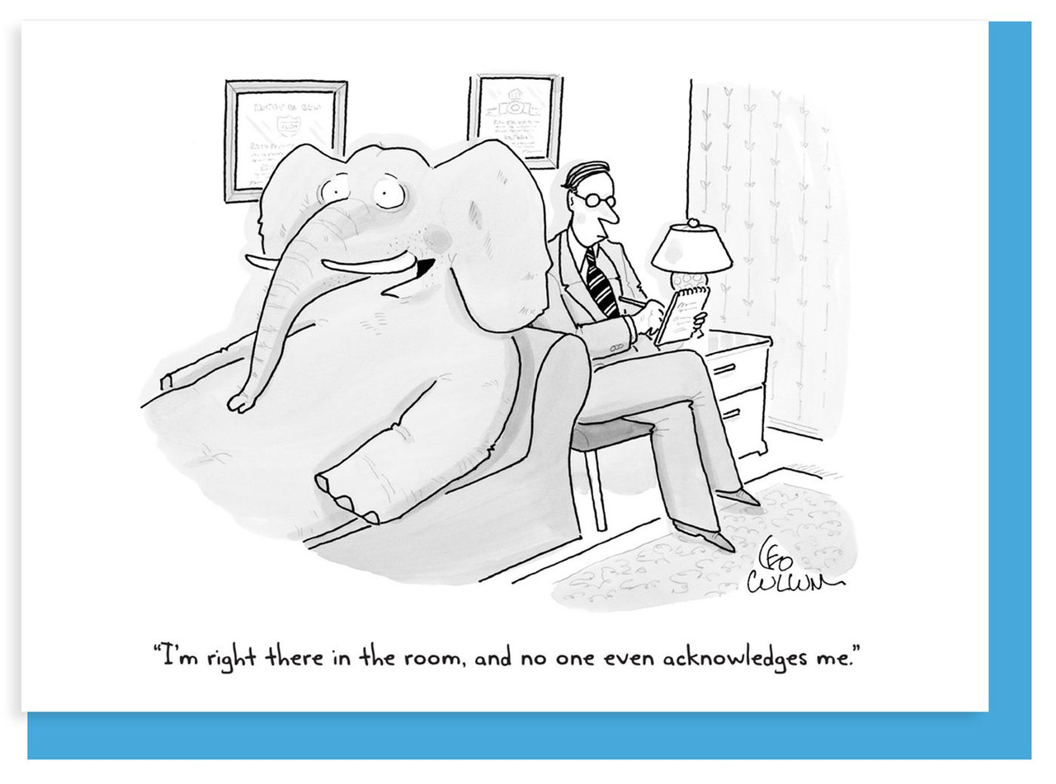
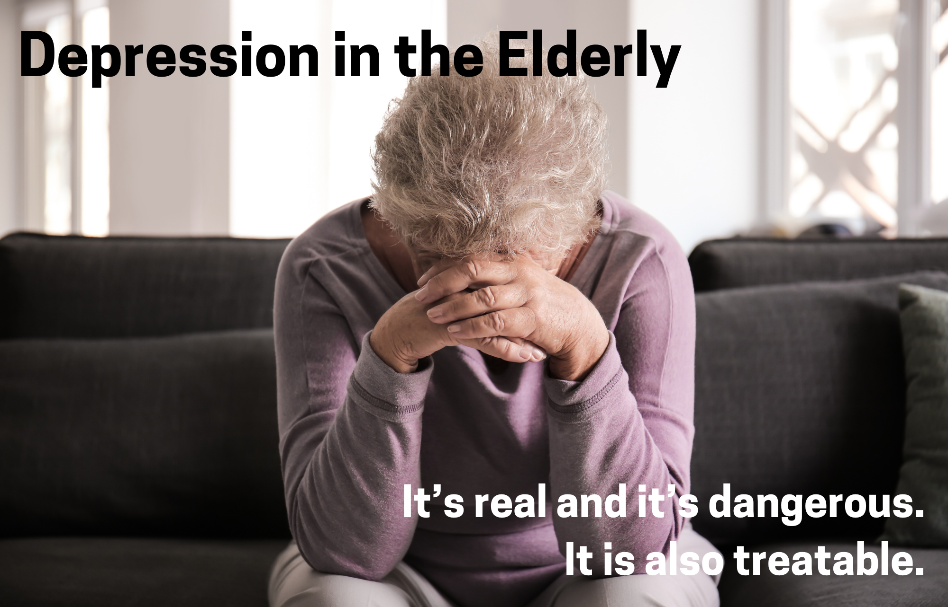
Notes:
So, knowing this drives home the point that depression is real and it’s dangerous especially in terms of elevated risk for suicide but keeping in mind that it is treatable!
Most importantly, we need to acknowledge the elephant in the room and not just sweep it under the rug and allow it to be overlooked as a normal part of aging instead of an illness to be concerned about.

Slide 12
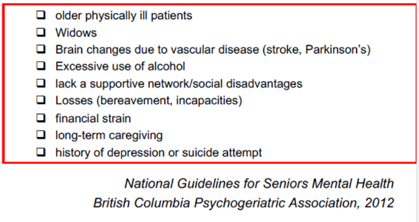
DEPRESSIVE DISORDERS
10.8% estimated lifetime prevalence of major depressive disorder in Canadians.
Increases with:
Notes:
There is almost an 11% estimated prevalence of MDD in Canadians … That’s a high number! Keep in mind this is estimated; it may be even higher given the unreported instances of depression related to stigma around the subject. And as we discussed briefly before, there is an elevated risk of developing depression when …
This helps put into perspective perhaps, people in your own social circles, family, friends, who may have one or many of these risk factors and what their mood might be and how they might be coping.

Slide 13
Loneliness,
Isolation,
COVID 19,
Mental health
Oh My!
Notes:
I would like to touch upon loneliness, isolation and what we experienced and learned from the pandemic and their effects on mental health.

Slide 14
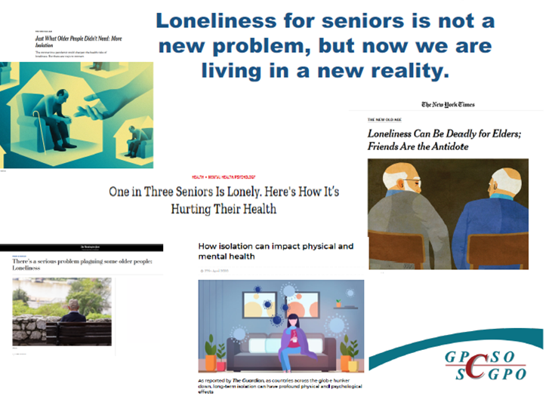
Notes:
For all the health care providers that work in the community, or in RH or LTC homes with seniors, you know that loneliness and isolation is not a new problem. During the pandemic however, we lived in a new reality of increased barriers to accessing care and services, as well as a halt to supports and services that had been essential to wellbeing and embedded in everyday routine such as ADP, community centre programs, community outreach in person. So, though there were barriers to accessing social supports to prevent loneliness and isolation before the pandemic, during the pandemic there was a huge period of adaptation to find meaningful solutions like virtual or telephone which is still useful post-pandemic, but it ultimately it did create more barriers for seniors accessing services (Fear of falling ill, decompensation during the pandemic)

Slide 15
BOTH ARE IMPORTANT AND TIMELY TO UNDERSTAND
Isolation: a state that arises from having too few or no social relationships
Loneliness: The subjective perception of having insufficient social relationships or not enough meaningful contact with people
You can be an isolated senior and not feel lonely
You can be a well supported senior and feel extremely alone
Notes:
Let’s take a few moments to clarify the difference between isolation and loneliness.
Isolation: We had used the word a bit differently throughout the pandemic in the sense that we may be isolating but still connecting with social supports using technology and distancing.
The key thing to understand about the difference between isolation and loneliness is:

Slide 16
Notes:
This infographic summarizes the dangers of senior loneliness and isolation. Keep in mind how high these percentages are for seniors especially in addition to the risk factors we discussed previously.
It also helps us to understand further loneliness vs isolation; as you can see, the rate of depression for seniors in residential care is as high as 44%; Even though we might assume that seniors living in RH or LTC are less isolated and therefore lonely when living in a building surrounded by other people and receiving increased support.

Slide 17

RISK IDENTIFICATION,
SCREENING & ASSESSMENT

Slide 18
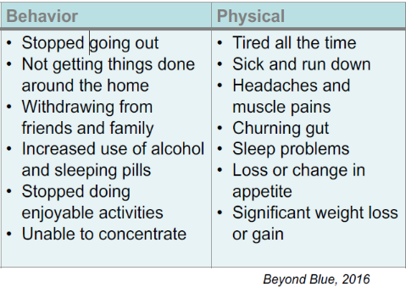
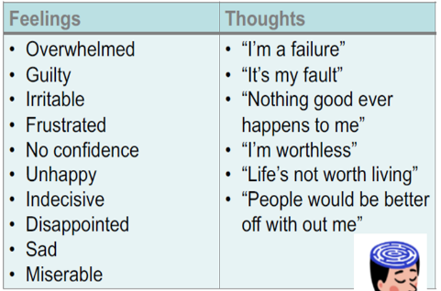
DEPRESSION
Beyond Blue, 2016
Notes:
In an individual who is depressed, we might observe noticeable changes in behavior such as:
As well as physical symptoms:
There are also changes we might not see unless we prompt the person by asking questions about their feelings and thoughts.
For example:
In some cases, the individual might share these feelings and thoughts without having to prompt them. Nevertheless, we will speak a little later about how to have these conversations. It’s important to keep in mind that if you notice a client is voicing these negative thoughts, either out of the blue or more frequently, or showing a change in behavior or physical health with no organic cause, it’s always worth exploring.

Slide 19
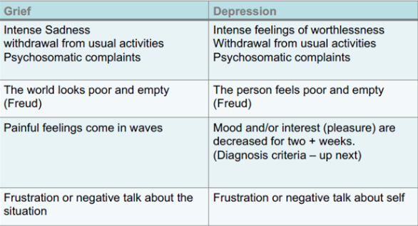
GRIEF VS DEPRESSION
Notes:
I would like to spend some time discussing conditions that may present very similarly to depression and therefore be mistaken for it. The first is grief. When a person is grieving, we might see …
It’s also relevant to note that there are different types of grief. We won’t be exploring all of them today, but essentially grief can present differently depending on the person. For example, it can be prolonged and complicated, and a person can be grieving and depressed simultaneously. The key message I would like you to take away today is that grief is different from depression as it’s intensity can fluctuate, and the person’s focus is on the loss or situation, whereas, depression is persistent, prolonged and the person’s focus is on the self.

Slide 20
APATHY VS DEPRESSION
Apathy
Lack of feeling or emotion (impassiveness)
Lack of interest or concern (indifference)
Common symptom of dementia
Depression
Varying degrees of sadness, despair, and loneliness and that is typically accompanied by inactivity, guilt, loss of concentration, social withdrawal, sleep disturbances, and sometimes suicidal tendencies
Anhedonia: a psychological condition characterized by inability to experience pleasure in normally pleasurable acts
Notes:
Then there is Apathy. When a person has apathy, we see…
And, as we discussed previously, in depression we see…
Apathy can be mistaken as a symptom of depression but in apathy, once the individual is encouraged and engaged in an activity, they will be able to enjoy it. We commonly see apathy as a symptom of dementia because it is related to the frontal lobe of the brain and the loss of capacity to plan and organize. There is no distress in apathy whereas in depression there is distress.
In depression we see anhedonia; where the individual is unable to experience pleasure even when participating in an activity that had once brought them joy.

Slide 21
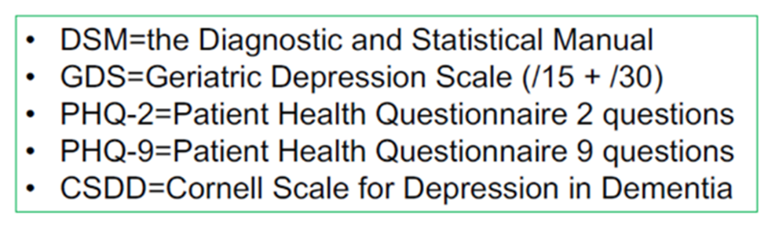
DEPRESSION: SCREENING
How do you screen or assess for depression in your workplace? (standardized/nonstandardized)?
What tools or outcome measures are typically used?
Notes:
I would like everyone to think about how you screen for depression in your workplace. Is it standardized or not standardized? What tools or outcome measures are used? The questionnaires in the green box are tools we use frequently at GPCSO to screen for depression. DSM diagnostic criteria and these questionnaires will be our focus for the next few slides. As we go through them, think about which ones might be best suited to use in your practice, if not already used.

Slide 22
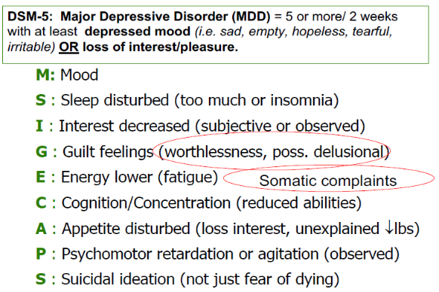
Depression: M SIG E CAPS
Notes:
According to the Diagnostic and statistical manual of mental disorders (known as the DSM-5), major depressive disorder is diagnosed when the following criteria are met: 5 or more of the symptoms listed below must be present for at least a 2-week period as well as either a depressed mood (for most of the day!) OR a loss of interest or pleasure.
The letters highlighted in green; MSIGECAPS is an acronym to help you remember the symptoms of depression …
In older adults, we might see feelings of guilt or somatic complaints more predominantly.

Slide 23

Monkey Smoking In Green Eyeglasses & CAPS
Monkey
Smoking
In
Green
Eyeglasses
CAPS
5/9
2+ weeks
Notes:
In addition to the acronym, we have a mnemonic to help us remember that we require 5/9 symptoms of depression to be present for 2 or more weeks. 5 of the symptoms can be remembered by thinking of “Monkey Smoking in Green Eyeglasses”, so mood, sleep, interest, guilt feelings and energy level. then CAPS. And to meet the diagnostic criteria, either Monkey (i.e. mood) or In (i.e. loss of interest) must be present.

Slide 24
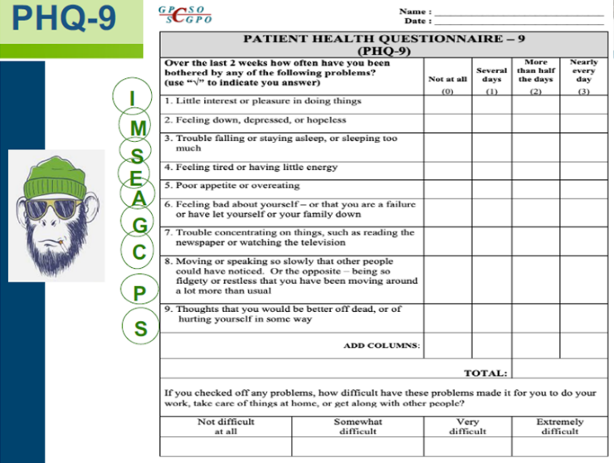
Notes:
The first screening tool we are going to look at is the patient health questionnaire, also more commonly known as the PHQ-9. This tool has 9 questions, each one being a symptoms that patient rates by how frequently each symptom has been present over the last 2 weeks; either “not at all”, “several days”, “more than half the days”, or “nearly every day”. The score is calculated based on the number of points each of their answers are worth; for example …
You will also notice towards the bottom of the page there is an additional question that helps you gauge how much these symptoms are having an impact on the patient’s ability to function. Note MSIGECAPS is the basis of this questionnaire and that the “monkey” or mood and “In” or interest portion is the first two questions.

Slide 25
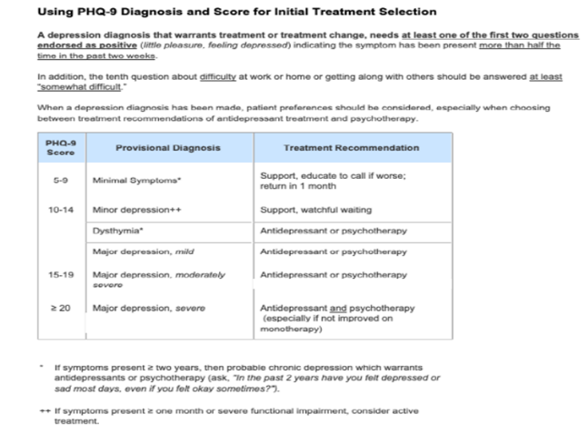
CHEAT SHEET ON FLIP SIDE
Notes:
On the flip side of the PHQ-9, there’s a cheat sheet to interpret the results which can help make a diagnosis and treatment decisions based on the severity of the symptoms.
A diagnosis can only be made by a psychiatrist (geriatric or otherwise), a nurse practitioner, a medical doctor or a doctor of clinical psychology.

Slide 26
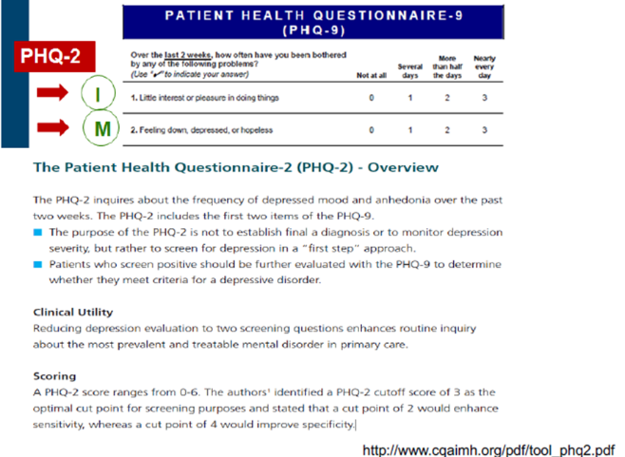
PHQ-2
Notes:
The PHQ-2 is a condensed version of the PHQ-9; it only includes the first two questions (“monkey” and “in” portion of the MSIGECAPS tool) mood and interest.
In my practice, I haven’t seen this tool used very often since our focus is mental health and we do more thorough screening as part of our assessments, but this can be very useful to use if you just want to take a few minutes to determine if a deeper evaluation is warranted. So, if your “Spidey senses” so to speak are tingling this can be a good place to start to validate your observations and initiate further assessment or conversation.

Slide 27
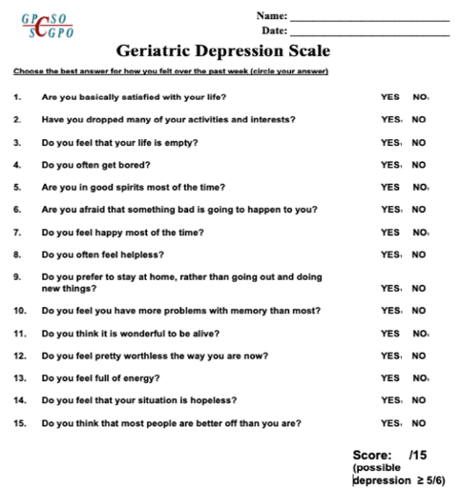
GDS
SHORT VERSION (/15)
Notes:
The next screening tool is the Geriatric Depression Scale or GDS. This is the 15-question version. Its format is a little simpler than the PHQ-9 as the patient simply needs to provide a yes or no answer to each question. I find this tool is also helpful in initiating a deeper conversation as sometimes the person likes to elaborate on why they answered yes or no.
You may have noticed there is a tiny 1 beside either the yes or the no for each question. For each question where the answer has a 1 beside it, these are added together to determine the score out of 15. For example … Under where the score is marked, it tells you that a score over 5/15 may indicate a possible depression. This tool also has the Monkey and In; mood and interest, to help with a possible diagnosis.
I realize I must sound like a broken record with all this Monkey and in business, but It’s really to help drive home the most important points to remember.

Slide 28
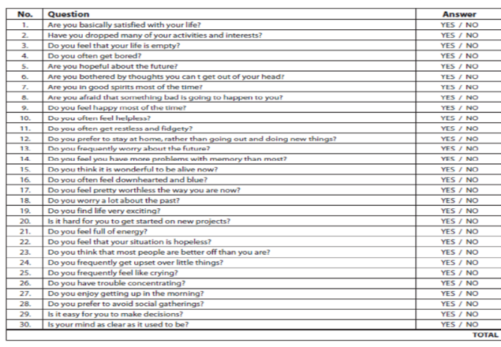
GDS
LONG VERSION (/30)
Notes:
This is what the GDS long version, so with 30 questions instead of 15, looks like.

Slide 29
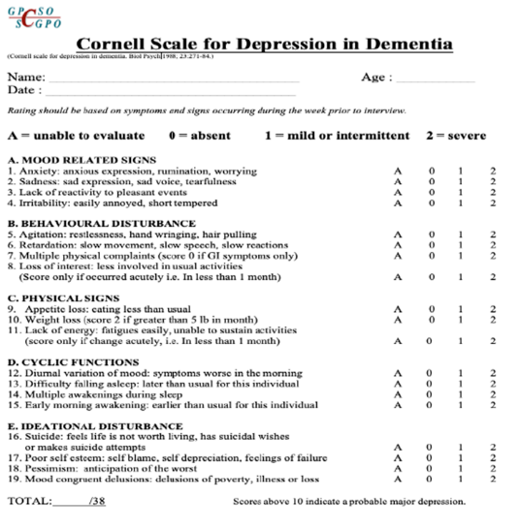
Notes:
The last screening tool we’re going to look at is the Cornell Scale for depression in dementia. As you can tell from the title this is useful for screening for depression in people who have dementia. It’s typically completed by a healthcare provider who is preferably with the patient almost daily like a nurse or health care aid in a RH for example. Or a caregiver. Someone who could notice the symptoms listed and their intensity over a week’s period. In question 3 under mood related signs they ask if there has been a “lack of reactivity to pleasant events” which is I find is worded well because this is the definition of anhedonia; so as not to mistake it for apathy. We also see in question 8 under behavioral disturbances is that loss of interest piece *only if it occurred acutely*, again, not to mistake the symptom for apathy.
The total score based on the intensity of the symptoms observed in which a score above 10/38 could indicate a probable major depression.

Slide 30
ANALYSIS & INTERPRETATION
Notes:
Ok, so you’ve completed a screening tool, initiated a conversation and collected some data. Now it’s time to analyze and interpret that data to try and complete the puzzle.

Slide 31
ANALYSIS
Screening tools help to clarify symptoms presence, frequency, and intensity
They can justify referrals & services
They can be used to monitor change over time
What else should be considered for your analysis and interpretation?
Notes:
If your role involves having a caseload or a group of clients that are assigned to you or see regularly, you get to know your clients well. Trust your gut and take the time to explore any red flags you might have identified. Perhaps you might even consider using a tool like the PHQ-2 regularly if you see a wide variety of patients in your workplace. These tools can justify referrals and initiating additional services and if you’re in a setting where you have the same patients regularly you can use the screening tools to monitor changes over time.
What else should be considered during your analyses and interpretation? Is there any additional context that is needed in addition to screening tools?

Slide 32
THE CLIENT’S STORY …
Are you able to gather collateral information (family, friends, neighbors, pharmacist, etc.)
Review timeline (new onset, big events, losses, change)
Have there been changes to function?
Safety concerns
Are they medically stable? Can something else account for what you are seeing?
Notes:
Can you gather collateral information (family, friends, neighbors, pharmacist, etc.) with the patient’s consent? This information can be helpful if you need to learn more about the person’s culture and how that might affect how you might go about the conversation in a culturally sensitive way and how you might interpret certain bits of information. Collateral can help you navigate what’s happening now in comparison to the person’s baseline (are the symptoms a big change from baseline, are symptoms longstanding but worse?)
Are they medically stable? Can something else account for what you are seeing? Do we need to rule out a delirium, or polypharmacy?

Slide 33
OTHER CONSIDERATIONS
Unintentional weight loss >5%/1month?
Affecting social relationships?
Affecting physical health care engagement?
Self-neglect, unexplained change in baseline?
Delusional excessive worry content?
Suicidal ideation and/or plan?
Notes:
On this next slide I am going to be talking briefly about suicide, so I just wanted to give a content warning beforehand as I understand this topic can be difficult for some.
If someone is being vague and perhaps saying something like “life is not worth living” it’s important to explore that further. Asking additional questions can feel delicate and it’s not easy to find the right words. But don’t be afraid to have conversations about suicide. Particularly identifying if they have a plan or considering a plan, and if they feel they may act on a plan or have intent to end their life. Do they have protective factors like family or religion that might keep them from acting on a plan? Do they have a support system? Are they willing to commit to a safety plan? Like calling the crisis line if they get overwhelmed or family or friends? It was once believed that talking about suicide would increase the risk of it; but talking about suicidal ideation can be validating, helping the person talk about an incredibly difficult topic and accessing help.
If you would like a screening tool for suicidal ideation, The Columbia-Suicide Severity Rating Scale or C-SSRS is a great tool that helps to assess suicide risk and has practical choices written down to help you word each question.

Slide 34
DIAGNOSIS OF DEPRESSION
Diagnoses of mental health disorders are made by geriatric psychiatrists, nurse practitioners, medical doctors and/or doctors of clinical psychology.
All other clinicians can screen but not make an official diagnosis.

Slide 35
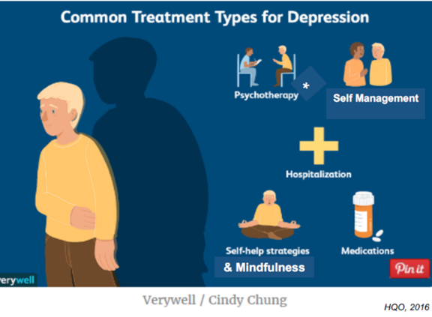
CARE PLANNING & INTERVENTION

Slide 36
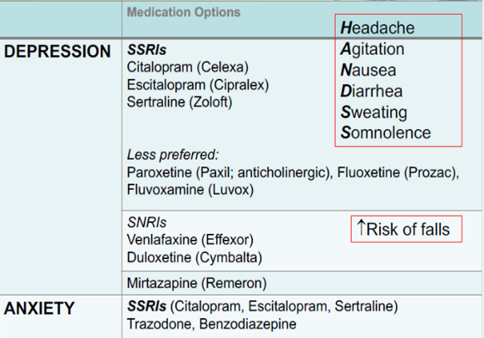
MEDICATIONS
Notes:
There are many non-pharmacological interventions for depression but in some cases, medications may be necessary to treat the depression which can also help people have the capacity to engage in non-pharmacological interventions as well. The most prescribed antidepressants for older adults are SSRIs or selective serotonin reuptake inhibitors. These include … less preferred SSRIs are paroxetine as it increases anticholinergic effects, fluoxetine as it can have prolonged side effects, and fluvoxamine. Citalopram, escitalopram and sertraline offer the best safety profile for the elderly, with less drug-to-drug interactions. As with any medication there can be side effects such as ….
SNRIs or selective norepinephrine reuptake inhibitors include … although, this class of anti-depressants increases the risk of falls.
SSRIs can also be used to treat anxiety. Trazodone is often used to help with sleep. Benzodiazepines like lorazepam (Ativan), diazepam, should be avoided to treat older adults, even on a short-term basis because it can impair cognition, mobility, increase risk of falls.
Given the risk, we utilize the low and slow approach when prescribing medications so that response to treatment and side effects can be monitored.

Slide 37
PSYCHOTHERAPY
CBT
Interpersonal psychotherapy
Brief dynamic/solution focused therapy
Reminiscence therapy
Mindfulness-based cognitive therapy
Behavioral activation therapy
Short-term dynamic psychotherapy
Couple/family
CBT and counselling can be just as effective as medication, however…
Notes:
A huge variety of psychotherapies exist, and they can be more or just as effective than medication treatment in some cases or used in addition to medication treatment in other cases. Only a small number of adults access psychotherapy services in part due to stigma, but also physical and financial barriers exist as well.

Slide 38
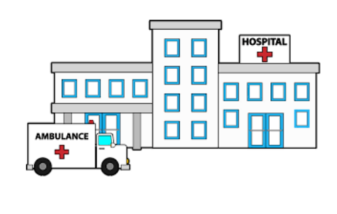
WHEN IS HOSPITALIZATION APPROPRIATE?
Notes:
If there is SI with a plan and/or intent;
Significant safety concerns such as not eating with significant weight loss, self-neglect, harm to others, catatonia.
Risk of significant decompensation which cannot be addressed quickly enough as an outpatient or in the community.
Perhaps we suspect an underlying medical issue or acute medical emergency such as a delirium.
Screening tools can be useful when transferring a patient to the ED in addition to your knowledge of the patient and observations as this is valuable context to communicate with the ED team to help them understand the severity of the symptoms that are reported and its progression over time leading to the need for urgent care.

Slide 39
Geriatric Psychiatry Community Services of Ottawa (GPCSO)
Excellence in mental health care for seniors within their community.
Fully bilingual geriatric psychiatry program. We work with older adults living in our community to optimize their mental health and/or dementias with challenging behaviors.
Team of Case Managers (Social workers, Occupational Therapists and Registered Nurses) and Geriatric Psychiatrists
Notes:
This is the clinic that I work with, we do centralized intake for all the outpatient geri psych referrals in the Ottawa area including for the Royal Ottawa Mental Health Center. Our goal is…
We are a referral-based service; so, all referrals need to be signed by a medical doctor or Nurse Practitioner.

Slide 40
CHAT
What are some Self-Management & Mindfulness strategies that you use to promote your mental health and wellbeing?
Put it in the chat!
Notes:
I would like to hear your thoughts again about…
Please enter your strategies into the chat box.

Slide 41
SELF-MANAGEMENT & MINDFULNESS
Self-management strategies
  Sleep hygiene
  Physical activities
  Nutrition
  Behavioral activation
  Increase social connections
  Mindfulness – here and now!
Monitoring for treatment adherence & response
Education and support (relationships, recurrence, crisis)

Slide 42
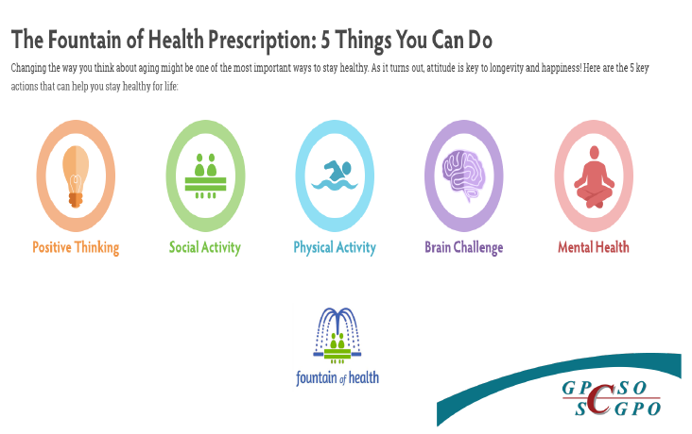
OPTIMIZING HEALTH & RESILIENCE
Notes:
This is a Canadian resource to help optimize health and resilience for caregivers and seniors but also anyone can use this tool to help set SMART goals in any or all of 5 key actions you see here. They have a telephone app and a website. The fountain of health focuses on the pillars of healthy aging and good mental health and provides a structured method to set goals and improve physical and mental health.

Slide 43
ADDITIONAL RESOURCES
  Advocacy Centre for the Elderly
  Champlain Local Health Integration Network - Home and Community Care and Champlain Health Line
  Local Community Centers and Senior Center Without Walls
  Coalition of Community Health and Resource Centers of Ottawa
  Geriatric Psychiatry Caregiver & Family Support Group
  Helpline - Ontario Caregiver
  Primary Care Outreach to Seniors
  Service Access to Recovery (Addictions referral resource) Montfort Renaissance
  Specialized Geriatric Services
  Online Resources: BounceBack program, Councelling Connect, The Walk-In Counselling Clinic
  GPCSO.org
  Resources for Patient and Families

Slide 44

What do I do?
How can I help?
Notes:
You’ve explored your concerns, done the screening, gathered additional information… what now?

Slide 45
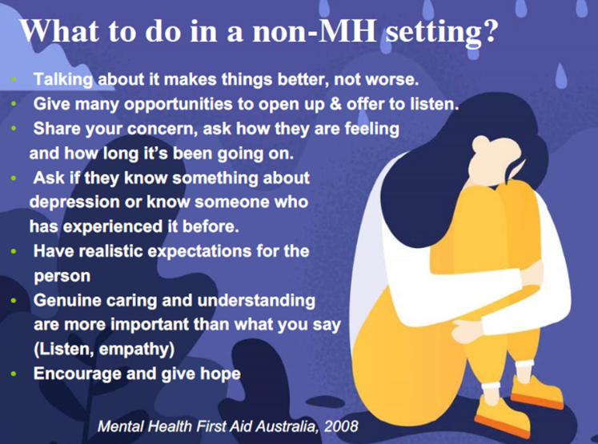
Notes:
What can you do in a non-mental health setting?
Again, talking about these topics makes it better not worse and can lessen the stigma. Try to give as many opportunities as you can in your busy work schedule to be present and offer to listen. Don’t be afraid to share your concerns with the person; you could say “I’ve noticed this, and I’m worried about you”/ “ you’re not coming out of your room as often; do you want to talk about it? Can you tell me more about that?”. People most often respond to that recognition, and it can help establish a meaningful connection. Having realistic expectations for recovery as well. It’s a process and can take time to heal, like any wound. Genuine caring and understanding speaks louder than words, we are all here today because we care.

Slide 46
HOW TO START THE CONVERSATION…
I’ve been worried about you. Can we talk about what you are experiencing? If not, is there someone you are comfortable talking to?
I am someone who cares and wants to listen. What do you want me to know about how you are feeling?
What can I do to help you to talk about issues with your family or someone else who cares about you?
I’m concerned about your safety. Have you thought about harming yourself or others?
US Department of Health & Social Services
Notes:
Here are some tips about how you can start a conversation about mental health…
It is important to get to know the client, family and culture and how it impacts their feelings. If you have permission to speak to the client’s family, they can also help provide some advice on how best to have this conversation.

Slide 47
WHAT IF THEY DON’T WANT HELP?
Check reason (mistaken beliefs, stigma, finances)
Remain friendly and open
Let them know they can contact you if they change their mind
Respect their right to refuse, unless…
If unsure/need help: CALL MENTAL HEALTH CRISIS LINE
1-866-996-0991
CALL 911: If someone wants to injure themselves/end their life or hurt someone else
Notes:
Sometimes, people don’t want help, or they are not ready to receive help….
If they continue to refuse there are some resources you could offer and if you are worried about their safety, contacting emergency services is always an option, particularly the mental health crisis line.

Slide 48

Notes:
This quote is pretty popular, but it really drives home the point that though you might be afraid to say the wrong thing, instead of saying nothing the reality is that people remember and respond to the genuine and caring intent to understand how they are feeling rather than what you said. We also use this quote in dementia care, but it’s also relevant for mood.

Slide 49
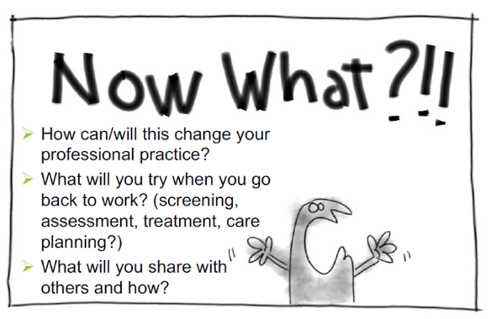
Notes:
I appreciate that was a great deal of information to process. I hope that you’ll consider how you might…

Slide 50
QUESTIONS?

Slide 51

jletemplier@bruyere.org
www.gpcso.org
613-562-9777 ext. 5239

Slide 52
REFERENCES
American Psychiatric Association. (2013). Diagnostic and statistical manual of mental disorders (5th ed.). Washington, DC: Author.
Beyond Blue Ltd (2016). Depression – Common signs and symptoms. Retrieved at https://www.beyondblue.org.au/the-facts/depression/signs-and-symptoms
British Columbia Psychogeriatric Association (March 2012). Meeting seniors’ mental health care needs in British Columbia: A Resource Document.
Available at: https://www2.gov.bc.ca/gov/content/family-social-supports/seniors/about-seniorsbc/seniors-action-plan/what-we-ve-done/dementia-guidelines
Canadian Agency For Drugs And Technologies In Health (CADTH) (8 September 2015). Rapid Response Service Diagnosing, Screening, and Monitoring Depression in the Elderly: A Review of Guidelines.
Canadian Coalition for Seniors Mental Health (CCSMH). (2006). National Guidelines for Senior’s Mental Health: the assessment and treatment of mental health issues in long-term care homes (focus on mood and behaviour symptoms). Canadian Journal of Geriatrics, 9: 59-64.
2006 and 2014 Update available at: https://ccsmh.ca/projects/long-term-care-homes/
RGPs of Ontario, A Competency Framework for Interprofessional Comprehensive Geriatric Assessment: Final Report (Revised Oct. 25, 2017).
U.S. Department of Health & Human Services. Supporting a Friend or Family Member with Mental Health Problems. Retrieved at: https://www.mentalhealth.gov/talk/friends-family-members/index.html

Slide 53
REFERENCES
Collins J., Harris D., LeClair K., (2010). Putting the P.I.E.C.E.S. Together: A Learning Resource for Providers Caring for Older Adults with Complex Physical and Cognitive/Mental Health Needs and Behavioural Changes (6th Edition). The P.I.E.C.E.S. Consult Group, Canada.
Dennis M, Kadri A, Coffey J. Depression in older people in the general hospital: a systematic review of screening instruments. Age Ageing [Internet]. 2012 Mar [cited 2015 Aug 17];41(2):148-54.
Available from: http://ageing.oxfordjournals.org/content/41/2/148.full.pdf+html
Health Quality Ontario (HQO). (October 2016). Quality Standards Major Depression: Care for Adults and Adolescents. Standards and resources available online:
https://www.hqontario.ca/Evidence-to-Improve-Care/Quality-Standards/View-all-Quality-Standards/Major-Depression
Mental Health First Aid Australia (2008). Depression First Aid guideline. Retrieved at : http://www.mentalhealthfirstaid.ca/EN/resources/Pages/MHFAguidelines.aspx
Mood Disorders Society of Canada. (2009). Quick Facts: Mental Illness and Addiction in Canada. 3rd Edition. Guelph, ON: MDSC.
National Guideline Clearinghouse [Internet]. Rockville (MD): Agency for Healthcare Research and Quality (AHRQ); 1997. *- Guideline summary: depression in the long-term care setting. 2011 [cited 2015 Sep 1]. Available from: http://www.guideline.gov/content.aspx?id=32668
Collins J., Harris D., LeClair K., (2010). Putting the P.I.E.C.E.S. Together: A Learning Resource for Providers Caring for Older Adults with Complex Physical and Cognitive/Mental Health Needs and Behavioural Changes (6th Edition). The P.I.E.C.E.S. Consult Group, Canada.

Slide 54

REFERENCES

