Slide 1


INTRODUCING
Cheryl
McShane
Cheryl is a Geriatric Assessor with the Geriatric Assessment Outreach Team of the Regional Geriatric Program of Eastern Ontario. She has been with the team for over 10 years, and, prior to this, she worked as a physiotherapist at the Queensway Carleton Hospital. Cheryl completed her Bachelor's of Science in Physiotherapy Degree at McGill University and has had experience working in a variety of clinical settings such as acute care hospitals, rehabilitation centers, retirement homes and long-term care facilities. In her current role, Cheryl enjoys helping community-dwelling seniors access health care and community services that will support them to remain as independent as possible. She is passionate about health promotion and tries to incorporate this as much as possible.
GERIATRIC ASSESSOR
QUEENSWAY CARLETON HOSPITAL

Slide 2
FALL PREVENTION​
Assessment and Intervention​
Cheryl McShane​
​Geriatric Assessor
Geriatric Assessment Outreach Team
Queensway Carleton Hospital
​
Notes:
Please have your Multifactorial Fall Risk Summary and Staying Independent Checklist Score

Slide 3
ACKNOWLEDGEMENT
Mary Haller, PT- TOH C-FAST Clinic (Retired)
Dr. Shirley Huang, Geriatrician TOH
Taryn McKenzie, APN- TOH C-FAST Clinic
Dr. Frank Molnar, Geriatrician TOH
Anna Banks, PT- West End Integrated Falls Prevention Program

Slide 4

LEARNING OBJECTIVES
Highlight the importance of fall prevention in seniors
Review age-related changes
Discuss the components of a multifactorial fall risk assessment
Identify modifiable and non-modifiable risk factors for falls
© Regional Geriatric Program of Eastern Ontario

Slide 5
FALLS ARE COMMON
It is estimated that 1 in 3 seniors is likely to fall at least once per year.
For those over 80 years old, 50% typically fall each year, and half of those will fall 2 or more times.
Falls cause 95% of all hip fractures.
Falls are the leading cause of injury-related hospitalization and death among individuals aged 65 years and older.
Falls cause 85% of seniors’ injury-related hospitalizations.
(Public Health Agency of Canada, 2014)
(Inouye et al, 2009)

Slide 6
WHY STOP FALLS?
Falls are not part of normal aging
Falls can lead to:
  Chronic pain
  Loss of confidence, reduced mobility and independence
  Fear of falling, depression and anxiety
  Activity restriction
  Social isolation
  (Public Health Agency of Canada, 2014)
Notes:
The numbers tell us that falls are a common and dangerous problem for seniors and the health care system caring for them. Many don’t fully recover.
Annual incidence of falls in cognitively impaired is 70-80%, double the normal population (Haines et al, 2010)

Slide 7
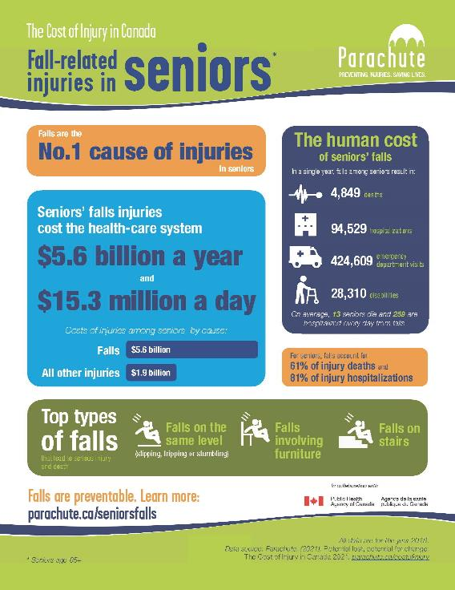
FALLS ARE COSTLY
In 2018, the direct cost of fall-related injuries in Canada for those aged 65 years and older was $5.6 billion.
(Parachute, 2018)

Slide 8
“By reducing seniors’ falls by 20 percent between 2010 and 2035, it is forecasted that we can save 4400 lives and save $10.8 billion in health-care costs.”
(Parachute, 2015)
Notes:
Louise

Slide 9
THE GOOD NEWS
The literature suggests that as many as 1/3 of falls-related adverse outcomes are preventable.
(LHIN Collaborative, 2011)

Slide 10
THE BAD NEWS
  Falls are under-reported
    highly subjective definitions of what constitutes a fall
    often attributed to normal aging
    denial/embarrassment/fear of being labeled as a faller and losing independence
    inaccurate recall, particularly for non-injurious falls
Notes:
Older people do not want to fall.
Older people do not like to admit they fall.
Many older people are afraid of falling and are aware of the cascade of consequences – broken hip, loss of independence, placement in a nursing home.
In our roles, we are the ones who have to ask.
Those who seek medical attention after a fall and/or those who are afraid of falling are at higher risk of :
further falls
decline in function
fractures
premature morbidity and mortality
(Division of Aging and Seniors 2005)

Slide 11

WHY DO FALLS OCCUR?
Biological Factors
Behavioural Factors
Environmental Factors
Socio-economic Factors
“Most falls occur as a result of compounding factors that combine and overwhelm an older person's ability to maintain or regain his or her balance.”
(Public Health Agency of Canada, 2014)

Slide 12
Can you name any Biological Risk Factors?
Write in the chat!
CHAT

Slide 13
BIOLOGICAL RISK FACTORS
Age-related changes
Medical conditions
Acute or chronic illness
Dizziness/postural hypotension
Bowel and bladder problems
Medications
Visual deficits/glasses
Hearing loss
Decreased sensation
Pain
Balance or gait problems
Foot problems (toe/nail deformities, ulcers, edema)
Lower extremity weakness
Depression
Cognitive impairment
Functional/ADL impairment
History of falls
Notes:
Draw attention to ones not yet said.

Slide 14
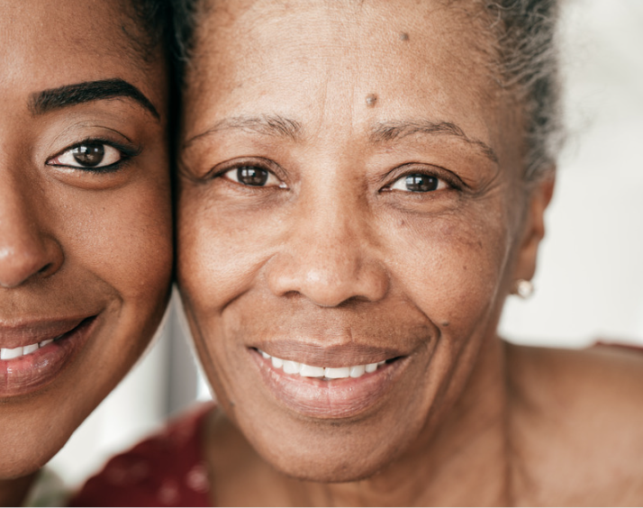
RISK FACTORS RELATED TO NORMAL AGING
Stiffening of connective tissue
Loss of muscle mass
Slowing of nerve conduction
Decreased visual acuity
Impaired depth perception
Cardiovascular changes
Decreased joint range of motion
Notes:
Changes to our cardiovascular, neurological, reproductive, pulmonary, musculoskeletal systems
Normal age-related changes result in a reduction in muscle mass of about 30% between the ages of 50-70 years, with a greater rate of loss in subsequent years.
Decreased in muscle strength, endurance and power leave on unable to prevent a slip, trip or stumble from becoming a fall.
Muscle weakness was found to be the most important risk factor, increasing the risk of a fall by 4-5 times.
Consequently:
Decreased gait velocity – stable until about age 70 then decreases about 15% per decade
Shortened step length
Increased postural sway
Wider base of support
Feet are not picked up
Decreased reaction time
Increased stance time
(AGS/BGS and American Academy of Orthopedic Surgeons Panel on Falls Prevention (2001). Guideline for the prevention of falls in older persons. Journal of the American Geriatrics Society, 49, 664-672).
WHO 2000 shows the importance of maintaining muscle mass to maintain function.
Nutrition, particularly protein intake, is key.

Slide 15
Physical inactivity, adiposity and sedentary behavior are ACCELERATORS of aging physiology.
Notes:
We can change the aging trajectory!

Slide 16
Can you name any Behavioural Risk Factors?
Write in the chat!
CHAT

Slide 17
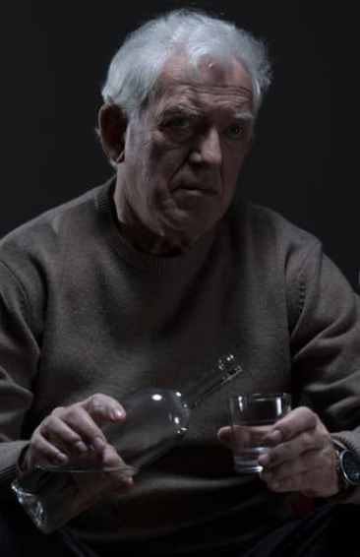
BEHAVIOURAL RISK FACTORS
Risk-taking attitudes (action or inaction)
Reduced physical activity
Excessive alcohol use
Fear of falling
Improper footwear/clothing
Use of assistive devices
Poor nutrition/hydration
Lack of sleep
Notes:
We have control over own behaviours so this is an avoidable risk factor
Risky behaviour can be caused by an “action” or “inaction”
Example of “action”: holding too many things in the hands when going up or down stairs so can’t use railing
Example of “inaction”: not using walking aid as recommended
Talk about not following through with recommendations
Fear of falling leading to inactivity leading to …
Lack of maintenance of assistive devices (cane tips worn, wheels on walker become loose, wrong height)

Slide 18
Can you name any Environmental Risk Factors?
Write in the chat!
CHAT

Slide 19
ENVIRONMENTAL RISK FACTORS- INDOORS
Poorly maintained home
Stairs without handrails or marking on the edges
Poorly lit stairs, ramps or doorways
Pets
Slippery floors, throw rugs, loose carpets
Raised sills in door jams
Clutter
Low toilet seats
Lack of grab bars in bathrooms
Stairs with irregular step width or height
Notes:
Draw attention to ones not mentioned.
In home- these are observations that can be made
In clinic- questions that must be asked

Slide 20
ENVIRONMENTAL RISK FACTORS - OUTDOORS
Use of assistive devices
Public/community hazards
Wintery conditions - snow or ice on stairs or walkway
Uneven sidewalks or cracks in sidewalks
Stairs without handrails or marking on the edges
Poor lighting
Objects on sidewalks or walkways such as garbage cans
Unmarked curbs or corners without curb ramps
Long crosswalks without pedestrian islands
Notes:
Do any of these surprise you?

Slide 21
Can you name any Social and Economic Risk Factors?
Write in the chat!
CHAT

Slide 22
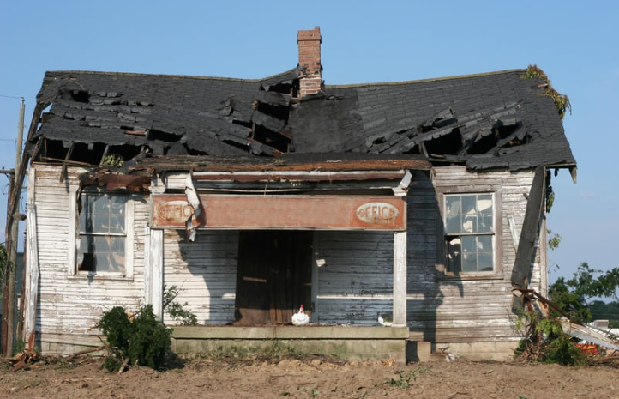

SOCIAL AND ECONOMIC RISK FACTORS
Isolation
Language barrier
Poor living conditions
Lack of transportation
Low level of education
Notes:
Draw attention to those not mentioned.
Can’t afford new glasses
No one to clean up incontinence spills
Nutritional deficiencies due to lack of good food.
Did any of these risk factors (biological, environmental, behavioural or social) surprise you?

Slide 23
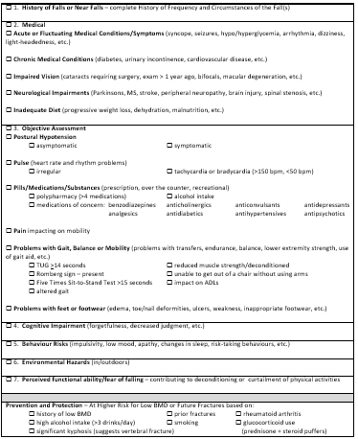
Multifactorial Fall Risk Summary

Slide 24
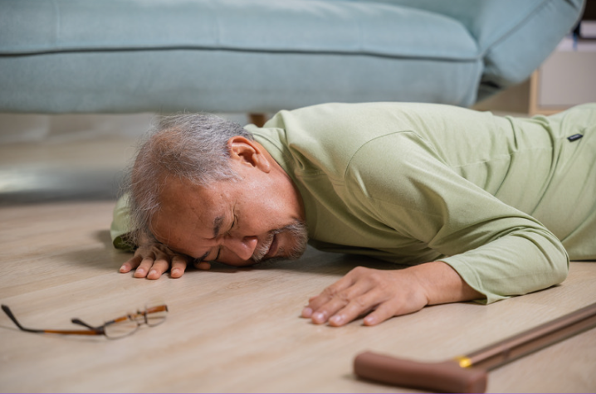
MULTIFACTORIAL FALL RISK SUMMARY
A History of Falls:
Frequency – escalating?
Circumstances
      Time of day
      Location of fall
      Events leading up to fall
      Any LOC? Any loss of balance?
      Mental status – alert, groggy, dizzy
      Environmental hazards
      Use of mobility aid
      Injury
      Sought medical attention
Notes:
The Geriatric Assessment Outreach Team developed a Multifactorial Fall Risk Summary after an evidence-based review of the literature in assessment of falls. It is based strongly on the AGS/BGS Clinical Practice Guidelines from 2013.
This summary is now used by the Champlain LHIN’s Fall Prevention Strategy Group in combination with an algorithm for educational purposes directed towards primary care providers and other health professionals about the assessment of falls.
We will spend the next bit of time going over this summary.
In a secondary anaylsis of a 2-year falls prevention trial looking at 341 falls, 90% of falls happened while moving.

Slide 25
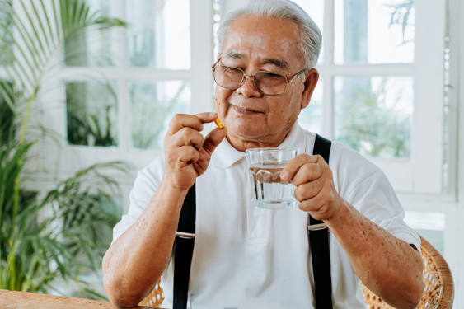
MULTIFACTORIAL FALL RISK SUMMARY
MEDICAL
Acute or Fluctuating Medical Conditions and Symptoms
For example:
      COVID-19
      Syncope
      Seizures
      Hypo/hyperglycemia
      Dizziness
      Light-headedness

Slide 26

MULTIFACTORIAL FALL RISK SUMMARY
MEDICAL
Chronic medical conditions
For example:
        -Cardiovascular disease
        -Bladder and bowel problems
        -Arthritis
        -Diabetes
Notes:
Hypertension has been shown to be associated with gait instability and changes in postural control. (CFPC p48)
Both OA and RA involve an increased risk for falls and fractures. The exact mechanism of risk is not clearly understood but common themes across studies point to poor dynamic and static balance, poor lower limb strength, polypharmacy and a history of fallings. (CFPC-p. 48)
Bladder and bowel problems
Urgency, frequency, nocturia, infections, incontinence.
Persons taking laxatives were twice as likely to fall as thoses not taking laxatives (CFPC p48)
The majority of gait disorders appear in connection with underlying diseases, particularly as disease severity increases
Conditions related to diabetes, such as neuropathy, retinopathy, nephropathy contribue to an increased risk of falls. Medications taken for diabetes are also shown to be associated with increased risk for falls and related injuries (CFPC p49)

Slide 27
MULTIFACTORIAL FALL RISK SUMMARY
MEDICAL
Impaired vision (cataracts requiring surgery, bifocals, macular degeneration, etc.)
Neurological impairments (Parkinson’s, MS, stroke, peripheral neuropathy, brain injury, spinal stenosis, etc)
Inadequate diet (progressive weight loss, dehydration, malnutrition, etc.)

Slide 28

MULTIFACTORIAL FALL RISK SUMMARY
OBJECTIVE ASSESSMENT
Pulse (heart rate and rhythm problems)
Postural Hypotension
  A decrease of ≥ 20 mm Hg (systolic BP) or ≥10 mm Hg (diastolic BP) within three minutes of standing
(MacDonald et al., 2016)
Notes:
Dr. Molnar (previous Medical Director of the Regional Geriatric Program of Eastern Ontario) and the Champlain LHIN Fall Prevention Strategy discuss the 3 Ps as 3 important modifiable risk factors.
1st one is Postural hypotension (in red).
Why - Body unable to compensate for pooling of blood in the venous systems of lower extremities and GI tract when rising

Slide 29
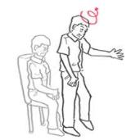
POSTURAL HYPOTENSION
Measure peripheral blood pressure and heart rate in the supine position and then after 1 and 3 minutes of standing.
    older adult may be symptomatic or asymptomatic
    many different causes
(MacDonald et al., 2016)
Notes:
Postural hypotension with ↑ in heart rate
Suspect volume dehydration
Postural hypotension with no change in heart rate
Potential - autonomic dysfunction or beta-blockage
Examples of autonomic dysfunction such as diabetes, hypothyroidism and Vitamin B12 deficiency
Beta blockage example – atenolol, metoprolol
Timing: morning, after meal, or after BP meds taken effect
Ask if senior symptomatic during position changes
Timing of testing has been shown to be important due to the variability of blood pressure throughout the day and the observation that patients tend to be most symptomatic from OH in the morning.
Other high yield times to test are after meals and when BP medications are expected to have peak effect.
Symptoms: dizziness, light headedness, vision change, swaying, weakness, presyncope
Symptomatic also important when no associated postural hypotension

Slide 30
MULTIFACTORIAL FALL RISK SUMMARY
Non-pharmacological:
Arising from bed in 3 stages
Pump ankles once sitting from lying
Avoid large meals
Avoid bending and standing quickly
Avoid hot baths
Avoid constipation – straining
Use elastic stocking
Elevate head of bed
Notes:
Many Causes- physician needs to investigate

Slide 31

MULTIFACTORIAL FALL RISK SUMMARY
Pills – prescription, over the counter, illicit, alcohol
Polypharmacy
Psychoactive medications (including sedatives, hypnotics, antidepressants, antipsychotics)
Digoxin, diuretics, antihypertensives, anticholinergic agents
Alcohol intake
Poor comprehension
Notes:
2nd P- pills (in red).
BEERS Criteria
STOPP
Medications can have side effects that are associated with increased risk of falls or injuries from falls
Review bottles, blister-packs, weekly dosettes
Taking as prescribed/over-taking/missing doses?
Taking at right time?
Understand what medications are for and taking for right reason?
What steps are taken if miss dose?
Using friends/relatives medications?
Mixing with alcohol or other drugs?
Volume of alcohol, marijuana, illicit drugs
Important to also assess:
OTC medications (and frequency)
Vitamins/minerals/natural products

Slide 32
NOW WHAT?
Encourage older adults to ask questions about their medications:
  Have any medications been added, stopped or changed, and why?
  What medication do I need to keep taking, and why?
  How do I take my medications, and for how long?
  How will I know if my medication is working, and what side effects do I watch for?
  Do I need any tests and when do I book my next visit?
(Safe Medication Use, n.d.)
Notes:
Even though you are not a doctor or NP, you can still talk to older adults about their medications.
If seniors do not know why they are taking some “high risk” medications or seem unaware of whether their medications can be associated with increased fall risk, encourage them to speak to their physician or pharmacist.

Slide 33
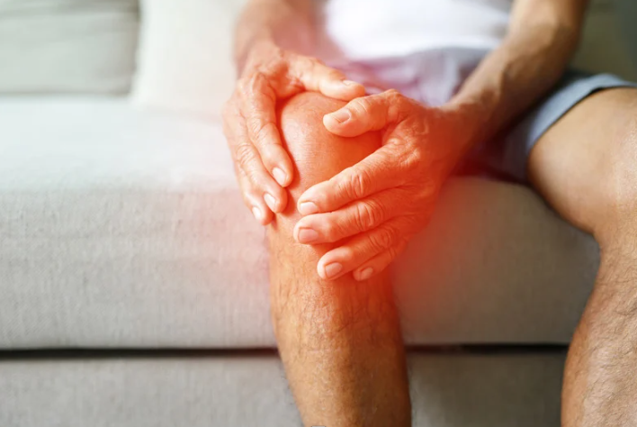
MULTIFACTORIAL FALL RISK SUMMARY
Pain – impacting on mobility
Notes:
3rd P- pain (in red).
Many seniors have pain
Often chronic – many under report
Pain can contribute to falls:
Limits mobility
Promotes musculoskeletal weakness due to inactivity
Impacts joint movement
Studies show that community-dwelling seniors with pain were more likely to have fallen in the past 12 months and to fall again in the future
Foot and chronic pain were particularly strong risk factors for falls
Educate and empower your patients!
Encourage patients to speak to their primary care providers about pain.

Slide 34
PAIN ASSESSMENT
(Registered Nurses Association of Ontario, 2013)
Notes:
Treatment of pain may improve gait, balance (and desire to be more active?)
Non-pharmacologic
Adjustments in daily routine, gait aid, exercise, joint replacements, physiotherapy
Psychological approaches
Pharmacologic

Slide 35
MULTIFACTORIAL FALL RISK SUMMARY
Problems with Mobility/Gait/Balance
    Reduced muscle strength
    Deconditioning
    Unable to get out of a chair without using arms
    Impact on ADLs
    Balance impairments
    Altered gait
    Use of gait aid
Notes:
The next several slide will explore how we can identify problems with mobility/gait and balance as well as recommend a few standardized assessment tools

Slide 36
MULTIFACTORIAL FALL RISK SUMMARY
Problems with Mobility/Gait/Balance
    Reduced muscle strength
    Deconditioning
    Unable to get out of a chair without using arms
    Impact on ADLs
    Balance impairments
    Altered gait
    Use of gait aid
Notes:
The next several slide will explore how we can identify problems with mobility/gait and balance as well as recommend a few standardized assessment tools

Slide 37
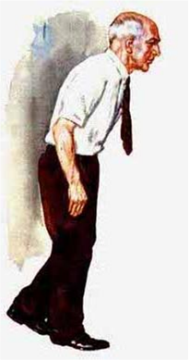
FUNCTIONAL ASSESSMENT
Timed Up and Go
Chair-Stand Test
Notes:
We know that mobility, length strength, balance and gait are important risk factors for falls.
SO how to we assess these in a clinical setting.
Several tests: BERG, tinetti, functional reach, dynamic gait index, Short Physical Performace Battery. All of these tests have their place but some are too complex for a frail population. Some are too long to administer.
Tinetti: objective measure of balance and gait. Limited with respect to dynamic balance assessment. Good for frail, housebound population. It is a 16 item assessment tool which was developed as a measure to screen older adults for balance and gait impairments.
Berg: It is a widely used balance outcome measure. It is a 14 item objective measure designed to assess static balance and dynamic balance and fall risk in adult populations. Each item is scored on a scale from 0-4 for a total of 56 points. It takes 15-20 minutes to administer, is free and easy to administer on community dwelling older adults and the equipment required is readily accessible in a clinic environment. The test can be very challenging for frail older adults. The items of the BBS highlight a patient’s strengths and weaknesses which help the Physiotherapist with exercise prescription and referral to community programs. This measure is very familiar to physiotherapists in the Ottawa area.
We are going to focus on 2 tests that provide standardized, objective and reproducible information. These tests can be completed in a timely manner as well. We will also review a simple way to look at static balance.

Slide 38
POLL
Have you ever heard of the Timed Up and Go?
Have you ever administered the Timed Up and Go?

Slide 39

TIMED UP AND GO (TUG)
Simple and practical performance measure of gait and balance
Standardizes most of the “basic mobility” tasks
Older adult is observed while he/she rises from a chair, walks 3 meters and returns to the chair
Standardized cut-off scores to predict risk of falling
A cut-off score of ≥ 13.5 seconds was shown to predict falling in community-dwelling frail elders
**TUG score for risk of falls is not valid with cognitive impairment
  (Shumway-Cook et al., 2000)
(Panel on Prevention of Falls in Older Persons, American Geriatrics Society and British Geriatrics Society, 2011)
Notes:
Summary: The Timed Up and Go test was included as a timed measure of gait ability including turning ability. The TUG helps to delineate indoor/outdoor walking abilities and fall risk. It is reliable and has excellent correlation with many functional outcome measures. It is a functional mobility test to screen balance, walking ability and fall risk.
<20 seconds is adequate for independent transfers and mobility
>30 seconds suggests higher dependence and risk of falls
Not only do we obtain valid, objective information but we have to opportunity to use our powers of observation to gain even more insight into a person’s strengths/weaknesses.
There is a book called Practical Neurology for the PCP. Its author suggests that: “if we only had one minute to examine a patient and were allowed only one neurologic test, we would choose station and gait.” (1981)
TUG can predict: risk of falls, risk of adverse events, MI, CHF, mortality

Slide 40
TIMED UP AND GO (TUG)
Observe Rising from Chair
  watch the speed of rising
  does the older adult need assistance or a boost?
  does the older adult lean forward on rising?
  are you worried the older adult might fall?
Notes:
*difficulty suggests possible myopathy, arthritis, parkinsonism, postural hypotension, deconditioning, hip disease, hemiparesis or paraparesis*

Slide 41
TIMED UP AND GO (TUG)
Observe Standing
  what is the older adult’s stance?
  does the older adult lean to one side?
  does the older adult sway?
  does the older adult have any balance problems?
  are you worried the older adult might fall?
  check for postural abnormalities
  does the older adult complain of pain standing still?

Slide 42
TIMED UP AND GO (TUG)
Observe Walking
  watch the height and width of the steps
  are steps irregular?
  can the older adult maintain balance while walking?
  are you worried the older adult might fall?
  look for asymmetric arm swing, abnormal arm and hand postures, and instability of the trunk
Notes:
Ataxia. Ataxia is a symptom – it indicates a problem with the cerebellum which controls coordinated movements. An inability to coordinate muscle activity.
decreased step height might suggest CNS disease, multiple sensory deficits, fear of falling, Parkinson's, NPH, habit
*path deviation suggests possible cerebellar disease, multiple sensory deficits, sensory or motor ataxia
*decreased step height suggests possible CNS disease, multiple sensory deficits, fear of falling, Parkinson’s, normal pressure hydrocephalus, poor habit

Slide 43
TIMED UP AND GO (TUG)
Observe Turning
  watch the speed of turning, steadiness and number of foot placements needed to complete the turn.
  are you worried the older adult might fall?
Notes:
*unsteadiness suggests possible Parkinson's, multiple sensory deficits, cerebellar disease, hemiparesis, loss of visual field, ataxia

Slide 44
TIMED UP AND GO (TUG)
Observe Sitting Down
  is descent smooth?
  is the speed of descent normal?
  does the older adult lean forward to sit?
  does the older adult need to hold onto the chair?
  are you worried the older adult may fall?
Notes:
In general “A walk test” *misjudgment of distance or falling into chair suggests possible decreased vision, proximal myopathy or ataxia
Observe gait pattern
Include directional changes
Include cognitive challenges (talk to them, divided attention)
Include head turns
Include changes in flooring (transition, colour, type)
Look at endurance
Effect on cardiovascular system
Gait aids
**Remember, you are testing patient in optimal environment free of distraction, traffic, snow and ice, sidewalks, pedestrians.

Slide 45
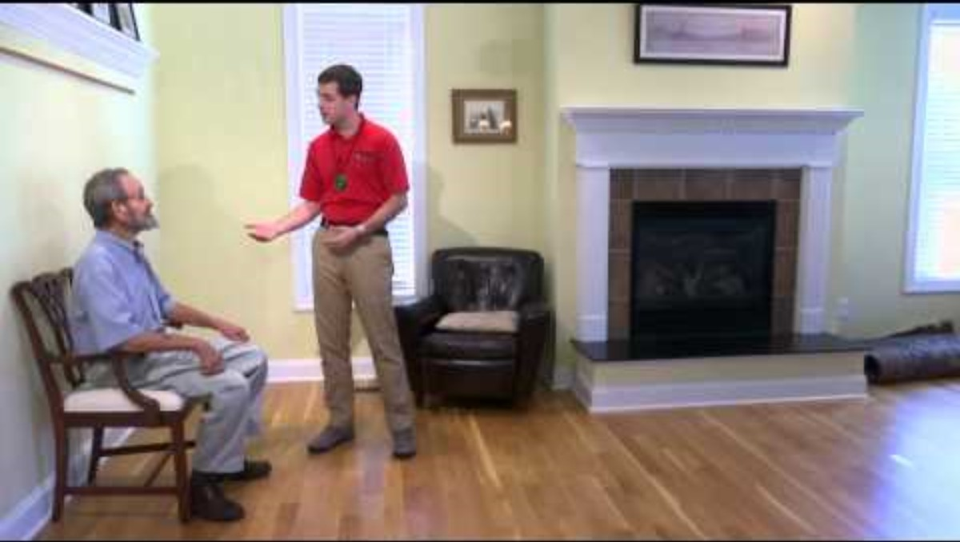
TIMED UP AND GO (TUG)
Timed Up and Go Video

Slide 46
POLL
Have you ever heard of the Chair-Stand test?
Have you ever administered the Chair-Stand test?

Slide 47
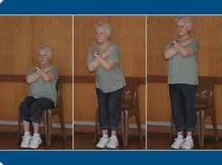
CHAIR-STAND TEST
Assesses leg muscle strength, balance and endurance
Older adult cannot use arms (arms are crossed on the chest)
Ask older adult to stand up to a full standing position and then sit back down again
Notes:
The Chair Stand Test
It is a measure of leg muscle strength, endurance and balance. It is quick and easy to administer and does not require any specialized equipment. There are several variations of this test including the measurement of time to do Five or Ten sit to stands. There is also a 30 second sit to stand test that measures the number of sit to stand repetitions done in 30 seconds.

Slide 48
LET’S TRY IT!

Slide 49
30 SECOND CHAIR-STAND TEST
AGE | Men Number of Stands | Women Number of Stands
60-64 | 14-19 | 12-17
65-79 | 12-18 | 11-16
70-74 | 12-17 | 10-15
75-79 | 11-17 | 10-15
80-84 | 10-15 | 9-14
85-89 | 8-14 | 8-13
90-95 | 7-12 | 4-11

Slide 50
FIVE-TIMES SIT TO STAND
Optimal cut-off time for predicting recurrent fallers is 15 seconds.
Estimate cut-off values for normal performance in community-dwelling older adults:
60-69 years: 11.4 seconds
70-79 years: 12.6 seconds
80-89 years: 14.8 seconds
(Buatois et al. 2008, 2010)
Notes:
The Five Times Sit to Stand Test (FTSST) is a test which measures the time it takes a patient to stand up and sit down completely five times in a row without arm support (the patient’s arms are folded across their chest). Inability to complete five repetitions without assistance or use of upper extremity support indicates failure of the test. The test is simple to learn and administer. This test version is less tiring for older adults to complete than the 10 times Sit to Stand Test or the 30 Second Sit to Stand test.
Summary: The Five Times Sit to Stand test is a simple measure of lower extremity functional strength. It was chosen for its objectivity, ease of use, additional measure of endurance and balance, and ease for patients to complete.

Slide 51
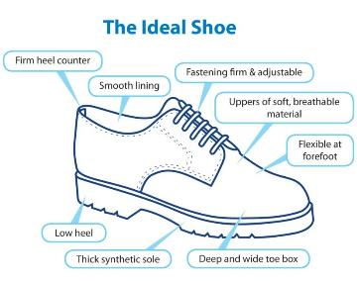
MULTIFACTORIAL FALL RISK SUMMARY
Feet (toe/nail deformities, ulcers, weakness, edema)
Footwear (inappropriate)
Notes:
Can tell a lot by looking at a person’s feet (function- able to take socks/shoes on/off; hygiene)
Why are shoes important?
Increase traction/grip on different surfaces
Stability and shock absorption
Comfort and pain reduction
Protection (especially for diabetic feet)
Reduce risk for falls
Good for walking outdoors, exercising and walking in your home.
Avoid walking barefoot or in socks.

Slide 52
MULTIFACTORIAL FALL RISK SUMMARY
Cognitive impairment
Low mood or behavior risks
Perceived functional ability/Fear related to falling
Notes:
Cognitive impairment:
Changes in cognition interfere with the ability of an individual to quickly respond to changes in their environment such as the ability to anticipate and adapt to environmental stimuli, particularly when quick solutions are needed that involve movement.
For those with dementia or other cognitive disorders the risk of falling and sustaining a fall injury is 2-3 times that of older people without cognitive impairment. Even with MCI, the incidence of multiple falls and falls with injury is shown to be twice that of people with normal cognition. (Delbaere, K., Kochan, N.A., Close, J.C., Menant, J.C., Sturnieks, D.L, Brodaty, H., and Lord, S.R. (2012). Mild cognitive impairment as a predictor of falls in community-dwelling older people. The American Journal of Geriatric Psychiatry, 20 (10), 845-853.
Depression
15% of community-dwelling seniors (2013) report clinically significant depressive symptoms, with rates even higher among those in LTC (CFPC p47)
Risk factors include: insomnia, nutritional deficiencies related to poor appetite and cognitive deficits affecting attention, executive function and processing speed. Activity restriction can also lead to muscl eweakness and poor balance.
Fear of falling
Up to 40% of those with a fear of falling decrease their physical activity, leading to muscle weakness and poor balance, social isolation and depression- further increasing their risk for falling. Fear of falling may also exist among family members, who may advocate activity restrictions that will further increase, rather than decrease, the older person’s risk of falling. (CFPC- page 50)

Slide 53
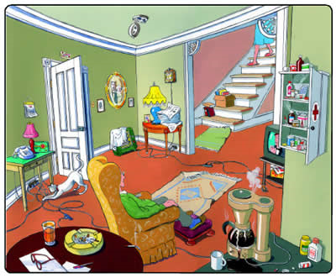
MULTIFACTORIAL FALL RISK SUMMARY
Environmental Hazards
Notes:
What do we see as hazards in this picture- write them in the chat

Slide 54
HOME SAFETY
CHECKLIST

Slide 55
MULTIFACTORIAL FALL RISK SUMMARY
Prevention and Protection: higher risk for low BMD, future fractures and falls based on:
  history of low BMD
  high alcohol intake (>3 drinks/day)
  significant kyphosis (suggests vertebral fracture)
  prior fractures
  smoking
  rheumatoid arthritis
  glucocorticoid use (prednisone + steroid puffers)
Notes:
Keep in mind the client’s risk for fractures as well…
Good opportunity to discuss prevention and protection

Slide 56
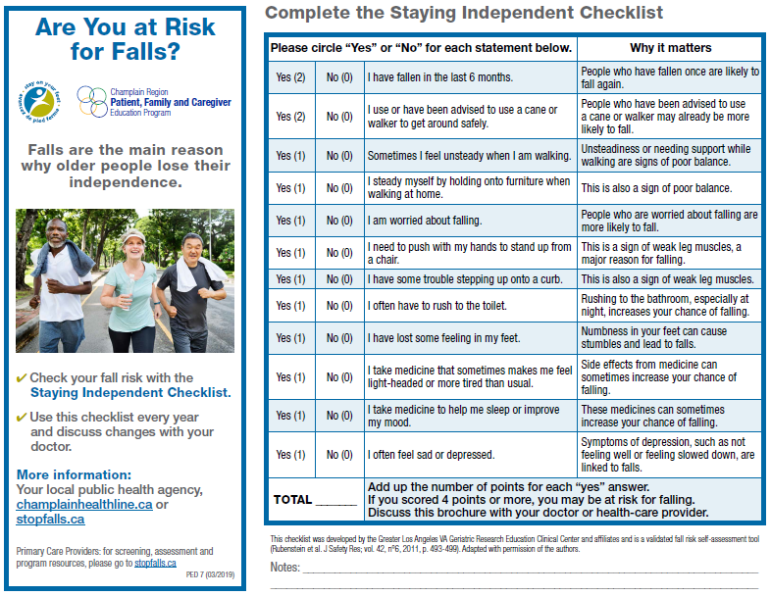
STAYING INDEPENDENT CHECKLIST

Slide 57
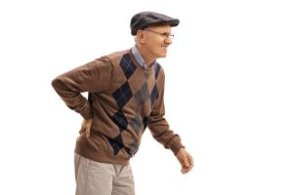
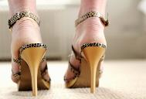
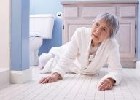

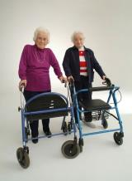
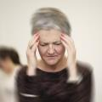
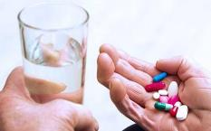
IMPRESSION
Goal of the assessment is to identify and address modifiable risk factors

Slide 58
IMPRESSION AND ANALYSIS
Putting the pieces together!
  Biological
  Behavioural
  Environmental
  Socio-economic

Slide 59
INTERVENTIONS
Recommendations to Primary Care Provider
Lab Work / CT / X-rays /BMD Test as indicated
Medication Review- minimization & modification (psychoactive and antipsychotic meds in particular)
Vitamin D supplementation
Pain management
Management of osteoporosis- (pharmacotherapy for older adults at high risk for major osteoporotic fracture)
Optimization of vascular risk factors
Management of heart rate and rhythm problems
Management of foot and footwear problems
Management of vision/hearing impairment
Further review of cognition/mental health
Notes:
Osteoporosis is a condition characterized by low bone mass, reduced bone strength and increased risk of fracture (spontaneous or trauma-associated).
At least 1 in 3 women, At least 1 in 5 men
Fracturing a long bone after falling from standing height is not normal
Over 80% of all fractures in people 50+ are caused by osteoporosis
Associated with loss of independence, pain, reduced mobility

Slide 60
INTERVENTIONS
Recommendations to Older Adult
Education re: fall prevention, postural hypotension, assistive devices
Adaptation/modification of home environment
Exercise program targeting strength and balance
150 minutes of physical activity per week
Clothing and footwear modifications
Modification of diet, hydration and nutrition
Socialization/counselling
Further pelvic health support (Kegels, reducing bladder irritants, behavioural intervention)
Health management (annual vision test, good sleep habits, chronic disease self-management, annual medication review)

Slide 61
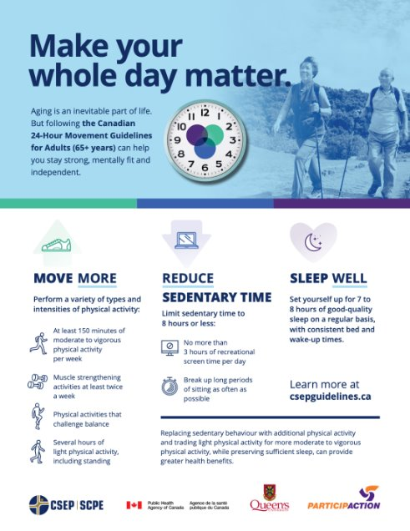
24-Hour Movement Guidelines
Notes:
Movement is medicine!
We were meant to move!
Goals: reduce sedentary time and increase physical activity
Physical activity: activities that increase movement throughout the day
Exercise: purposeful movement for the goal of increasing fitness
Weakness-deconditioning-stiffness...we need to give people reserve to hold up against these.
Moderate: can talk but not sing
Vigorous: can't say

Slide 62
EXERCISE RECOMMENDATIONS
Older adults can be classified as non-frail, pre-frail or frail
Non-frail adults: follow the Canadian Physical Activity Guidelines for Older Adults
  Take part in at least 2.5 hours (150 minutes) of moderate to vigorous intensity aerobic activity each week.
  Spread out the activities into sessions of 10 minutes or more.
  It is beneficial to add muscle and bone strengthening activities using major muscle groups at least twice a week.
  (Canadian Society for Exercise Physiology, 2021)
Notes:
Moderate: talk but not sing
Vigorous: only say a few words without pausing for breath
Rate of Perceived Exertion scales
"Talk test"- valid

Slide 63
EXERCISE RECOMMENDATIONS
Pre-frail and frail older adults: should perform various exercise modalities that include: aerobic, resistance, balance and flexibility activities.
Pre-frail (exhibit 1-2 physical deficits): 3x/week for 45-60 minutes per session (135-180 minutes weekly)
Frail (exhibit 3 or more physical deficits): 3x/week but for a shorter duration, 30-45 minutes. (90-135 minutes each week)
    (Bray et al., 2016)
Notes:
Evidence
Should work at an intensity of “somewhat hard” from BORG exertion scale
This article also suggests that “exercise is likely the medicine that will reverse frailty; at the very least it will slow down the accumulation of functional deficits”

Slide 64
INTENSITY IS THE KEY!
Even for pre-frail and frail older adults:
Exercise should start at MODERATE intensity, but progress to a more MODERATE-VIGOROUS intensity.
Notes:
Moderate: noticeably breathing, but able to participate in verbal conversation
Moderate-vigorous- breathign is more rapid and verbal conversation in challenging

Slide 65
“Exercise is the medicine to reverse or mitigate frailty, preserve quality of life, and restore independent functioning in older adults at risk of frailty.”
(Bray et al., 2016)
Notes:
Louise

Slide 66
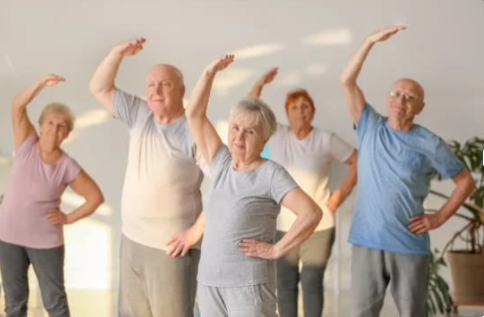
EXERCISES
Strength : exercises need to be progressive
Balance : exercises need to be challenging
Notes:
Older adults are sensitive to exercise
Dosing INTENSITY is key....even for, or expecially for, those that are sick.
Balance- at the edge of balance feeling like need to grab for support. For balance interventions to be effective, they need to be uncomfortable.

Slide 67
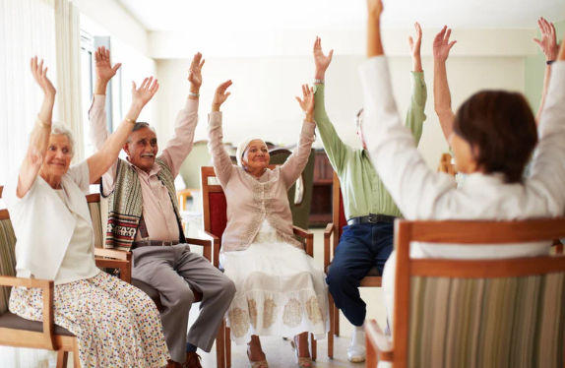
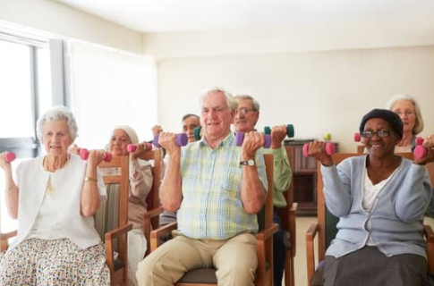
All types of exercises can reduce falls by 23% compared to inactive controls
(Doi.org/10.1186/s12966-020-01041-3)

Slide 68
GAIT AIDS
    Reduce - falls
    Improve - stability and safety
    - endurance
    - gait
    - function
    - quality of life

Slide 69
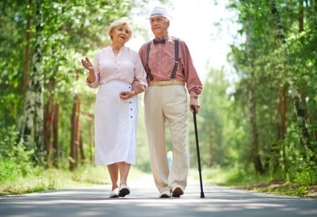
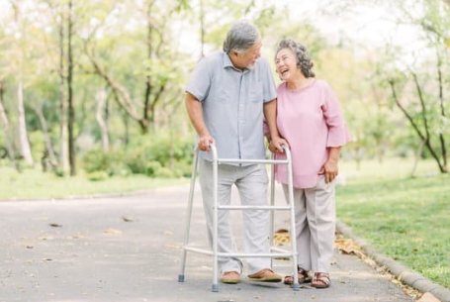
WHAT TO CHOOSE?
Choose a cane for:
  pain relief
  light joint support
  light balance and mobility support
Choose a walker for:
  moderate balance or postural concerns
  weakness
  pain
  limited energy

Slide 70
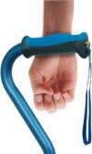
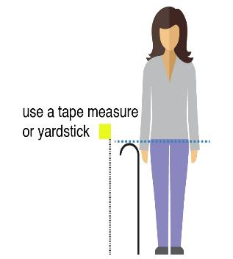
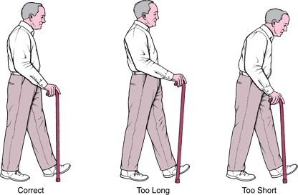
HOW TO MEASURE A CANE OR WALKER
Handle height = wrist level
with arm straight at side
Which hand for a cane?
for pain relief or joint support, hold opposite the weak side
for balance typically dominant side is easier

Slide 71
TIPS FOR USING A WALKER SAFELY
THE BRAKES:
Before getting up, the brakes must be locked (push down)
GETTING UP:
Push up from chair or bed then transfer hands to walker
WALKING:
Standing tall, push the walker forwards and walk stepping between the back wheels with each step
SITTING DOWN:
Walk to chair or bed, turn around and back up with walker until legs touch the seat, lock walker brakes, reach for chair/ support and sit down
USING WALKER SEAT:
Brakes must be locked (push down to lock); for extra safety walker can be positioned against a wall; hold on to walker while turning to sit. Meant only for taking rests, not for transportation

Slide 72
“Those who think they have not time for exercise will sooner or later have to find time for illness.”
Edward Stanley (1826-1893)

Slide 73
REFERENCES
Bray, N.W., Smart, R.R., Jakobi, J.M., & Jones, G.R. (2016). Exercise prescription to reverse frailty. Applied Physiology, Nutrition, and Metabolism. 41(10):1112-1116. https://doi.org/10.1139/apnm-2016-0226
Canadian Society for Exercise Physiology. (2021). Canadian physical activity guidelines for older adults 65 years and older. https://www.csep.ca/CMFiles/Guidelines/CSEP_PAGuidelines_older-adults_en.pdf
Inouye, S.K. Brown, C.J. and Tinetti, M.E. Medicare nonpayment, hospital falls and unintended consequences. New England Journal of Medicine, 2009, 360 (23), 2390-2393.
MacDonald, M.J., Klair, A., Khoury, L., & Molnar, F.J. (2016). 4D-AID: A practical approach to the assessment of orthostatic hypotension in older patients. CGS Continuing Medical Education Journal, 6(1).
LHIN Collaborative. (2011). Integrated provincial falls prevention: Framework and Toolkit. Retrieved from http://govdocs.ourontario.ca/node/8872
Ottawa Public Health. (2015). You can prevent falls. https://www.ottawapublichealth.ca/en/public-health-topics/you-can-prevent-falls.aspx
Panel on Prevention of Falls in Older Persons, American Geriatrics Society and British Geriatrics Society (2011). Summary of the Updated American Geriatrics Society/British Geriatrics Society clinical practice guideline for prevention of falls in older persons. Journal of the American Geriatrics Society, 59(1), 148–157. https://doi.org/10.1111/j.1532-5415.2010.03234.x
Parachute. (2015). The Cost of Injury in Canada Report. Retrieved December 6th, 2020, from https://parachute.ca/en/professional-resource/cost-of-injury-report/
Public Health Agency of Canada. (2014). Seniors’ Falls in Canada (Second Report). https://www.canada.ca/content/dam/phac-aspc/migration/phac-aspc/seniors-aines/publications/public/injury-blessure/seniors_falls-chutes_aines/assets/pdf/seniors_falls-chutes_aines-eng.pdf
Registered Nurses Association of Ontario. (2017). Preventing falls and reducing injury from falls (4th Edition). https://rnao.ca/sites/rnao-ca/files/bpg/FALL_PREVENTION_WEB_1207-17.pdf
Registered Nurses Association of Ontario. (2013). Assessment and management of pain (3rd Edition). https://rnao.ca/sites/rnao-ca/files/AssessAndManagementOfPain_15_WEB-_FINAL_DEC_2.pdf
Evidence on physical activity and falls prevention for people aged 65+ years: systematic review to inform the WHO guidelines on physical activity and sedentary behaviour | International Journal of Behavioral Nutrition and Physical Activity | Full Text (biomedcentral.com)
Safe Medication Use (n.d). Safe medication use. Canadian Medication Incident Reporting and Prevention System. Retrieved December 6th, 2020, from https://safemedicationuse.ca/
© Regional Geriatric Program of Eastern Ontario

Slide 74
THANK YOU!
QUESTIONS?

Slide 75
cmcshane@qch.on.ca
https://www.qch.on.ca/

