Slide 1

Chantal
Foidart
Chantal completed a Bachelor of Science in Occupational Therapy at the University of Ottawa. She has been a Geriatric Assessor with the Geriatric Assessment Outreach Team of the Regional Geriatric Program of Eastern Ontario (RGPEO) since 2015. Chantal also recently worked a research assistant for the University of Sherbrook. She has experience working as an occupational therapist, clinical coordinator and case manager in a variety of clinical settings such as a rehabilitation center and in the community. In her current role, Chantal enjoys helping community-dwelling seniors optimize their health and access community services that will support them to remain in their homes.
GERIATRIC ASSESSOR
BRUYERE HEALTH

Slide 2
Living At Risk or With Risk?
Chantal Foidart
Geriatric Assessor
Geriatric Assessment Outreach Team
Bruyere Health
Notes:
Thank you for the introduction!
Welcome to this presentation that looks at whether we are living AT risk or WITH risk?

Slide 3
ACKNOWLEDGEMENT
With very special thanks and recognition to:
Heather MacLeod, Lead researcher of the LwR:DSA Research Group
Notes:
I want to take a minute to recognize and thank Heather MacLoed, the Lead researcher in the Living with Risk: Decision support approach research group who put together this presentation and continues to work on improving the approach that we’re talking about today.

Slide 4
CHAT
What a risky thing you’ve done recently?
Put it in the chat box!
Notes:
In order to really understand risk assessment and management of risks, we first need to understand what is risk to us – so I would like you to write in the chat box what risky thing you’ve done recently.

Slide 5

This Photo by Unknown Author is licensed under CC BY-SA-NC
Notes:
This is a great example that Heather had in her presentation and I kept it because I think that it’s so great! She liked to lick the lid of the condensed milk can when she did her Christmas baking, but there’s a big risk of her cutting her tongue on the edges, but it’s SO worth it!

Slide 6
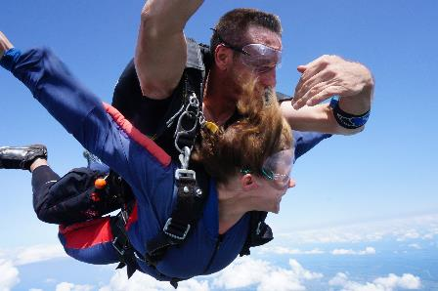
CHAT
Why did you take this risk?
Put it in the chat box!
Notes:
And now I’d like you to put in the chat WHY you took this risk

Slide 7
Risk
  Living with Risk
  Resilience
An Approach
  Identify, Assess
  Manage
Notes:
My hope is that by the end of this session you will:
- Understand risk, living WITH risk and resilience
- Learn about the Living with Risk: Decision Support Tool
Which is a 4 step approach to:
- Objectively evaluate an older adult’s risk status
- Identify several strategies for working with older adults on managing risk
And then apply these concepts to the case study later today.

Slide 8

LIVING WITH RISK
This Photo by Unknown Author is licensed under CC BY
Notes:
So what do we know about living with risk?

Slide 9

WHAT WE KNOW
Home is where 85% of Canadians over the age of 55 want to remain for as long as possible even if their health changes (Canadian Mortgage and Housing Corporation, 2008).
Notes:
We know that
the majority of older adults not only want to remain at home for as long as possible

Slide 10
WHAT WE KNOW
  Home is also where the majority of older adults want to be discharged to following hospitalization.
  Popejoy, 2011
Notes:
but home is also where the majority of older adults want to be discharged to, following a hospital admission (Popejoy, 2011).

Slide 11
Older adults at home
I want to leave this house feet first…
Staff spend too much time focusing on the risks and things I can’t do.
Patients
Community managers
Acute care is not discharging patient’s home.
In-patient managers
Staff are delaying discharge.
Notes:
When safety is a concern:
We hear Inpatient Managers say:
That Staff are delaying discharge
We hear Community Program Managers say:
That Acute care is not discharging patients home
We hear Inpatients say that:
Staff spend too much time focusing on the risks and things they can’t do versus what they can do
Lastly we hear Older adults living at home say:
I am leaving this house feet first and in a box…
So the tensions of supporting our older adults to live with risk, exists and is something that all clinicians grapple with whether we are working in the hospital or in the community.

Slide 12




WHAT IS THE RESULT
Patients don’t’ go home
caregivers are stressed
Clinicians have moral distress
system
Patient Flow is affected
Notes:
So what’s the result when safety is a concern?
Sometimes patients who want to go home, don’t get home.
Sometimes patients do get home but caregivers are stressed.
In both these cases when patients don’t go home or do go home, clinicians have moral distress about it.
And ultimately there is a system level impact where patient flow is affected. This refers to the fact that hospitals can only admit people into the hospital and do surgeries etc if they can discharge people out of the hospital. So this now is a system wide issue!

Slide 13
WHAT WE KNOW
Clinicians:
Define
risk negatively (Titterton, 2005)
Define
living at risk negatively (MacLeod & Stadnyk, 2015)
Define
living at risk differently (MacLeod & Stadnyk, 2015)
Focus
on the negative consequences (Titterton, 2005)
Focus
on the physical consequences (Clarke, 2000)
Assess
risk comprehensively - 8 factors (MacLeod & Stadnyk, 2015)
Notes:
What we also know is that clinicians:
Define risk negatively
Define living at risk negatively
Define living at risk differently, the definitions can vary greatly
Focus on the negative consequences of risk taking
Focus on the physical consequences of risk taking but also
Assess risk comprehensively by considering 8 different factors. These 8 factors were condensed for ease of use in this approach.

Slide 14
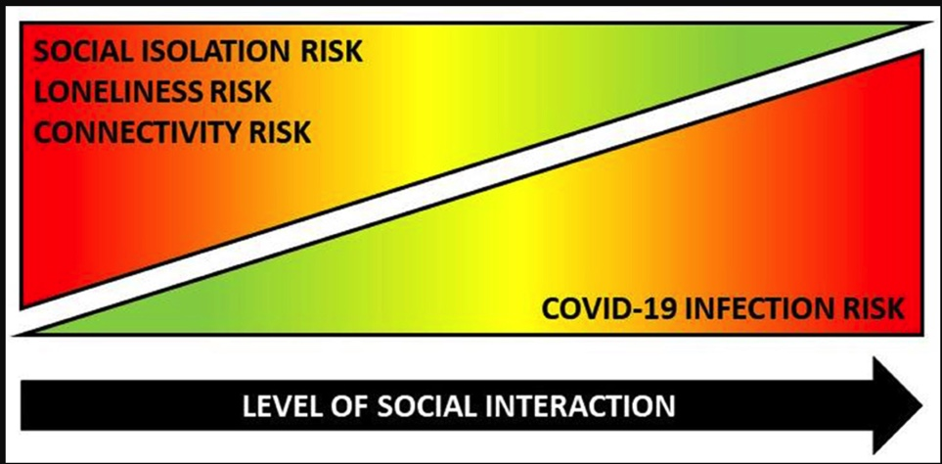
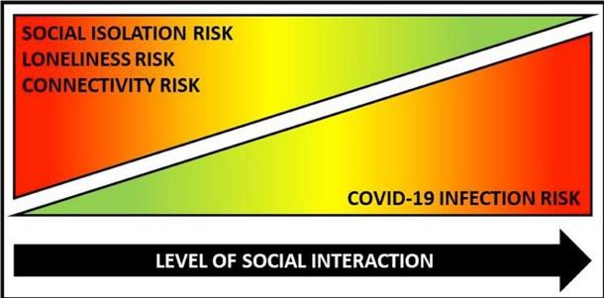
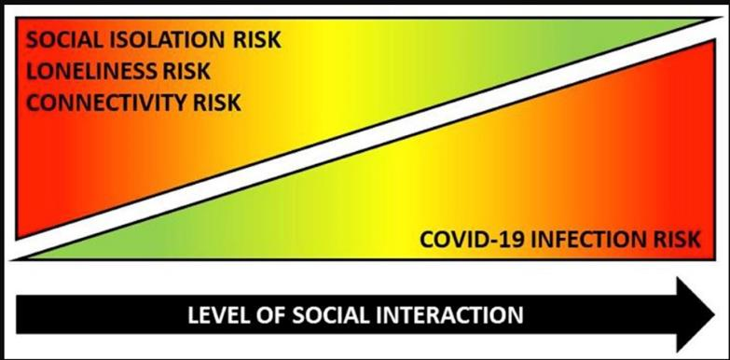
Ex. Covid-19 Social Connectivity Paradox
↑ Deconditioning
↑ Medical acuity
↑ Psychosis
↑ Confusion
↑ Anxiety
↑ Caregiver stress
(Lee Smith et al. 2020)
Notes:
The bias towards physical consequences is illustrated with the social connectivity paradox, that we saw with Covid-19.
This is a great example, because there was a public safety directive in place to prevent older adults from getting Covid, but they experienced negative consequences from social isolation. Our team saw, what you likely saw, which was an increase in deconditioning (therefore increased falls), increase medical acuity in the community, increased psychosis, increased confusion, increased anxiety and increased caregiver stress. So this is a great example of reducing the risk of one condition, but increasing the risk of others.

Slide 15

WHY IS IT HARD??
Do good
Do no harm
Right to self-determination
TENSIONS – Bioethic Principles
Notes:
So why is risk assessment and management so hard?
What we know is that there are tensions that exist when assessing and managing risks
We are constantly balancing the bioethics principles of
Do no harm and do good on the one hand with
The right to autonomy and self-determination that ultimately might lead to negative consequences on the other hand

Slide 16
WHY IS IT HARD??
Rational
Emotional
TENSIONS – Decision Making
Notes:
​There is also the tension between health care practitioners and within themselves - in balancing the science behind our knowledge by practicing evidence informed health care which leads to a rational approach to decision making,
which may be juxtaposed with client, patients or caregivers and possibly even within the clinicians using their emotions and feelings as the basis for their decisions.

Slide 17

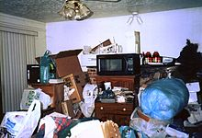
WHY IS IT HARD??
Hope
Support
This Photo by Unknown Author is licensed under CC BY-SA
This Photo by Unknown Author is licensed under CC BY-SA
TENSIONS – Outcomes
Notes:
Health care clinicians also have the tension of, on the one hand, wanting the best possible outcomes for their patients
but on the other hand, having to support the minimum requirements of living for these same patients. This can be very hard to do.

Slide 18
PATIENTS
CARERS
CLINICIANS
Goals of Care Differ
Safety Concerns
(Kuluski et al. 2013 )
Notes:
When there are safety concerns: Goals of care can differ between clinicians, caregivers and patients.

Slide 19
WHAT IS THE SOLUTION?
Clinicians are better able to support older adults to live with risk:
Define
risk negatively
Define
living at risk negatively
Define
living at risk differently
Focus
on the negative consequences
Focus
on the physical consequences
Assess
risk comprehensively - 8 factors
〉Broaden your definition of risk
〉Broaden your definition of living at risk
〉Clarify your definition of living at risk
〉
Broaden your approach
to risk assessment
Shared decision-making
19
Notes:
So what is the solution?
Clinicians are better able to support older adults to live with risk when they do the following:
broaden their definition of risk – think back to what people wrote in the chat a few minutes ago, about WHY they took risks!
broaden their definition of living at risk, maybe understanding that everyone lives WITH some degree of risk.
clarify their definition of living at risk and
broaden their approach to risk assessment and use a shared decision making approach
So HOW do we do this?

Slide 20
BROADENING DEFINITION OF RISK
From Negative
“the possibility that something unpleasant or unwelcome will happen; A situation involving exposure to danger (oxford dictionary)”
To Neutral
“risk is the effect of uncertainty on objectives where the consequences could vary from loss and detriment to gain and benefit (Purdy, 2010).”
“the harms and benefits of… are…”
“the risks and benefits of... are...”
20
Notes:
As indicated before, we know that clinicians tend to identify risk as negative, as indicated by this definition from the Oxford Dictionary,
“the possibility that something unpleasant or unwelcome will happen; A situation involving exposure to danger”
We also see that clinicians view risk as negative with continual use within health care of the term “the risks and benefits of X, are Y and Z…”
The implied use of the term risk in this sentence suggests that benefits represents the positives outcomes, therefore a risk must be negative.
What effect does viewing risk negatively have on our ability to support our patients to live with risk? If we only see risk as negative, why would we support our patients to live with risks?
So clinicians are better able to support older adults to live with risk when they can broaden their understanding and definition of risk to be a more neutral definition.
A neutral definition would be “risk is the effect of uncertainty on objectives where the consequences could vary from loss and detriment to gain and benefit.” This definition of risk broadens our understanding of risk by acknowledging that taking a risk can involve both positive and negative consequences. In broadening our concept of risk, we should then be translating the “risks and benefits” phrase to “the harms and benefits of X are Y and Z”.
This concept really struck me when I was working on the research project for the approach that we will talk about in a few minutes. Since then, in my daily practice, I try to discuss strengths and weaknesses with patients. At the end of my assessments, I speak about what’s going well and not as well for them. I try to acknowledge all the things they can still do, I find that this helps get buy-in for recommendations that you’re making. They don’t feel that you’re only seeing the negative side of them.

Slide 21
BROADENING – LIVING AT RISK
From Negative
Living ‘at’ risk
To Neutral
Living ‘with’ risk
“a judgment about an impairment within an environment that can cause a perilous event that has the increased potential for a negative consequence (MacLeod & Stadnyk, 2015).”
Care that is focused on
Optimizing health
Leveraging the older adult’s strengths
Adapting the older adult’s environments
Minimizing or preventing concerns
Minimizing negative consequences
Augmenting positive consequences
Acknowledging physical and emotional consequences
21
Notes:
Clinicians are better able to support older adults to live with risk when they broaden their definition of living at risk. As indicated previously, clinicians define living at risk negatively, they define living at risk as :“a judgment about an impairment within an environment that can cause a perilous event that has the increased potential for a negative consequence “
Though clinicians are better able to support older adults to live WITH risk when broadening their understanding of risk by moving away from labeling people as living AT risk to living WITH risk. This acknowledges that we are all making decisions on a daily basis that might be considered risky by some and could result in some kind of negative or positive consequence. We should therefore be expecting that all of our patients are already living with risk before they intersected with us on their health care journey.
We all have the freedom to make these choices and decisions, then why are we asked to weigh in on our frail older adults’ ability to live with risk.
So what does broadening our definition of living WITH risk mean from a care perspective? It means that we focus on optimizing the older adult’s health, leveraging their strengths, adapting their environment or activities, minimizing the negative consequences, highlighting or augmenting the positive consequences, acknowledging that there are both physical and emotional consequences to all decisions.
EXAMPLE???

Slide 22
CLARIFYING RISK
Impairments & Personality | Environments | Perilous Events | Consequences
Impairments Cognitive Physical Mental Health Medical Personality Personality factors | Physical Home Neighbourhood Social Paid/unpaid support Economic Financial resources | Falls Unsafe med use Abuse Fires Malnourishment Unsafe Driving Wandering Suicide ↓Health Maintenance ↓House Maintenance | Health Related Death Hospitalization Injury/harm Harm to others Life Related Functional decline Financial decline Eviction Relocation to LTC Being over protected Quality of life Resilience Meaningful Activity
(MacLeod & Stadnyk, 2015)
22
Notes:
Clinicians are better able to support older adults to live with risk when they
Clarify what they are calling risk.
Surprisingly the clinicians in the Living with Risk study all defined risk differently. Some clinicians referred to risk as an impairment or related to the older adult’s personality, others referred to the older adults environment as being risky, other clinicians described the perilous events, while others were talking about the consequences.
When talking about the concerns that you have about your patient who is an older adult, it is important to clarify what you are calling risk.

Slide 23

BROADENING RISK ASSESSMENT
Balancing the physical and emotional consequences
Balancing the risks of remaining in hospital and going home
Balancing the negative and positive consequences of risk taking
Notes:
Clinicians are better able to support older adults to live with risk when they
Broaden their assessment of risk.
This means acknowledging both the physical and emotional consequences of a decision. For instance , when we are recommending relocation from an older adults home to minimize physical harm, have we acknowledged in the discussions the emotional consequences associated with no longer living in one’s home? That can change the discussion! Which one has more weight for the patient??
Also we have seen how the public health directives related to COVID-19 has favored the physical consequences of getting COVID-19 versus the emotional and physical consequences resulting from social isolation.
What we also know is that while frail older adults may be at risk of negative consequences should they be discharged home, they are also at increased risk of negative consequences by remaining in hospital. So, have the consequences of remaining in hospital been considered?
For instance, the negative consequences of remaining in hospital result in
Longer hospitalizations
Functional impairments
Unanticipated medical or surgical interventions
These consequences can include: Delirium, Malnutrition, Urinary incontinence, Pressure ulcers, Infections and Adverse Drug effects just to name a few. Fernancex, Callahan, Likourezos, Leipzig (2008). House staff member awareness of older inpatients’ risks for hazards of hospitalization Archives of Internal Medicine 168 (4), February 25. 390-396.
Lastly have you balanced both the negative and positive consequences of risk taking?

Slide 24
LIVING WITH RISK… BUILDING RESILIENCE
Comes about by taking a risk or overcoming a challenge (Resnick, 2014) .
A process by which people bounce back from adversity, reintegrate and ideally grow from the experience (Resnick, 2014).
High resilience later in life has been associated with
  reduced depression,
  mortality risk,
  better self-perceptions of aging successfully,
  increased quality of life and
  improved lifestyle behaviours (MacLeod et al., 2016).
Notes:
What we also know is that by supporting living with risk we are supporting the building of resilience. I love this concept so much, so let me repeat it! “by supporting living with risk we are supporting the building of resilience”
Resilience by definition can only occur when a risk has been taken or a challenge has been overcome.
The research on children is showing that overprotecting kids and not allowing them to take risks have shown increased depression, increased anxiety and decreased resilience. We also see the same negative consequences with older adults.
Our older adult clients on the other hand have had a lifetime of building their resilience, with having survived the depression, a couple of wars, changing health status and all of life challenges. For those of use working with older adults in the community we see the proof. There is something about the client’s social environment, physical environment, personality, skills, ability, hopes and dreams, that in a situation, that we as health professionals might label as living at risk, they wake up another day and persevere.
Resilience is a global term that refers to a process by which people bounce back from adversity and grow from this experience (Resnick, 2014).
High resilience later in life has been associated with reduced depression, reduced mortality risk, better self-perceptions of aging successfully, increased quality of life and improved lifestyle behaviours (MacLeod et al., 2016)

Slide 25
SHARED DECISION MAKING
PATIENTS
CARERS
CLINICIANS
Expert in life, value, beliefs, goals, dreams, reward, positive consequences
Experts in illness, disease, causes, resources, adaptations,
negative consequences
Risk
Reward
Notes:
As you indicated at the beginning of this presentations we, ourselves, only ever think of the rewards of taking risks, yet when we put on our clinicians hats, we only consider the negative consequences.
So we need to have a shared decision making process so that we can bring to the table our expertise in illness, disease, resources and why we have concerns, but acknowledging that the patient is the expert in their life and that they can be the only ones to articulate what is important to them and what the positive consequences are for them,

Slide 26
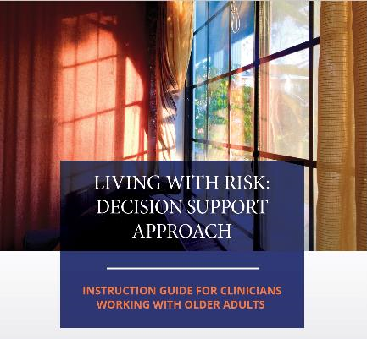
SUPPORTING LIVING
WITH RISK
Notes:
So how can we support living WITH risk?
This is where the The Living with Risk Decision Support Approach comes in!

Slide 27
LwR: DSA – FOUNDATIONAL CONCEPTS
Best Practice
Community
Hospital
Practical Approaches
CGA
Dignity of Risk
Therapeutic Risk
Shared Decision Making
All clients
Client, caregiver and clinician
Person-Centered Care
What matters most
Values, beliefs
Notes:
The Living with risk Decision Support Approach is a 4 step approach based on the best practice from both the community and the hospital settings and based on the following concepts:
Best practice
from Community and Hospital based practicing health care practitioners working with frail older adults (MacLeod & Stadnyk, 2015).
Practical approaches based on
The Comprehensive Geriatric Assessment, which as you learned yesterday, it’s a Holistic review of an individuals physical, cognitive, mental, medical health and environment which focuses on the optimization of health, safety and function
Dignity of Risk is the principle of allowing an individual the dignity afforded by risk-taking that results in the enhancement of personal growth and quality of life (Ibrahim & Davis, 2013) it is based on the belief of the right to self-determination which suggests that we all have the right to succeed and the right to fail
Therapeutic Risk Acknowledges the positive health and wellbeing outcomes that can arise from risk taking (Marsh & Kelly, 2018).
Shared Decision Making is the concept where clinicians and patients work together to make decisions about treatments and care plans based on clinical evidence that balances potential negative consequences and expected outcomes with patient preferences and values (Hoffman et al., 2014).
Lastly, Person-Centred Care highlights Respecting patient preferences, values and expressed needs and involving them in health care decisions

Slide 28


LwR:DSA
Clinical tool
To inform treatment interventions and recommendations
Communication tool
To support shared decision making with patients/clients, families/caregivers and clinicians.
Notes:
The LWR:Decision support approach can be used
Individually or in a team-based environment
As a clinical and or communication tool
As a clinical tool, clinicians have found that it
Summarizes and clarifies the concerns
Assists with the clinical reasoning required for decision making and problem solving
Facilitates a clear action plan
Facilitates the discharge planning process
As a communication tool, clinicians have found that it
Facilitates conversations with patients, caregivers and team members
Organizes and highlights information for communication and documentation

Slide 29
LwR:DSA
Holistic, structured, systematic review of an older adult’s risk status
Identifies potential strategies that
  decrease negative consequences,
  augment positive consequences of the risk,
  address impairments, leverage their strengths and adapt their environments
Acknowledges the older adult’s decisions and choices
Notes:
The LWR decision support approach is a holistic, structured, systematic review of an older adult’s risk status that identifies potential strategies that decrease negative consequences, augment positive consequences of the risk, addresses impairments, leverages strengths and adapts their environments, all while acknowledging the older adult’s decisions and choices.

Slide 30
LwR:DSA
Objective tool to help with discharge and care plan discussions by:
framing information clinicians are already gathering,
ensuring a wide variety of risk categories are addressed,
supporting a balanced problem-solving approach
  by providing a consistent process which includes participation from the older adult and their caregiver,
outlining accountability for whose job it is to address each risk, and
encouraging a collaborative team approach.
Notes:
It’s an objective tool that helps with discharge and care planning discussions by:
framing information clinicians are already gathering,
ensures a wide variety of risk categories are addressed,
supports a balanced problem-solving approach by providing a consistent process which includes participation from the older adult and/or their family/caregiver,
outlines accountability for whose job it is to address each risk, and
encourages a collaborative team approach.

Slide 31
LwR:DSA
When to use the approach?
  Integrate into usual care after assessment has been completed.
  Use when discharge plan and/or care goals differ
    Between clinicians
    Between clinicians, the older adult and caregiver
    Between the older adult and their caregiver
Notes:
The tool can be used to integrate into usual care after an assessment has been completed
And may be best used when discharge plan and/or care goals differ
Either Between clinicians
Between clinicians, the older adult and caregiver
Between the older adult and caregiver
It is not a tool that
replaces clinical judgement,
Nor is it a tool that predicts outcomes with certainty,
Or results in an overall score.

Slide 32
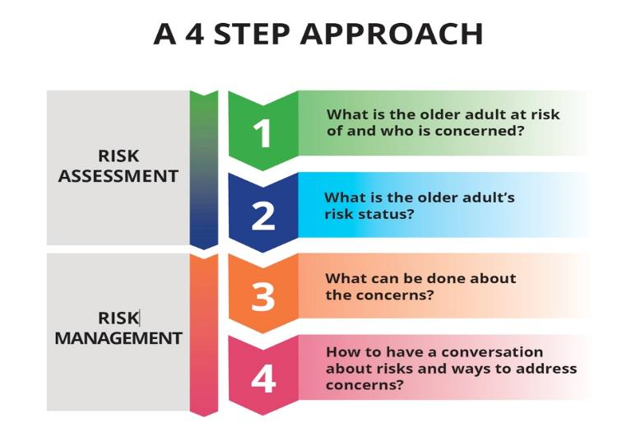
LIVING WITH RISK: DECISION SUPPORT APPROACH
Notes:
The LWR decision support approach involves 4 steps

Slide 33
LIVING WITH RISK: DECISION SUPPORT APPROACH
Notes:
The first step is asking: What is the older adult at risk of and who is concerned?

Slide 34
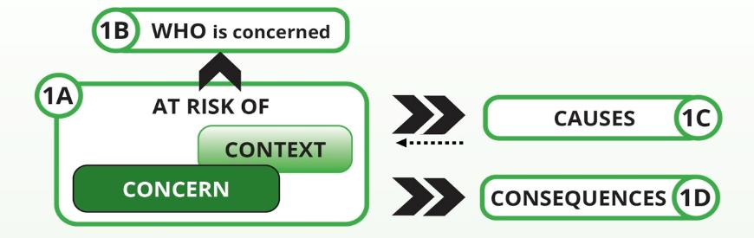
1. WHAT IS THE OLDER ADULT AT RISK OF AND WHO IS CONCERNED?
Notes:
This is a breakdown of the components of the first question that we’ll take a look at.
Let’s start with WHO is concerned?

Slide 35
1. WHAT IS THE OLDER ADULT AT RISK OF AND WHO IS CONCERNED?
Perceiving risk differently:
  Older adult (MacCourt & Tuokko, 2010; Cott & Tierney, 2013)?
  Family member (Clarke, 2000; Cott & Tierney, 2013)?
  Health professionals (Cott & Tierney, 2013; MacLeod & Stadnyk, 2015)?
  Yourself?
Misalignment of goals (Kuluski, et al. 2013):
  Patients, Caregivers, Physicians
Notes:
Is it the patient, the family member, your team or is it you that has the concern? Not surprisingly we all perceive risk differently:
Patient tend to only refer to themselves as being at risk when it pertains to situations outside of themselves – i.e. living in a risking neighbourhood.
Family members: focus on the present and how it effects the client’s interpersonal relationships. Family members tend to be more risk averse than professionals
Health Professionals tend to focus on the physical consequences, the negative consequences and the future consequences. They also tend to overestimate risk.
These factors are due to our scientific training, our knowledge of illness, disease, diagnoses, impairments and their predicted trajectory.
Personally we may have different tolerances for risk
the more experience one has the more comfortable they are with tolerating their patients to take risks,
the closer one is to 65, the more they are able to tolerate their clients taking risk,
And a threat of legal action can influence your decisions,
Not surprisingly the fact that we all perceive risk differently impacts on problem identification and problem solving but also impacts on communication.
Identifying who has the concern helps us know who needs recommendations or interventions. Also knowing who is not concerned helps frame an approach of education and acknowledge in times of denial or an opportunity to focus on the strengths.
Is the family member the one with the problem because they do not feel adequately prepared medically, cognitive, emotionally, physically, financially to support the patient at home?
Are they being overprotective? Do they have reasonable concerns? Do they have secondary gains? – they benefit from client selling the home or they don’t want house sold as they will have no where to live? Do they need the client to drive?
Is it a team member that differs with you on the concerns or problems?
Or are you the one who has the problem?
Are your personal values and beliefs interfering with supporting the client’s choices?
Are you overprotecting the client or do you have a tendency to be desensitized?
As health professionals
do we have limited resources?
Do we have pressures to non-admit clients?
Do we have limited information?
Do we feel unsupported by our organizations should something happen, do we feel a professional moral obligation - do not harm, prevent harm?
We certainly experience the tensions of wanting the best for the patient (do no harm, do good”) but have to support the minimal requirements of living

Slide 36
CHAT
1. WHAT IS THE OLDER ADULT AT RISK OF AND WHO IS CONCERNED?
What risk are you most concerned about?
Put it in the chat box!
Notes:
In the chat box – Can you indicate what risk are you most often concerned about for your patient?

Slide 37
1. WHAT IS THE OLDER ADULT AT RISK OF AND WHO IS CONCERNED?
Clearly state what you, the older adult, caregiver and/or health care team are saying the older adult is at risk of
Understand differences of opinions
Determine onset and progression
Determine in what context these concerns occur
Concerns
Falls, Malnutrition, Medication mismanagement, Fires, Wayfinding, Motor vehicle collision, Suicide, Homicide, Financial mismanagement, Abuse
Contexts
Unsafe driving, using the stove to prepare meals, up at night to use the washroom, taking medication on their own,
Notes:
it is really important that you indicate what the older adult is at risk of.
If there are differences of opinions about the concerns
Understand why this might be?
Is it denial, lack of insight or stoicism on behalf of the patient?
Is it stress, lack of capability or secondary gains for the caregiver?
Is it over protectiveness of desensitization, fear of litigation for the clinician?
Is there a lack of information for the team?
Once you state the concerns
Determine the onset and progression
For instance if this is not new or different, has this been addressed before?
If not, are these choices that the patient is making
If so, are there new factors that can be addressed?

Slide 38
1. WHAT IS THE OLDER ADULT AT RISK OF AND WHO IS CONCERNED?
Determine the cause(s)
Cause(s)
Impairments (cognitive, physical, psychological), Health conditions (medical illnesses),
Concern(s)
Falls, Malnutrition, Medication mismanagement, Fires, Wayfinding, Suicide, Accidents
Consequence(s)
Health related (death, hospitalization, injury/harm, harm to others),
Quality of life related (functional decline, financial decline, eviction, relocation to long-term care, over-protected, resilience, engagement in meaningful activities)
Context(s)
Activity
Elements of the activity (place, time)
Personality factors
Social environment (paid, unpaid support), Economic environment (financial resources)
Physical environment (home, neighbourhood),
Notes:
Once you have identified the concerns and when it started
What are the possible causes?
Is there a change in the patients
Cognitive abilities
Mental health
Physical health
Medical illnesses?
Are there changes to the patients
Physical context?
Social support?
Or Financial resources?
Are any of these causes
Treatable?
Reversible?
Adaptable?
Able to be supported?

Slide 39
1. WHAT IS THE OLDER ADULT AT RISK OF AND WHO IS CONCERNED?
Determine the consequence(s)
Cause(s)
Impairments (cognitive, physical, psychological), Health conditions (medical illnesses),
Concern(s)
Falls, Malnutrition, Medication mismanagement, Fires, Wayfinding, Suicide, Accidents
Consequence(s)
Health related (death, hospitalization, injury/harm, harm to others),
Quality of life related (functional decline, financial decline, eviction, relocation to long-term care, over-protected, resilience, engagement in meaningful activities)
Context(s)
Activity
Elements of the activity (place, time)
Personality factors
Social environment (paid, unpaid support), Economic environment (financial resources)
Physical environment (home, neighbourhood),
Notes:
Then we ask, what are the potential positive and negative consequences for your client?
Are they
health related
Life related?

Slide 40
1. WHAT IS THE OLDER ADULT AT RISK OF AND WHO IS CONCERNED?
Example
Poor balance, poor vision, polypharmacy
Causes
Falls
Concern
Hip Fracture
Consequence
Up at night to use washroom
Context
Notes:
Here are some examples of determining what are the concerns, context, causes and consequences:
Here is a client that we are concerned about falls in the context that they could occur at night when the client is up to use the washroom.
After the assessment we felt that the cause of the falls were related to the older adults poor balance, poor vision and polypharmacy and we were concerned about the potential consequence of a hip fracture as the client had osteoporosis.

Slide 41
1. WHAT IS THE OLDER ADULT AT RISK OF AND WHO IS CONCERNED?
Example
Cognitive impairment, alcohol mis-use
Causes
Not paying bills
Concern
Eviction
Consequence
Lack of social support
Context
Notes:
In this example we were concerned about the older adults ability to manage their finances and pay their bills as they had no one to help them with this.
We felt this was due to cognitive impairment possibly related to alcohol mis-use and could lead to eviction if a system to pay the bills is not put in place.

Slide 42
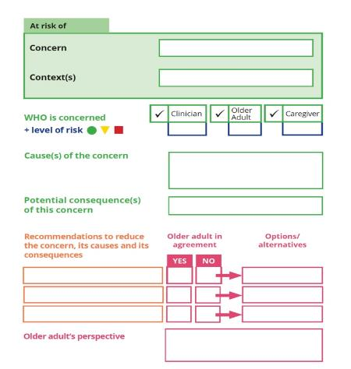
RISK ANALYSIS WORKSHEET
1. WHAT IS THE OLDER ADULT AT RISK OF AND WHO IS CONCERNED?
FALLS
URINATING AT NIGHT
POOR VISION
POLYPHARMACY
POOR BALANCE
HIP FRACTURE
Notes:
Here’s how we can put all this information in the Risk Analysis Worksheet:
So we’re concerned about the client’s falls
Under the context when they’re urinating at night
The cause of the concerns is poor vision, polypharmacy and poor balance.
And then we would write in the potential consequence of this risk is a hip fracture

Slide 43
LIVING WITH RISK: DECISION SUPPORT APPROACH
Notes:
Step 2 has you determine the risk status of the older adult.

Slide 44
2. WHAT IS THE OLDER ADULT’S RISK STATUS?
Is this a low, medium or high-risk situation?
  How do you assess risk status?
Business
  Likelihood x severity of the consequences
Notes:
Once you have an understanding of
what the older adult is at risk of,
who is concerned,
The next step is to determine if it’s a high, medium or low risk situation.
How do you currently assess the older adult's risk status?
Businesses assess risk by considering two factors only:
What is the likelihood of this concern happening
And how severe are the consequences?

Slide 45
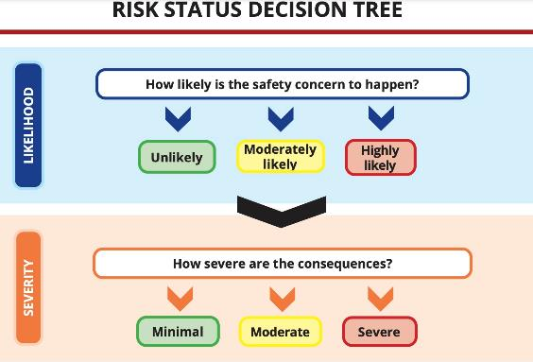
2. WHAT IS THE OLDER ADULT’S RISK STATUS?
Notes:
Assessing the level of risk typically consists of considering two factors;
First determine how likely it is that the safety concern will happen,
Is it unlikely to happen?
Are there risk factors that might increase their chances of this safety concern happening? If so, then rate the likelihood as moderately likely.
Or are there risk factors suggesting that it is highly likely to happen?

Slide 46
2. WHAT IS THE OLDER ADULT’S RISK STATUS?
Notes:
Next ask how severe are the consequences?
Based on the type of safety concern for this particular older adult, would you rate the consequences as minimal, moderate or severe?
Consider factors such as medical history and context to determine severity of negative consequences. Also consider if the consequences are temporary or permanent. Clinicians rated the situation as higher risk when the consequences affecter others.

Slide 47
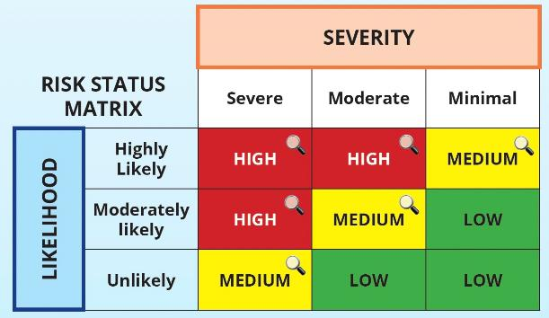
2. WHAT IS THE OLDER ADULT’S RISK STATUS?
Notes:
Determine the older adult’s overall risk status by plotting the likelihood rating and severity rating from the previous decision tree into this matrix to determine if this is a low, medium or high risk situation.

Slide 48
2. WHAT IS THE OLDER ADULT’S RISK STATUS?
ADDITIONAL CONSIDERATIONS IF MEDIUM OR HIGH RISK
How frequently is the safety concern happening?
How imminent are the consequences of the concern?
Does the person have reliable, consistent support in place?
Are there other concerns occurring?
Notes:
There are additional factors especially for medium and high risk situations that might increase or decrease the person’s risk status.
For instance,
How frequently is the safety concern happening, if it isn’t happening frequently, this may reduce the overall level of risk
How imminent are the consequences of the concern? For instance, the consequences for malnutrition take longer to take affect versus the immediate effects of a fire or falls. If there is time to put into place recommendations to prevent the effects of the consequences, this might reduce the overall risk status.
Does the person have reliable, consistent support in place? If they do, this could reduce the level of risk.
Are there other concerns occurring? If there are, this might increase the level of risk.

Slide 49
RISK ANALYSIS WORKSHEET
1. WHAT IS THE OLDER ADULT AT RISK OF AND WHO IS CONCERNED?
FALLS
URINATING AT NIGHT
2. WHAT IS THE OLDER ADULT’S RISK STATUS?
POOR VISION
POLYPHARMACY
POOR BALANCE
HIP FRACTURE
Notes:
Here is where we would put the risk status into the Risk Analysis worksheet for the example of the older adult getting up at night to go to the washroom:
Here we have the clinician indicating moderate concern
We have the older adult indicating, by a green dot, as not concerned
And the caregiver as being moderately concerned

Slide 50
LIVING WITH RISK: DECISION SUPPORT APPROACH
Notes:
Once you have an understanding of
what the older adult is at risk of,
who is concerned,
And what the overall risk status is,
We want to look at what can bed one about the concerns.

Slide 51
3. WHAT CAN BE DONE ABOUT THE CONCERNS?
What does the older adult want?
What can be done about the concerns, causes and consequences?
  Prevent the concerns or minimize the frequency
  Adapt or modify the contexts
  Address impairments, enhance or leverage strengths, adapt environments or activities
  Minimize the negative consequences, augment the positive consequences
  Weighing the emotional and physical consequences
Notes:
First and foremost we need to start with what the older adult wants
What matters most to them and how can we support this.
Then we can look at how we can support our older adult client goals by
Preventing the concerns
Minimizing the frequency of the concerns
Addressing any impairments
Enhancing or leveraging their strengths
Adapting their environments or activities
Minimizing the negative consequences
Augmenting or highlighting the positive consequences
And Weighing the emotional and physical consequences
What can be done about the concerns are also based on
Your clinical role and program mandate
Resource availability related to the patient’s
financial resources
The program’s eligibility criteria and the
Wait times for the resources

Slide 52
MANAGING RISK - CONCERNS
Concerns
Falls:
  Impairments – improve strength, diagnose cognitive impairment and optimize brain health…
  Environment – adaptations to decreased fall hazards, flooring, stairwell….
  Consequences – fracture prevention medication….
  Contexts- reduce liquid intake past 6:30
Fires:
  Impairments – diagnose cognitive impairments and optimize brain health…
  Environment – unplug the stove….
  Consequences – MOW, meal programs…
Notes:
Here are some examples on how to manage risks when addressing concerns.
For falls, we can
Provide recommendations to optimize impairments by improving leg strength, diagnosing a cognitive impairment and optimizing brain health.
We can recommend adaptations to the older adult’s physical environment by decreasing any fall hazards
We can prevent the consequence of a fracture by recommending fracture prevention medication and
We can adapt the context of falls occurring at night when getting up to use the washroom by reducing liquid intake past 6:30 in the evening
I’ve also included examples on how we can address the concern of fires.

Slide 53
For each event – develop your own strategies
MANAGING RISK - CAUSE
3. If older adult needs help with meal preparation:
Meals on Wheels
Wheels to Meals
Private meal prep services (in house or delivery)
For Malnutrition
1. If older adult needs Dietician:
*Day Hospitals
*Family health teams
*Specialty: Community Diabetes Education
*Private: Dietitians of Canada
4. If older adult needs medical recommendations:
Oral supplements
Changes to medications
Lab work up
Optimization of medical conditions
Diet Specific recommendations
Decreased Alcohol intake
Need for dentist or denturist
2. If older adult is having trouble accessing food:
*Grocery bus
*Good food box
*Meal Delivery
*Internet Orders
5. If older adult needs education:
City of Ottawa Nutrition Info Line: 311
http://ottawa.ca/en/residents/public-health/nutrition
www.unlockfood.ca
Notes:
Your team can also develop more specific strategies for each concern based on the cause of the concern.
For instance is the older adult at risk of malnutrition due to
Medical causes?
Difficulty accessing food due to community mobility or financial difficulties?
Difficulties with meal planning and/or preparation?
Lack of education?

Slide 54
MANAGING RISK - CONTEXT
Addressing the underlying psychosocial need
Love: feeling unconditionally accepted
Comfort: feelings of closeness to others
Identity: knowing your story and who you are
Occupation: activities with personal significance
Inclusion: having a distinct place in a group
Attachment: specific emotional bonds with people, pets, places, objects
Environment: sense of safety and security
Person-centered risk assessment framework for older adults living with dementia (Lee, et al., 2019)
Notes:
Managing risks can also be finding an activity that is less risky to address an underlying psycho-social need.
For example, does the activity that’s considered risky provide the psycho-social need for love, comfort, occupation, inclusion, attachment or related to the environment? If so, how can you find another activity that addresses that same psycho-social need?

Slide 55
MANAGING RISK - OUTCOMES
  Prevent the concern
  Eliminate the concern
  Minimize the consequences
  Increase the concern
  Share the risk
  Accept the risk – supporting resilience
  (MacLeod, 2013)
Notes:
When managing risk, you need to be intentional about what are you trying to accomplish with your recommendations or treatment. Is it realistic?
For instance, some recommendations decrease one potential for harm, but increases the risk for another potential for harm.

Slide 56
MANAGING RISK - PROCESS
  By collaborating with older adult, caregiver and others
  By informing the older adult
  By delaying and waiting
  By overriding the older adult’s wishes
                (MacLeod, 2013)
Notes:
The majority of clinicians wanted to manage risk by collaborating with older adults, caregivers and others, and when this wasn’t possible, they at least felt a need to inform the older adult.
For those who are working with the older adult over time, they could delay and wait, but only in times of imminent harm to self or others can we override the older adult’s wishes.

Slide 57
RISK ANALYSIS WORKSHEET
1. WHAT IS THE OLDER ADULT AT RISK OF AND WHO IS CONCERNED?
FALLS
URINATING AT NIGHT
2. WHAT IS THE OLDER ADULT’S RISK STATUS?
POOR VISION
POLYPHARMACY
POOR BALANCE
3. WHAT CAN BE DONE ABOUT THE CONCERNS?
HIP FRACTURE
NIGHT LIGHT
MEDICATION REVIEW
WALKER
Notes:
So if we come back to our older adult who is falling at night when they’re getting up to go to the washroom, here’s where we put our recommendations on the Risk Analysis worksheet.
We could recommend a night light, a review of medication and recommend the use of walker.

Slide 58
LIVING WITH RISK: DECISION SUPPORT APPROACH
Notes:
So the last step, of the 4 step approach, is how to have a conversation about risks and how to address?

Slide 59

RISK ANALYSIS WORKSHEET
1. WHAT IS THE OLDER ADULT AT RISK OF AND WHO IS CONCERNED?
FALLS
URINATING AT NIGHT
2. WHAT IS THE OLDER ADULT’S RISK STATUS?
POOR VISION
POLYPHARMACY
POOR BALANCE
HIP FRACTURE
3. WHAT CAN BE DONE ABOUT THE CONCERNS?
NIGHT LIGHT
3. WHAT CAN BE DONE ABOUT THE CONCERNS?
MEDICATION REVIEW
WALKER
CANE
WALKER DOES NOT FIT IN WASHROOM
Notes:
So if we go back to our example, the older adult agreed with the night light, and the recommendation to have a medication review, but declined using a walker, as the walker does not fit in the bathroom. But the older adult did agree to use a cane as an alternative.

Slide 60
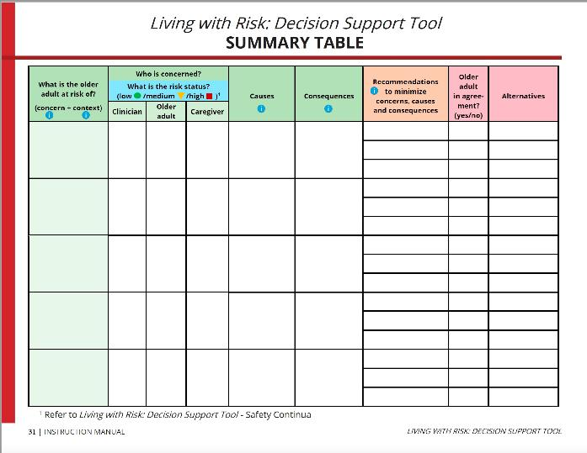
3. WHAT CAN BE DONE ABOUT THE CONCERNS?
How to hve a conversation
Poor vision
Polypharmacy
Poor balance
Night Light
Yes
Falls
Hip Fracture
Med Review
Yes
Walker
No
Cane
Notes:
When we fill out the Risk Analysis Worksheet it automatically fills in this summary table. It can be used to discuss with the older adult and family all the concerns they and the team had. This summary table was able to provide the rationales for the concerns and for their recommendations, which is information that older adults have indicated, in the most recent research project on the tool, stated that they would like.

Slide 61
3. WHAT CAN BE DONE ABOUT THE CONCERNS?
Establish priorities
Focus on what matters most
Support discussions
Understand differences of opinions
Notes:
In order to support intentional and productive conversations with the older adult, their caregiver and/or your team, having a conversation is helpful. First steps are to
Complete the living with risk decision support tool summary table
And Discuss your rationales for
Your concerns
Your risk status determination
And Your recommendations
Show how they support the older adult’s priorities
When there are disagreements or differences of opinions,
support the discussions to understand
Provide reasons and rationales for the divergence
And Where the older adult is capable, accept their right to their decisions.

Slide 62
LIVING WITH RISK: BUILDING RESILIENCE
What are the older adult’s goals?
Have you acknowledged both the physical and emotional consequences?
What can you do to optimize the older adult’s health and environments?
What are you calling risk?
Have you acknowledged both the benefits and consequences?
What can you do to minimize the concerns or negative consequences?
1
2
3
4
5
6
Notes:
To recap the important points of supporting living with risk and building resilience; are as follows:
Make sure you know what are the patient’s goals and how can you support them. Is there a dissonance between what you are suggesting and what the family and patient want? How can you resolve this disagreement? Using the living with risk decision support approach can help ensure comprehensive and intentional discussions about the concerns and prove or disprove the validity to the concerns.
Secondly, What are you calling risk? Is there an opportunity for clearer communication on what is being called risk?
In your analysis have you acknowledged both the benefits of taking the risk and the consequences?
And in your analysis have you acknowledged both the physical consequences and the emotional consequences of taking risks?
Have you also acknowledged ways to optimize the patients health and environments and leverage their strengths?
What can be recommended to minimize the concerns and in instances where we can what are the opportunities to minimize the negative consequences?
We are working with patients who are readjusting and redefining their new normal - how does one know what their new boundaries or limitations are? Until you over-shoot them?
Lastly remember that
that risks have the potential for both negative and positive consequences
That people may make decisions rationally or emotionally
That health practitioners do not all define risk the same

Slide 63
LIVING WITH RISK: BUILDING RESILIENCE
https://lwrdsa-vivreaveclesrisques.recherche.usherbrooke.ca

Slide 64
Notes:
Thank you and looking forward to your questions before we read the case study together.

Slide 65
RESOURCES
Braudy Harrris, P. (2008). Another wrinkle in the debate about successful aging: The undervalued concept of resilience and the lived experience of dementia. International Journal of aging and human development, 67(1), 43-61.
Beauchamp, T.L. & Childress, J.F. (2009). Principles of Biomedical Ethics (6th ed). New York: Oxford University Press, Inc.
Canadian Mortgage and Housing Corporation. (2008). Impacts of the aging of the Canadian population on housing and communities. Ottawa, ON:CMHC.
Clarke, C. (2000). Risk: Constructing care and care environments in dementia. Health, Risk & Society, 2(1), 83-93.
Cooney Jr., L, Kennedy, G., Hawkins, K., Balch Hurme, S. (2004). Who can stay at home? Assessing the capacity to choose to live in the community. Archives of Internal Medicine, 164, 357-360.
Cott, C., & Tierney, M.C. (2013). Acceptable and unacceptable risk: balancing everyday risk by family members of older cognitively impaired adults who live alone. Health Risk & Society, 15(5), 402-415.
Felton, A., Wright, N., & Stacey, G. (2017). Therapeutic risk-taking: A justifiable choice. British Journal Psychological Advances, 23(2), 81–88.
Gunstone, S. (2003). Risk assessment and management of patients whom self-neglect: A ‘grey area’ for mental health workers. Journal of Psychiatric and Mental Health Nursing, 10, 28-296.
Heyman, B., Griffiths, C., & Taylor, J. (2002). Health risk escalators and the rehabilitation of offenders with learning disabilities. Social Science and Medicine, 54, 1429-1440.

Slide 66
RESOURCES
Hoffmann, T.C., Légaré, F., Simmons, M.B., McNamara, K., McCaffery, K., Trevena, L.J., Hudson, B., Glasziou, P.P., & Del Mar, C.B. (2014). Shared decision making: what do clinicians need to know and why should they bother? Medical Journal of Australia, 201(1), 35-39.
Horton, K. & Arber, S. (2004). Gender and the negotiation between older people and their carers in the prevention of falls. Ageing & Society, 24, 75-94.
Ibrahim, J.E., & Davis, M.C. (2013). Policy and practices updates: Impediments to applying the ‘dignity of risk’ principle in residential aged care services. Australasian Journal on Ageing, 32(3), 188–193.
Kuluski, K., Gill, A., Naganathan, G., Upshur, R., Jaakimainen, RL., & Wodchis, WP. (2013). A qualitative descriptive study on the alignment of care goals between older persons with multi-morbidities, their family physicians and informal caregivers. BMC Family Practice, 14:133
Lee, L., Hillier, L., Lu, S., Martin, S., Pritchard, S., Janzen, J., & Slonim, K. (2019). Person-centered risk assessment framework: assessing and managing risk in older adults living with dementia. Neurodegenerative Disease Management, 9(1), 47–57. https://doi.org/10.2217/nmt-2018-0031
MacCourt, P., & Tuokko, H. (2010). Marginal competence, risk assessment, and care decisions: A comparison of values of health care professionals and older adults. Canadian Journal on Aging, 29 (2), 173-183.
MacLeod, H. (2013) Understanding risk: Health professionals’ decision making with frail community-dwelling older adults. Halifax, Nova Scotia: Dalhousie University.
MacLeod, H., & Stadnyk, R.L. (2015). Risk: ‘I know it when I see it’: how health and social practitioners defined and evaluated living at risk among community-dwelling older adults. Health, Risk & Society, 17(1), 46-63.
MacLeod, S., Musich, S., Hawkins, K., Alsgaard, K., & Wicker, ER. (2016). The impact of resilience among older adults. Geriatric Nursing, 37 (4), 266-272.

Slide 67
RESOURCES
Marsh, P., & Kelly, L. (2018). Dignity of risk in the community: a review of and reflections on the literature. Health, Risk & Society, 20(5-6), 297-311.
McDermott, S. (2010). Professional judgments of risk and capacity in situations of self-neglect among older people. Ageing & Society, 30, 1055-1072.
Ottawa Public Health (2010). The burden of injury in Ottawa, 2010. Ottawa: Ottawa Public Health.
Oxford Dictionary retrieved from https://en.oxforddictionaries.com/definition/risk on October 12th, 2016
Popejoy, L. L. (2011). Complexity of family caregiving and discharge planning. J Fam Nurs, 17(1), 61- 81. doi:10.1177/1074840710394855
Purdy, G. (2010). ISO 31000:2009 Setting a new standard for risk management. Risk Analysis, 30(6), 881-892. Doi:10.1111/j.1539-6924.2010.01442.x
Resnick, B. (2014). Resilience in Older Adults. Topics in Geriatric Rehabilitation, 30(3),155-163.
Skeleton, F., Kunik, M., Regev, T. & Naik, A. (2010). Determining if an older adult can make and execute decisions to life safely at home: A capacity assessment and intervention model. Archives of Gerontology and Geriatrics, 50, 300-305.
Titterton, M. (2005). Risk and risk taking in health and social welfare. London: Jessica Kingsley Publishers.
United Kingdom Department of Health. (2007). Independence, choice and risk: a guide to best practice in supported decision making. van Loon, J. (2002). Risk and technological culture: Towards a sociology of virulence. Oxon: Routledge.
Yardley, L. ,Donovan-Hall, M., Francis, K., and Todd, C. (2006). Older people’s views of advice about falls prevention: a qualitative study. Health Education Research, 21(4), 508-517.

