Slide 1


INTRODUCING
Dr. Lisa
Walker
Dr. Walker has worked as a Clinical Neuropsychologist at the Ottawa Hospital for 25 years. She provides consultation services in an acute care in-patient setting where she conducts cognitive assessments for diagnostic, treatment planning and functional purposes, as well as capacity assessments under the Health Care Consent Act. Dr. Walker is a Clinician Investigator with the Ottawa Hospital Research Institute where she has a research program evaluating cognitive health in multiple sclerosis. She has held leadership roles with the University of Ottawa Brain and Mind Research Institute. She is an Associate Professor of Medicine and an Adjunct Professor of Psychology at the University of Ottawa, as well as an Adjunct Research Professor with both Psychology and Cognitive Science at Carleton University. She also has a private practice where she provides neuropsychological evaluations.
NEUROPSYCHOLOGIST
THE OTTAWA HOSPITAL

Slide 2
CAPACITY
Dr. Lisa Walker
Neuropsychologist
The Ottawa Hospital
Notes:
Louise
Welcome everyone.
Vickie and I are excited to talk to you about cognitive impairment and Behavioural and Psychological Symptoms of Dementia .
It has been a wonderful experience working together and learning from each other.
We come from very different workplaces:
I work in the community with a wide range of clients; some having very early changes in cognition, some who have a known dementia.
Vickie works in LTC facilities with clients who typically have a known dementia and are experiencing behavioural and psychological symptoms of dementia.
We both assess changes in cognition and develop interventions. Just at different ends of the spectrum.

Slide 3

LEARNING OBJECTIVES
Review laws and provincial guidelines governing decision-making capacity
      Health-related decisions
      Assigning Power of Attorney (property, personal care)
Review informal screening of older adults for treatment and placement decisions
© Regional Geriatric Program of Eastern Ontario

Slide 4
DEFINING CAPACITY
Notes:
Louise

Slide 5


CAPACITY
A legal construct (changes in legislation in the 1990’s)
Refers to a person’s ability to engage in reasoned decision-making
  The ability to Understand the information that is relevant to making a decision
  The ability to Appreciate the reasonably foreseeable consequences of a decision
      Ability to manipulate information rationally, weigh options
      Ability to apply facts to one’s personal situation
      Realistically appraise outcome (insight)
      Justify choice
      Be consistent, come to same conclusion each time
If a pt is found incapable, the SDM makes the decision (NOT the treating team)
Notes:
Let’s start with the basics:
Cognition is a function of the brain (our central command center).
In general, it is our ability to interact with the world around us.
It includes many important functions such as:
Learning and memory: For example: our ability to remember conversations and events or learn new information or how to do new things
Language: Not just our ability to speak but also to read, write, and understand
Visual and spatial function: for example: navigating in our environment
Executive function: making decisions, problem solving and organizing our lives.
Social function: how we interact appropriately with our family, friends and colleagues.
These are just some of the many cognitive domains that are important for our day-to-day lives.

Slide 6
ETHICAL CONSIDERATIONS
Notes:
Louise

Slide 7
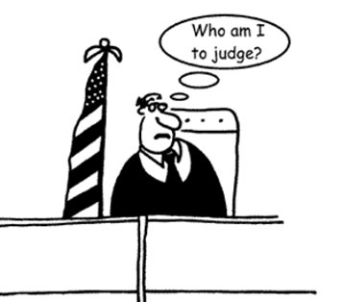
ETHICAL CONSIDERATIONS
PERSONAL BIAS
We must be aware of our own biases
A poor decision (in our opinion) does not necessarily imply incapacity

Slide 8

ETHICAL CONSIDERATIONS
AUTONOMY vs PROTECTION
Need to balance
  Our desire to support an impaired person's autonomy
  Our desire to protect an impaired person (and ourselves) from risks/dangers caused by their diminished capacity
This tension informs most competency assessments, and most legal/ethical issues regarding vulnerable persons

Slide 9

THE CONCEPT OF RISK
Capacity legislation is meant to provide protection for vulnerable persons who due to disability, illness, or infirmity, cannot act on their wishes
“Protecting”… although we want to protect vulnerable persons, all people have the right to assume risks inherent in their decisions if risks are understood
“Their wishes”…We need to understand the individual’s value system, beliefs, eccentricities
A reasoned decision is not always a reasonable decision
NOT the presence of risk that matters but the appreciation of risk
Notes:
Let’s start with the basics:
Cognition is a function of the brain (our central command center).
In general, it is our ability to interact with the world around us.
It includes many important functions such as:
Learning and memory: For example: our ability to remember conversations and events or learn new information or how to do new things
Language: Not just our ability to speak but also to read, write, and understand
Visual and spatial function: for example: navigating in our environment
Executive function: making decisions, problem solving and organizing our lives.
Social function: how we interact appropriately with our family, friends and colleagues.
These are just some of the many cognitive domains that are important for our day-to-day lives.

Slide 10
QUESTIONING CAPACITY
Notes:
Louise

Slide 11

REFERRAL QUESTION
Please assess patient’s capacity

Slide 12

APPROPRIATE RESPONSE
Capacity for what?

Slide 13

GLOBAL VS SPECIFIC
Capacity is not a global concept
Must establish the particular type of decision-making capacity that is being questioned
Types:
    Treatment consent capacity
    Discharge planning capacity
    Financial capacity
    Capacity to assign POA
    Research consent capacity
    Testamentary capacity

Slide 14

LEGISLATION
Mental Health Act
Substitute Decisions Act
Health Care Consent Act *
Patient Restraints Minimization Act

Slide 15
MENTAL HEALTH ACT
Notes:
Louise

Slide 16
MENTAL HEALTH ACT
Form 1
  Not an assessment of decision-making capacity
  Allows a pt to be admitted involuntarily (for up to 72 hours) for psychiatric assessment
Form 3
  Not an assessment of decision-making capacity
  Certificate of involuntary admission (for up to 2 weeks)
  Must be signed by a different physician than the one who signed Form 1
  Patient must be notified with a Form 30
When MHA refers to capacity it references HCCA

Slide 17
SUBSTITUTE DECISIONS ACT
Notes:
Louise

Slide 18
SUBSTITUTE DECISIONS ACT
(Property)
Can only be assessed by designated capacity assessors
  Under the Ministry of the Attorney General's office
Capacity for property management
  Can ask Capacity Assessment Office for a list of designated capacity assessors
    https://www.attorneygeneral.jus.gov.on.ca/english/family/pgt/capacity.php
    Fees paid by pt's family or referring unit if an in-pt
    Pt can refuse (family could then go through court system)
    If pt has only government assets, consider trusteeship (individual or institution)

Slide 19
WHEN TO QUESTION CAPACITY FOR PROPERTY
Confusion
Isolation
Blindness
Illiteracy
The person cannot buy food, personal care items, pay bills
Sharing their home without compensation for fair share of expenses
Large sums taken from accounts
Person is in debt and does not know why
Notes:
Let’s start with the basics:
Cognition is a function of the brain (our central command center).
In general, it is our ability to interact with the world around us.
It includes many important functions such as:
Learning and memory: For example: our ability to remember conversations and events or learn new information or how to do new things
Language: Not just our ability to speak but also to read, write, and understand
Visual and spatial function: for example: navigating in our environment
Executive function: making decisions, problem solving and organizing our lives.
Social function: how we interact appropriately with our family, friends and colleagues.
These are just some of the many cognitive domains that are important for our day-to-day lives.

Slide 20
WHEN TO QUESTION CAPACITY FOR PROPERTY
Presence of “new” lawyer or no legal representation
POA has been unexpectedly changed
Person asked to sign legal papers without understanding what they mean
Person cannot remember signing papers or making payments, transfers
Signatures on cheques or papers look suspicious
Bank statements no longer sent to the person
Notes:
Let’s start with the basics:
Cognition is a function of the brain (our central command center).
In general, it is our ability to interact with the world around us.
It includes many important functions such as:
Learning and memory: For example: our ability to remember conversations and events or learn new information or how to do new things
Language: Not just our ability to speak but also to read, write, and understand
Visual and spatial function: for example: navigating in our environment
Executive function: making decisions, problem solving and organizing our lives.
Social function: how we interact appropriately with our family, friends and colleagues.
These are just some of the many cognitive domains that are important for our day-to-day lives.

Slide 21
CAPACITY FOR PROPERTY
If an incapable person does not have a continuing POA, the Substitute Decisions Act of Ontario (SDA) states that the Ontario Public Guardian and Trustee (PGT), by default, then becomes the entity who will manage an incapable person's financial affairs while that person remains incapable and alive.
Notes:
Louise

Slide 22
CAPACITY FOR PROPERTY
The SDA, however, does give a person the right to apply to the Ontario Superior Court to be appointed as guardian of an incapable person's property/financial affairs in place of the PGT. The application process is relatively costly and requires a capacity assessment of the alleged incapable person; notice of the application to be served on the incapable person as well as that person's family and the PGT; and a management plan of the incapable person's assets to be approved by the Court.
Notes:
Louise

Slide 23
SUBSTITUTE DECISIONS ACT
(Power of Attorney)
No formal training required
Need good working knowledge of legal definition
Different thresholds for assigning POA for personal care and property (finances)
Personal Care
  Do they have the capacity to understand whether the proposed attorney has a genuine concern for their welfare?
  Do they appreciate that they may need to have the attorney make decisions for them?
    I discuss the types of potential decisions

Slide 24
POINTS TO CONSIDER
POA is not a blanket privilege
    For each personal care decision, the person’s capacity to make the decision MUST be revisited
Knowing there is a POA does NOT mean you automatically turn to the attorney for health care decisions (even if POA previously used)
If a person currently has a POA but is found to be incapable of making a new one, the current power of attorney remains in effect.

Slide 25
SUBSTITUTE DECISIONS ACT
(Power of Attorney)
Property
  Does the person know what kind of property they have and its approximate value?
    Is the person aware of obligations to his dependents?
    Do they know that the attorney will be able to do on their behalf anything they could do with their property except make a will (subject to any restrictions in the POA)?
    Do they know that the attorney must account for the dealings with the property?
    Do they know that, if capable, they can revoke the POA?
    Do they understand that unless the attorney manages the property prudently its value may decrease?
    Do they realize that the attorney could misuse the authority given?

Slide 26
WHO CAN YOU CONTACT WITH CONCERNS?
Ottawa Police - 613-236-1222 x 5822
Crime stoppers - 1-800-222-TIPS (8477)
Ministry of the Attorney General’s Victims Support Line - 1-888-579-2888
Senior Safety Line - 1-866-299-1011
Ontario Network for the Prevention of Elder Abuse - 1-416-916-6728
Advocacy Centre for the Elderly - 1-416-598-2656
Public Guardian and Trustee Special Investigation Unit (POA concerns) - 1-844-640-3615
Notes:
Let’s start with the basics:
Cognition is a function of the brain (our central command center).
In general, it is our ability to interact with the world around us.
It includes many important functions such as:
Learning and memory: For example: our ability to remember conversations and events or learn new information or how to do new things
Language: Not just our ability to speak but also to read, write, and understand
Visual and spatial function: for example: navigating in our environment
Executive function: making decisions, problem solving and organizing our lives.
Social function: how we interact appropriately with our family, friends and colleagues.
These are just some of the many cognitive domains that are important for our day-to-day lives.

Slide 27
HEALTH CARE CONSENT ACT
Notes:
Louise

Slide 28
HEALTH CARE CONSENT ACT
Primary use at TOH is for treatment decisions and decisions surrounding discharge planning
Covers care facilities only (i.e. rehab, LTC)
  Not retirement homes or group homes
No formal training required for evaluators

Slide 29

EVALUATORS
Not called assessors (reserved for SDA)
Evaluators are members of regulated health professions:
    Physicians
    Nurses
    Speech-language pathologists
    Occupational therapists
    Physiotherapists
    Social workers
    Audiologists
    Optometrists
    Psychologists (all Neuropsychologists at TOH have experience)
    Physician’s Assistants cannot be evaluators given that they are not part of a regulatory college (capacity evaluation must be done by the supervising MD)

Slide 30
PRESUMPTION OF CAPACITY
All individuals are assumed to be capable unless there are reasonable grounds to believe that the person is incapable
Thus, the individual is capable, unless shown on a balance of probabilities or preponderance of evidence that the individual does not understand the facts necessary to make a decision about those matters and is unable to appreciate the reasonably foreseeable consequences of a decision or lack of decision
If capacity is considered “borderline”, law states we must err on side of self-determination and find pt capable

Slide 31
FUNCTIONAL ABILITIES RELEVANT TO CAPACITY
Communicate a choice
Understand relevant information
Appreciate the relevance of the information for one's own circumstances
Manipulate information rationally

Slide 32

COMMUNICATE A CHOICE
The ability to communicate a choice is a “threshold” issue; if pts are unable to express a choice, usually there is no need to consider their status regarding other abilities
May be impacted by disease or dysfunction (e.g. aphasia, severe dementia, etc.)
May also be that pt vacillates from moment to moment or is unable to make a decision

Slide 33

UNDERSTAND
The ability to comprehend what one is being told about the disorder, its treatment, and its benefits and risks
To have and retain an adequate factual knowledge base and to be able to take in and retain information about various options
Must retain only long enough to make a decision
If person forgets, they must come to same conclusion each time issue is discussed

Slide 34

APPRECIATE
In addition to understanding what they are being told by the medical team, they must also appreciate the significance of that information for their own situation
A realistic appraisal of various possible outcomes (need sufficient insight) and an ability to justify one’s choice through reasoning in a logically consistent way to arrive at a decision
Reasoning must be based on a personal belief system which cannot be refuted by objective evidence

Slide 35

RATIONAL MANIPULATION OF INFORMATION
Ability to reason with and process the information provided by the medical team
The ability to weigh options (each with its own benefits and risks)
Being able to work with the information given to reach a decision

Slide 36
INCAPACITY IS NOT…
Willingness to take risks
Making decisions that may be different from most others
Eccentricity
Making decisions based on an unusual value system
Synonymous with a diagnosis or condition (dementia, schizophrenia, low IQ, TBI)

Slide 37

THREATS TO CAPACITY
Impaired mental status (delirium)
Psychiatric illness
Developmental disability
Cognitive impairment
  20% misclassified as incapable if use MMSE cut-off of 23 alone
Poor memory
  Memory functions should be sufficient to recall information at time of decision making

Slide 38
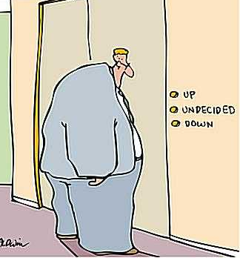
THREATS TO CAPACITY
Poor insight/denial
  Failure to recognize seriousness of illness
  Minimizing effects of illness on functional status
Delusional thinking
  Making decision based on inaccurate beliefs (e.g. paranoia)
Anxiety and stress can cripple or complicate decision making

Slide 39


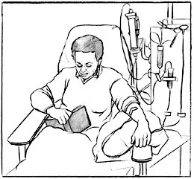
ONCE INCAPABLE, ALWAYS INCAPABLE?
Capacity can fluctuate over time (e.g. delirium, intoxication)
Capacity varies with the decision to be made (e.g. aspirin vs. terminating dialysis)

Slide 40
CAN WE HOLD AN INCAPABLE PERSON AGAINST THEIR WILL?
HCCA states that, where an SDM consents to treatment on behalf of an incapable person, the SDM may also consent to the incapable person’s admission in hospital for purpose of receiving the treatment
We previously thought that the HCCA had no custodial powers and thus in cases when a patient was actively trying to leave the hospital, we would invoke the MHA and hold someone under a MHA Form
This is an inappropriate use of the MHA
  the MHA is appropriate to use when someone requires admission (and confinement) in hospital as a result of a mental illness

Slide 41
CAN WE HOLD AN INCAPABLE PERSON AGAINST THEIR WILL?
Although dementia can be considered a mental illness under the DSM-5, these patients are not typically being treated for the dementia per se, but rather are typically admitted because their care needs exceed that which can be provided in the community, or they (or others) are at risk if they return home
In cases where the patient must remain in hospital for their safety or ongoing care (i.e., they would be at risk in an independent living environment), then we can restrain or confine them according to the Patient Restraints Minimization Act if this is part of the treatment plan that the SDM has consented to (under the Health Care Consent Act)

Slide 42
CAN WE HOLD AN INCAPABLE PERSON AGAINST THEIR WILL?
The PRMA also states that a hospital or facility may restrain or confine a patient or use a monitoring device on him or her if it is necessary to prevent serious bodily harm to him or her or to another person
There are also provisions under common law
  There is a common law duty of a caregiver to restrain or confine a person when immediate action is necessary to prevent serious bodily harm to the person or to others
  If the pt is deemed to be at risk of “imminent serious bodily harm”
  This statement is up to interpretation
  Best to seek advice from CMPA or College or Professional Liability Insurance provider if unsure

Slide 43
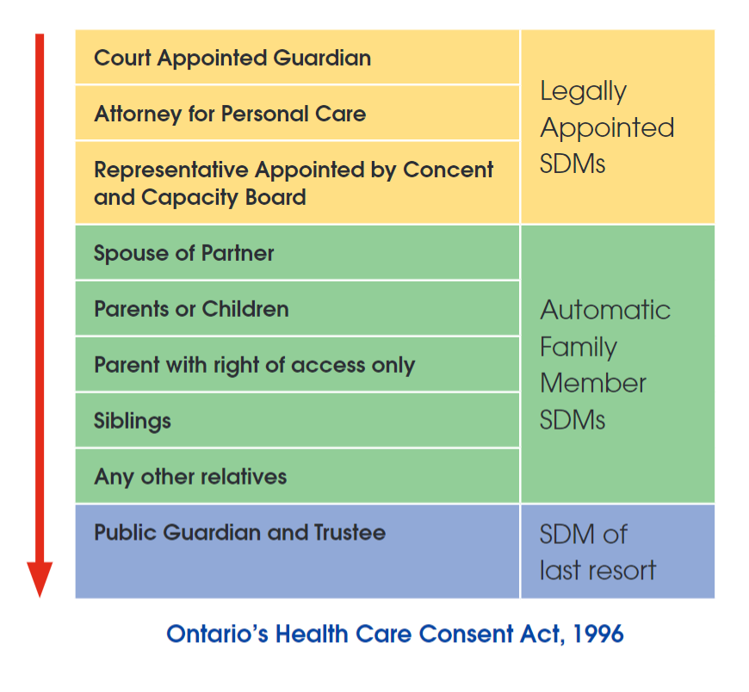
SUBSTITUTE DECISION MAKER HIERARCHY
Notes:
- SDM must be at least 16yo unless the SDM is the parent of the incapable person
- Two persons are not spouses for the purpose of this section if they are living separate and apart as a result of a breakdown of their relationship. 2004, c. 3, Sched. A, s. 84 (4).
- if SDMs, with equal authority to make the decision who meet all the requirements, disagree on whether to give or to refuse consent, then the PGT shall make the decision for them

Slide 44
THE ELDERLY: SPECIAL CONSIDERATIONS
  Consider cognitive changes, slowed mentation, sensory limitations, fatigue
  Consider divergent cultural, religious beliefs, generational factors
  Privacy, a concern (establish rapport; do not equate vagueness and refusal to answer with incapacity)
  Time needed to mull it over
  Superficial social skills can create false sense of decision-making integrity
Notes:
Let’s start with the basics:
Cognition is a function of the brain (our central command center).
In general, it is our ability to interact with the world around us.
It includes many important functions such as:
Learning and memory: For example: our ability to remember conversations and events or learn new information or how to do new things
Language: Not just our ability to speak but also to read, write, and understand
Visual and spatial function: for example: navigating in our environment
Executive function: making decisions, problem solving and organizing our lives.
Social function: how we interact appropriately with our family, friends and colleagues.
These are just some of the many cognitive domains that are important for our day-to-day lives.

Slide 45
WHEN SHOULD WE BE CONCERNED ABOUT CAPACITY?
  Unmet needs (house in shambles, unpaid bills,…)
  Manifest failure, repeated admissions, ED visits
  Imposition of risk to others
  Person makes no/inconsistent decisions
  Evidence of threats to ability to “understand” & “appreciate”
    Cognitive impairment or dementia
    Impaired reality testing
    Impaired insight
    Severe mood or personality disturbance/distorted appraisal of outcomes
Notes:
Let’s start with the basics:
Cognition is a function of the brain (our central command center).
In general, it is our ability to interact with the world around us.
It includes many important functions such as:
Learning and memory: For example: our ability to remember conversations and events or learn new information or how to do new things
Language: Not just our ability to speak but also to read, write, and understand
Visual and spatial function: for example: navigating in our environment
Executive function: making decisions, problem solving and organizing our lives.
Social function: how we interact appropriately with our family, friends and colleagues.
These are just some of the many cognitive domains that are important for our day-to-day lives.

Slide 46
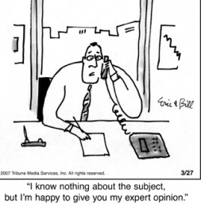
ASSESSING CAPACITY TO CONSENT TO TREATMENT
Capacity to consent to treatment is understanding the information relevant to making the decision and appreciating the reasonably foreseeable consequences of a decision or lack of decision
Must be assessed by the health care professional proposing the treatment
  Often an opinion is asked of others with expertise
  in capacity (e.g. Neuropsychology)

Slide 47
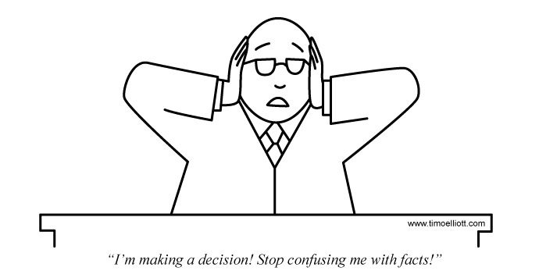
4 ELEMENTS REQUIRED FOR CONSENT
The consent must relate to the treatment
The consent must be informed
The consent must be given voluntarily
The consent must not be obtained through misrepresentation or fraud

Slide 48

ASSESSING CAPACITY TO CONSENT TO TREATMENT
Treatment must not be given unless consent has been obtained
Consent must be informed
Person must receive the following info:
  nature of treatment
  Expected benefits and risks
  Potential side effects
  Alternative treatment options
  Potential consequences of not receiving treatment
  Must be given opportunity to ask questions
Do not proceed with capacity interview until patient has been given this information

Slide 49
ASSESSING CAPACITY TO CONSENT TO TREATMENT
If evaluator is not part of the treating medical team, he/she must learn about patient’s condition and treatment options
  i.e. evaluator must understand and appreciate in order to assess same in the patient
  Info must be sought from medical team if not clear in chart
  Need info on condition, treatment options, prognosis with proposed treatment, prognosis without proposed treatment, etc.
  Patient does not need to know technical info but must have a basic layperson’s understanding

Slide 50

ASSESSING CAPACITY TO CONSENT TO TREATMENT
Suggested questions:
  Do you have a medical problem that needs treatment?
  What will the treatment likely do for you?
  Why do you think it will have that effect?
  What do you think will happen if you do not receive the treatment (e.g. worst case scenario)?
  Why has this treatment been recommended?
  How did you reach the decision to accept [reject] the recommended treatment?
  What factors were important to you in reaching that decision?
  How did you balance those factors?

Slide 51
ASSESSING CAPACITY TO CONSENT TO TREATMENT
Additional information that may be required:
May need to see patient multiple times to determine if their condition fluctuates and to determine if their decision making fluctuates
Neuropsych testing for examination of reasoning and/or cognitive abilities
Collateral information to learn of any changes in patients’ level of functioning not apparent in examination

Slide 52
CODE STATUS AND HCCA
Code status is a special situation
    HCCA applies
          if need for resuscitation is reasonably likely given patient’s current health condition
    HCCA does not apply
          for routine canvassing; this is advance directive and not eligible for substitute decisions
Notes:
Let’s start with the basics:
Cognition is a function of the brain (our central command center).
In general, it is our ability to interact with the world around us.
It includes many important functions such as:
Learning and memory: For example: our ability to remember conversations and events or learn new information or how to do new things
Language: Not just our ability to speak but also to read, write, and understand
Visual and spatial function: for example: navigating in our environment
Executive function: making decisions, problem solving and organizing our lives.
Social function: how we interact appropriately with our family, friends and colleagues.
These are just some of the many cognitive domains that are important for our day-to-day lives.

Slide 53

ASSESSING CAPACITY FOR DISCHARGE DECISIONS
TOH Home First policy - we are typically no longer addressing this issue as it relates to discharge to a nursing home (with some exceptions)
MOH mandate - we are no longer supposed to discharge pts directly to a NH from hospital (SW explores all other d/c options)
Discharge planning capacity addressed only when pts capacity to consent to discharge to another care facility (e.g. rehab, chronic care) is being questioned
In cases of LTC admission – final determination of capacity rests with Ontario Health atHome (formerly HCCSS, formerly LHIN, formerly Home Care)

Slide 54
ASSESSING CAPACITY FOR DISCHARGE DECISIONS
Person must receive the following info:
  Proposed discharge plan
  Potential benefits of discharge plan and any associated risks
  Alternative discharge options
  Potential benefits and risks if recommended option is not chosen
  Must be given opportunity to ask questions
  TIME! (do not tell someone they cannot go home and then expect them to agree with you without adequate time to digest the info)
Do not proceed with capacity interview until patient has this information and has had time to come to a reasoned conclusion

Slide 55
ASSESSING CAPACITY FOR DISCHARGE DECISIONS
Suggested Questions
  How might your medical/thinking problems interfere with your ability to function?
  How likely is it that you might fall/forget medications/get lost/etc?
  Where would you like to go when you leave the hospital?
  Why have you chosen this option?
  Where does the medical team feel would be the best place for you after you leave the hospital? Why?
  What benefits/risks might there be to either option?
  What is the worst possible scenario to your safety if you were to return home?
  Are you willing to accept these risks?

Slide 56

RIGHTS ADVICE
The HCCA does not mandate that rights advice be given
However, section 1 describes one of the purposes of the HCCA as “the enhancement of the autonomy of persons” to whom treatments are proposed by “allowing those who have been found incapable to apply to a tribunal for a review of the finding” and “to promote communication and understanding between health practitioners and their patients or clients”
This section is used to interpret the rest of the act
If a HCP does not advise a person of the finding of incapacity and does not make them aware of the rights of review, how can these purposes be fulfilled?

Slide 57
RIGHTS ADVICE
A HCP may be negligent and subject to professional misconduct for failing to advise the person that they have been found incapable in respect to treatment if that person then suffers harm from that failure to inform
The harm is the loss of decision-making authority and being subjected to treatments they may have refused
It may be considered battery to treat a patient without consent if it is subsequently determined by the CCB/court that the pt was capable and would have refused the treatment

Slide 58
RIGHTS ADVICE
The person giving rights advice should be the person responsible for the assessment of capacity (i.e. the person proposing the treatment)
It is typically the physician who is proposing the treatment so the physician must give rights advice
There is no specific rights advice form (like in the MHA)
The pt must simply be provided with the name and contact information for the Consent and Capacity Board

Slide 59
QUESTIONS?

Slide 60
lwalker@toh.ca
https://www.ottawahospital.on.ca/

Slide 61
RESOURCES
Public Guardian & Trustee’s Office www.attorneygeneral.jus.gov.on.ca/english/family/pgt/
https://store.lexisnexis.com/en-ca/products/a-guide-to-consent-capacity-law-in-ontario-2025-edition.html
https://www.ontario.ca/page/mental-capacity
https://www.familyeducationgroup.com/capacity-assessment/
https://www.lco-cdo.org/en/our-current-projects/legal-capacity-decision-making-and-guardianship/#:~:text=Ontario's%20laws%20for%20legal%20capacity,decisions%20must%20nonetheless%20be%20made.
https://www.ontario.ca/laws/statute/92s30
https://www.ontario.ca/laws/statute/96h02
https://www.cmpa-acpm.ca/en/advice-publications/handbooks/consent-a-guide-for-canadian-physicians
https://www.oha.com/news/a-practical-guide-to-mental-health-and-the-law-in-ontario
https://jcb.utoronto.ca/wp-content/uploads/2021/03/ace.pdf

